Slide 2
Questions from Annie Moos
Choose one to answer….
If you could be any animal, what animal and why?
If a genie grants you one wish, what do you wish for you and why?
If you could pick up one new skill instantly, what would it be and why?

Slide 3
Online/hybrid learning tools
Core Technology Skill: EDU 241

Slide 4
Synchronous & asynchronous opening discussion
How do you define synchronous & asynchronous?

Slide 5
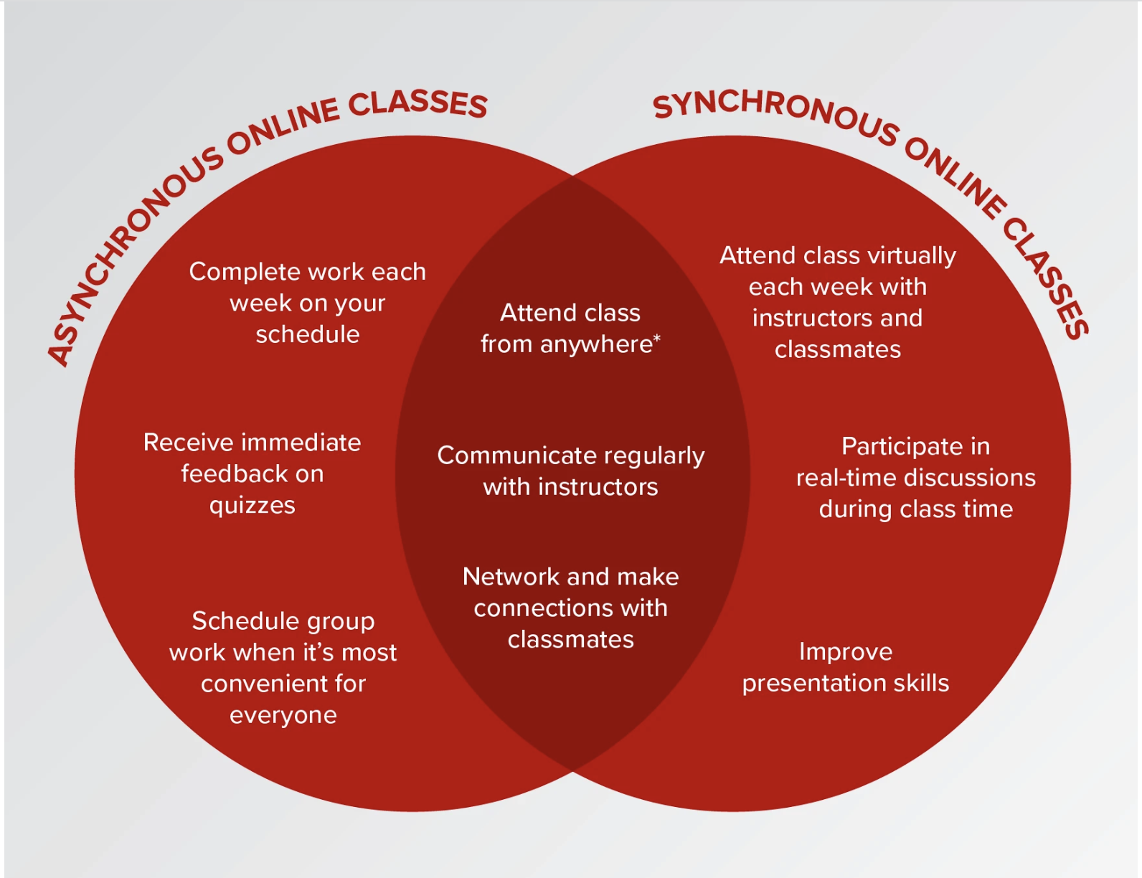
Synchronous & asynchronous opening discussion

Slide 6
Synchronous & asynchronous opening discussion
Based on your experiences, what are the benefits and challenges of synchronous learning?
Based on your experiences, what are the benefits and challenges of asynchronous learning?

Slide 7

THE RECENT CHALLENGE
The recent pandemic (COVID) has forced significant changes to teaching and learning
Education looks different
Teachers engage in the teaching and learning process differently

Slide 8



Categories to consider: online & hybrid
(1) Online Meet Spaces
(2) Virtual Classes
(4) Cool Tools
(3) Remote Lesson Delivery

Slide 9
(1) Online meet Spaces
Zoom
Skype
Fuze
WebEx
GroupMe
Gather
Slack
Google Meet
LogMein

Slide 10

(2) Virtual classrooms
Bitmoji Classrooms: Allows teachers to create a fun virtual representation of their classroom for students to use online; can be shared with platform already used in remote learning (e.g Google Slides)

Slide 11
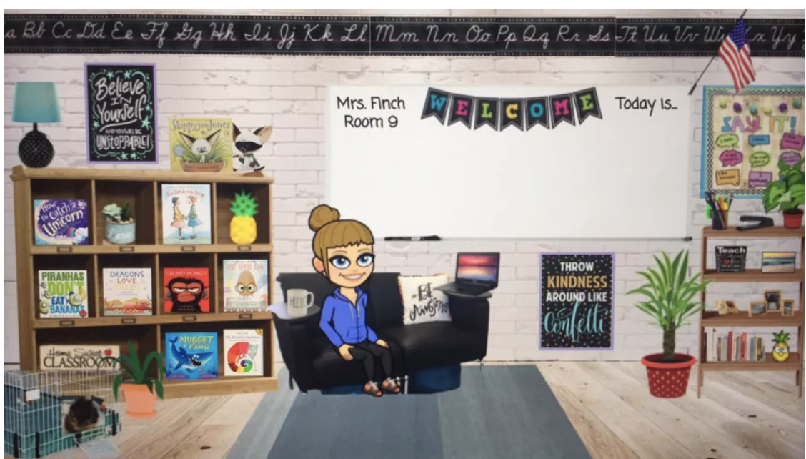
(2) Virtual classrooms
Here is an example from a Gustavus graduate

Slide 12
(2) Virtual classrooms
How do I set up a Bitmoji classroom?
Here’s an in-depth article
Here’s a short overview:
Open a blank google slide (Bitmoji Chrome extension) or ppt
Collect images
Create your “scene”
Add interactive links (optional)

Slide 13
(3) Remote lesson delivery
What tools can be used to deliver lessons remotely?
Learning Management System tools (e.g. Seesaw, Schoology, etc)
Discussion boards (e.g. Padlet)
Screen casting tools (Nearpod),
PearDeck (can be used asynchronously)
Hyperdocs (check out this video)

Slide 14
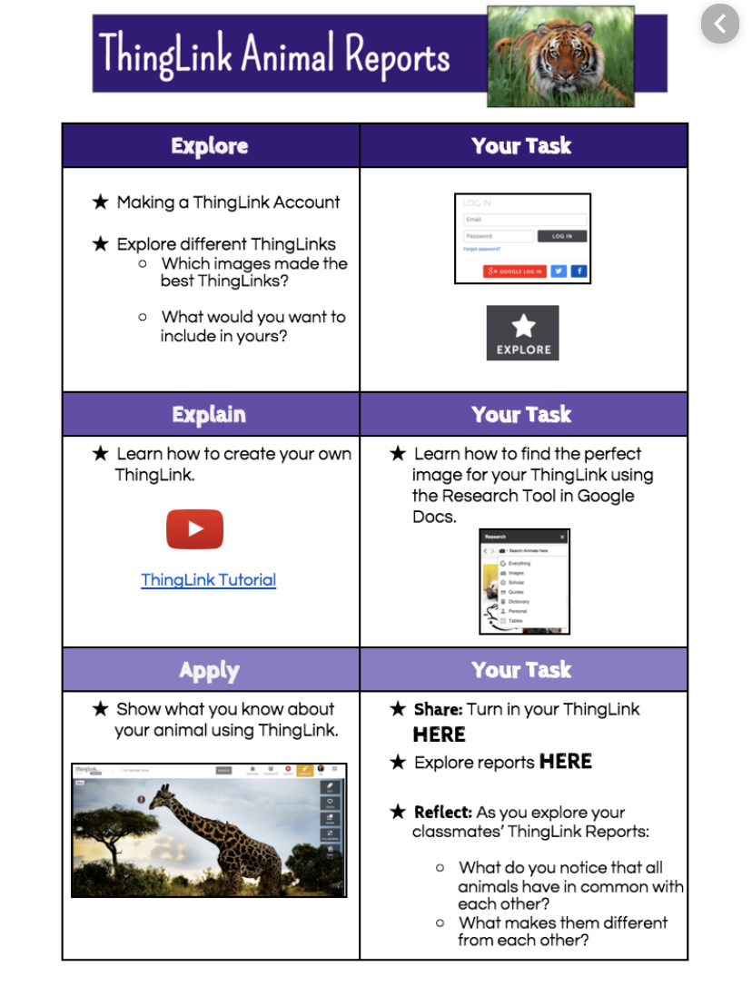
Hyperdoc example

Slide 15
(3) Remote lesson delivery
Hyperdocs templates:
Teachers Give Teachers
Templates by content area
Hyperdoc Google Slides

Slide 16
(4) Cool Tools
Jamboard
Podcasting
Perusall
Video (Adobe Spark, Flipgrid)
See the document linked on the course website (today’s class) for additional resources…

Slide 17
What do I do now?
Pick one tool/platform (Online Meet Space, Virtual Classes, Remote Lesson Delivery, OR Cool Tools)
Add to your website (the usual): use the tool to describe, 2 pros & 2 cons, how can you use the tool/platform in your future classroom?

