Slide 1
Tell Me Something Good!
Share something good or positive that’s happening in your life

Slide 3
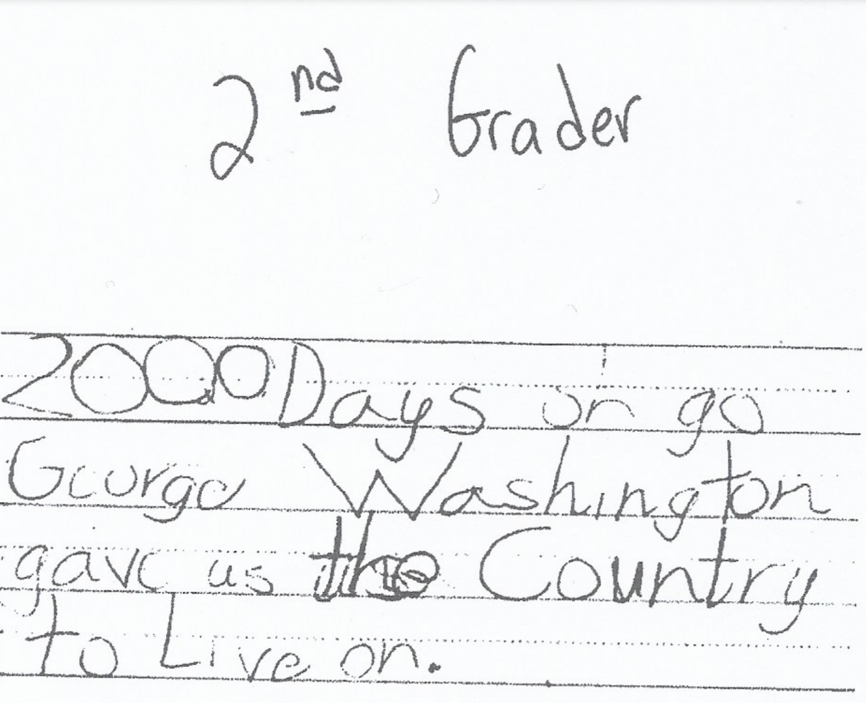
What evidence do you see of egocentricity?
What evidence do you see that the student potentially has difficulty thinking abstractly?

Slide 4

3rd Grade
What evidence do you see of the student beginning to think logically?
What evidence do you see that the student beginning to think empathetically?

Slide 5
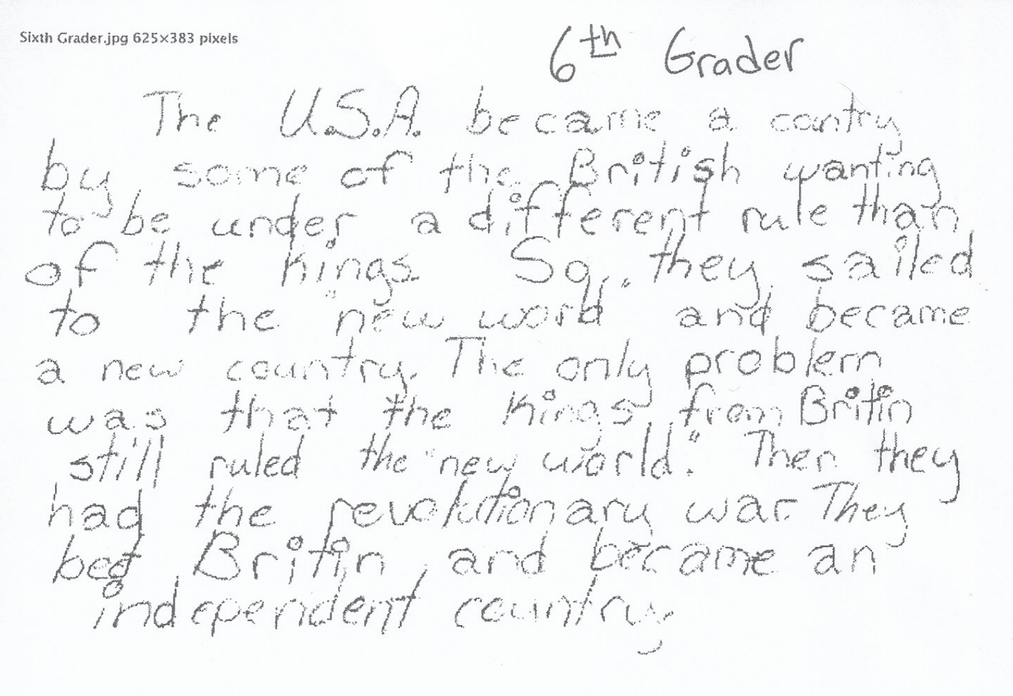
What differences do you observe between this response and the previous response?

Slide 6
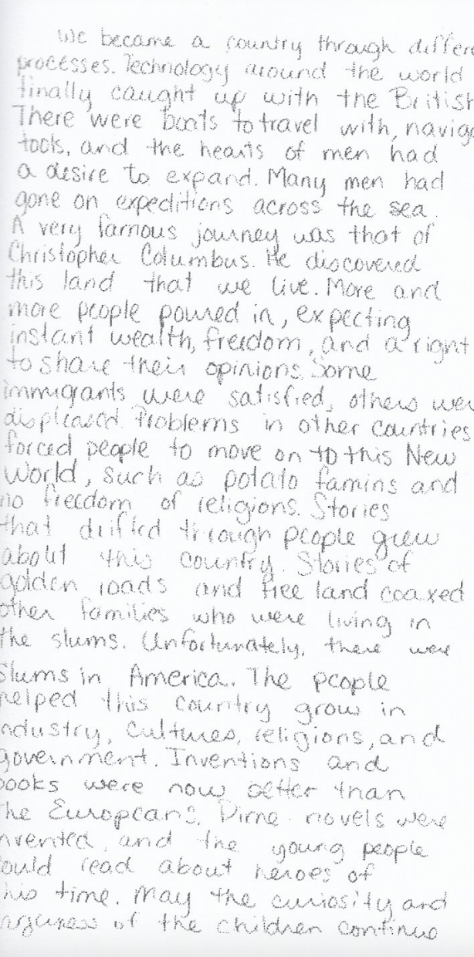
8th Grade

Slide 7
Vygotsky:
Learning Through Social Interaction
Zone of Proximal Development, Scaffolding,
Language

Slide 8
How do you learn best?
Think of a time you learned something challenging — a sport, a skill, or a concept.
Who helped you?
How did they help?

Slide 9
How do you learn best?
This idea — that we learn best through guided support — is central to Vygotsky’s theory.
Teachers and peers act as “more knowledgeable others”
Language is a cognitive tool
Learning is social before it’s individual & Learning benefits from scaffolding

Slide 10
Teachers and peers act as “more knowledgeable others”
Zone of Proximal Development
“ . . . is the distance between the actual developmental level as determined by independent problem solving and the level of potential development as determined through problem solving under adult guidance or in collaboration with more capable peers” (Vygotsky)

Slide 11
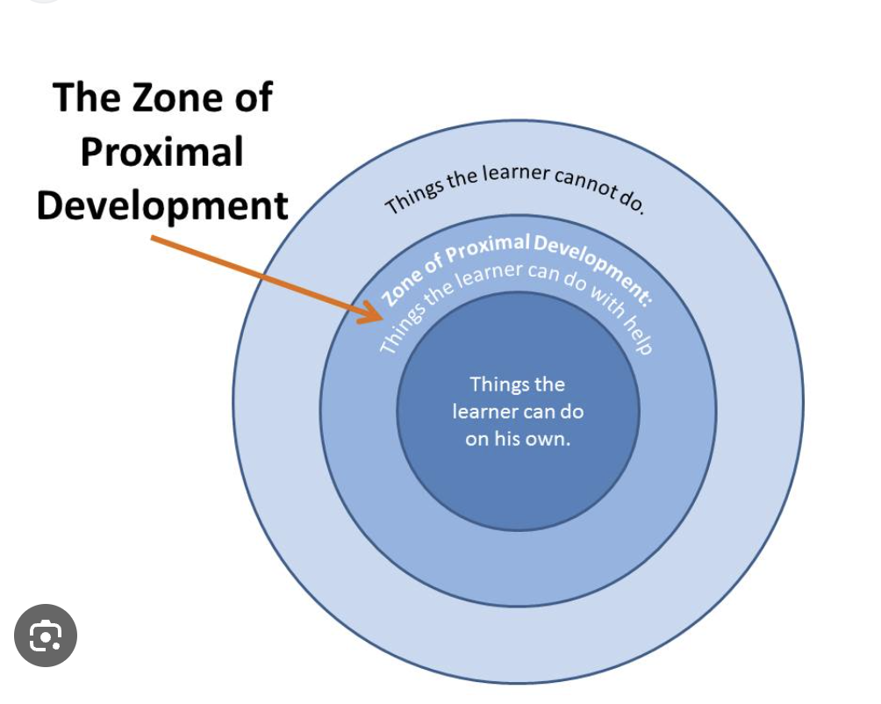
Zone of Proximal Development

Slide 12
Language is a cognitive tool
Language is the bridge between social learning and independent thinking.
Ask students to verbalize their thinking
  “Why do you think that?” “Can you explain your thinking?” “How do you know that”?
  Model think-alouds as a teacher
  Paired teaching: “experts” teach “novices”
  Ask students to regularly verbalize their thinking process in math, science, art, and music
    Teachers tend to rely on visual/auditory product
Remind students that struggling to put understanding into words is a normal part of learning.
  We have all said at some point in our lives: “I know what I’m trying to say, I just can’t put it into words.”
Provide students with language support for technical terms & academic language specific to content area
  Word walls
  Vocabulary cheat sheets

Slide 13
Learning benefits from scaffolding
The temporary supports teachers provide to help learners work within their ZPD.
Scaffolding is not about doing the work for students, but about helping them reach the next step.
Examples Include:
Modeling and think-alouds
Guided practice
Feedback and questioning
Visual aids or sentence stems

Slide 14
Learning benefits from scaffolding
I Do, You Watch
(model metacognitive thinking aloud)
3x – 4 = 8
2x – 2 = 6
I Do, You Help
3x + 2 = 14
(or stations, group work)
I Help, You Do
Independent Work
I Watch, You Do
Gradual release of support so students can accomplish goal independently
 | Direct Instruction | Modeling | Guided Practice | Independent Practice
Teacher | I Do | I Do | I Help | I Watch
Student | You Watch | You Help | You do | You Do

Slide 15
Learning benefits from scaffolding
Example of a teacher using scaffolding in the classroom
Consider the following questions while observing the video:
How does the teacher define scaffolding?
How does the teacher use scaffolding to enhance learning within the classroom?
 | Direct Instruction | Modeling | Guided Practice | Independent Practice
Teacher | I Do | I Do | I Help | I Watch
Student | You Watch | You Help | You do | You Do

