Slide 1

Emotional Check-In

Slide 2
Cognitive Development: Piaget’s
Theory
EDU 330: Educational Psychology
Daniel Moos, PhD

Slide 3
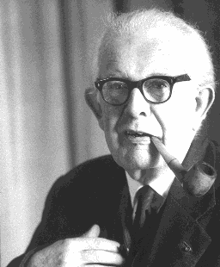
Who is Piaget?
(1896 - 1980)
Incredibly intellectually curious at a young age
Published a short scientific paper on the sighting of an albino sparrow…
…at the age of 10!
Earned his doctorate in natural sciences at 21
Developed a theory to explain developmental differences in children’s thinking and behavior

Slide 4
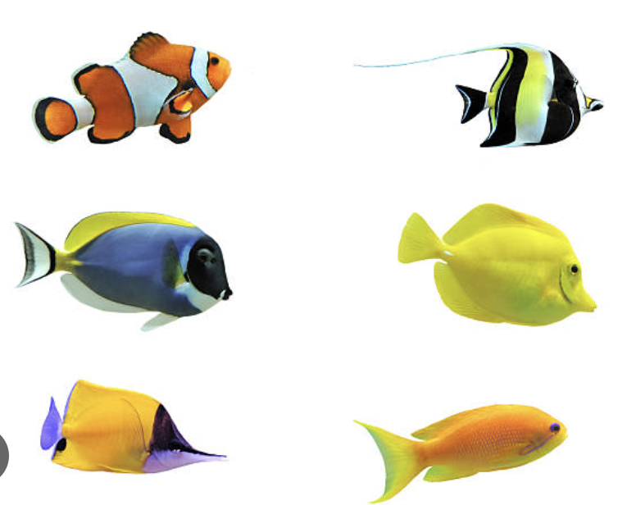
Assumptions of Piaget’s Theory
“Schemas”
Cognitive framework that helps interpret information
My daughter grew up with a saltwater fish tank in our basement
What schema did my daughter have of fish?

Slide 5
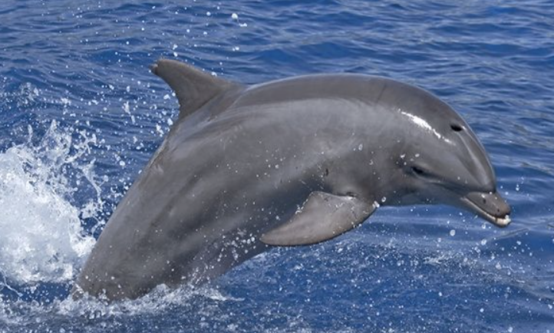
Assumptions of Piaget’s Theory
“Disequilibrium”
A state of cognitive imbalance that is experienced when encountering information that requires us to develop new schema or modify existing schema
I took my daughter to a zoo and she saw a dolphin for the first time.
Why did this experience cause disequilibrium?
Why do you think Piaget assumed disequilibrium leads to learning?

Slide 6
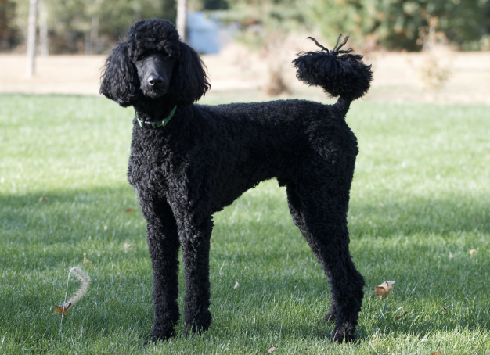
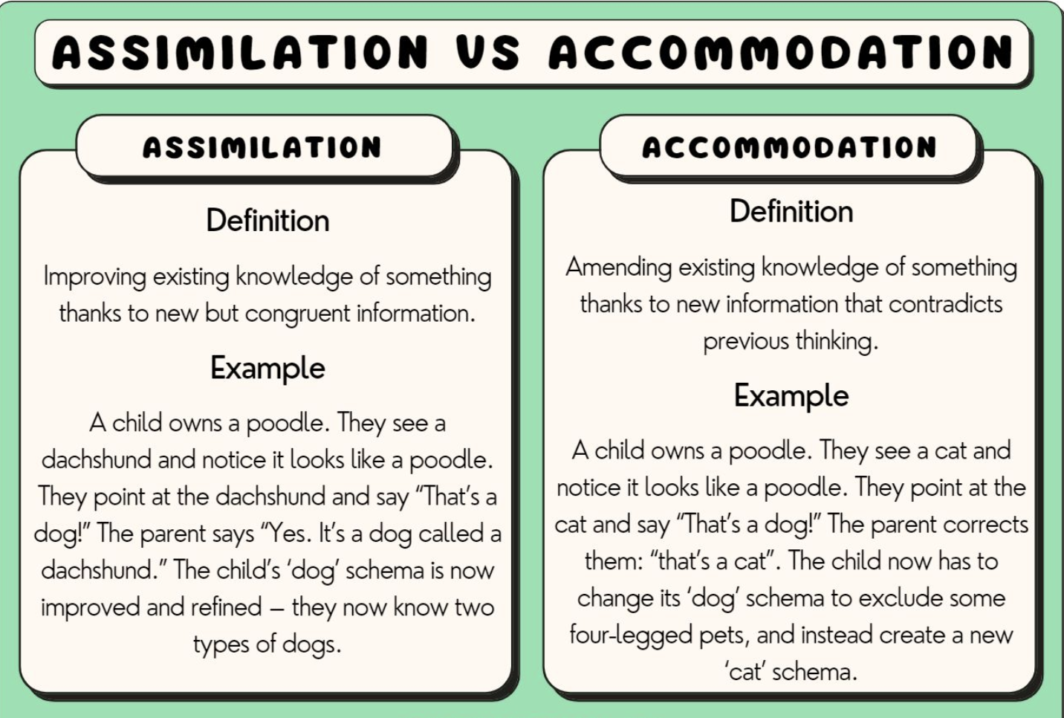

Assumptions of Piaget’s Theory
Poodle – what is the child’s schema of a dog?
How does a seeing a dachshund for the first time create disequilibrium?

Slide 7

Assumptions of Piaget’s Theory
Poodle
Climbs a tree when the child tries to pet it!
How does a seeing a cat for the first time create a different type of disequilibrium than seeing a dachshund for the first time?

Slide 8
Assumptions of Piaget’s Theory
Assimilation & Accommodation
in an Elementary Classroom
Math Problems | What is the student’s division schema ? | How does this relate to assimilation & accommodation?
4 ➗ 2
9 ➗ 3
Single digit divisions result in a smaller number
X
(Developing initial schema of division)
Any digit division results in a smaller number
(integrate new information into existing schema)
How do these problems present “new” but “congruent” information?
Assimilation
50 ➗ 25
1000 ➗ 200
Digit division can result in larger OR smaller number
(Develops new schema/significantly modifies current schema to accommodate)
How do these problems present new information that contradicts the current schema?
Accommodation
10 ➗ 0.5 = 20
20 ➗ 0.2 = 100

Slide 9
Assumptions of Piaget’s Theory: Stage Theory
Sensorimotor (birth – 2)
Child explores world through senses and physical motor movements
Child coordinates motor movements into increasingly long chains of behavior
Begin to understand cause & effect
Emergence of object permanence towards end of this period (early on, infants believe something exists only if they can see it)

Slide 10
Assumptions of Piaget’s Theory: Stage Theory
Preoperational (2 - 7)
Begin to interact symbolically, play “pretend”/make believe
Vocabulary substantially increases
Grammatical and sentence construction moves to sentences
Several cognitive limitations persist, including:
  Egocentricity (tend to view their viewpoint & perspective)
  Challenge in understanding conservation of matter (something doesn’t change because it looks different)

Slide 11
Assumptions of Piaget’s Theory: Stage Theory
Concrete Operational (7 - 11)
Conservation of matter understood
Decentering: Being to realize feelings and thoughts are not unique, become more empathetic (“Theory of mind”).
More likely to understand logical rules and express thinking in logical sequencing; numerical ability improves
Many students continue to be challenged thinking abstractly and hypothetically

Slide 12
Assumptions of Piaget’s Theory: Stage Theory
Formal Operational (11 onward)
Increased capacity to think abstractly & hypothetically (use symbols related to abstract concepts, such as algebra)
      2x + 5 = 9
      2x + 5 = 11
Increased capacity to hypothetically
    If you could invite four people from any of the historical periods we have studied, who would you invite and why? (Social Studies)
    If you could go back in time and ask Darwin any science question, what would it be and why? (Science)
Typically more capable of “thinking like a scientist”
  Generate hypotheses and systematically test them using experiments

Slide 13
Implications: Piaget’s Theory
“Children should be able to do their own experimenting and their own research. Teachers, of course, can guide them by providing appropriate materials, but the essential thing is that in order for a child to understand something,… [the child] he must re-invent it. Every time we teach a child something, we keep [the student] from inventing it [themselves]. On the other hand, that which we allow [the student] to discover by [themselves] will remain with [the student] visibly”. Piaget (1972, p. 27)

Slide 14
Implications: Piaget’s Theory
Learning should be student-centered and accomplished through active discovery.
The teacher’s role is to facilitate learning rather than direct instruction.
Piaget’s theory is based upon biological maturation and stages; the notion of “readiness” is important.
Consequently, education should be stage-specific, with curricula developed to match the age and stage of thinking of the child.
  For example, abstract concepts like algebra or atomic structure are not suitable for primary school children.
Assimilation and accommodation require an active learner, not a passive learning

Slide 15
Implications: Piaget’s Theory
In your opinion, what is a strategy/approach to teaching that promotes a student-centered classroom in which the teacher facilitates students’ engagement in active learning?

Slide 16
Piaget: Criticisms
  Underestimates Children’s Capabilities
  Overestimates Adolescents’ Capabilities
  Vague Explanations for Cognitive Growth
  Cultural Differences
Notes:
8

