Slide 1
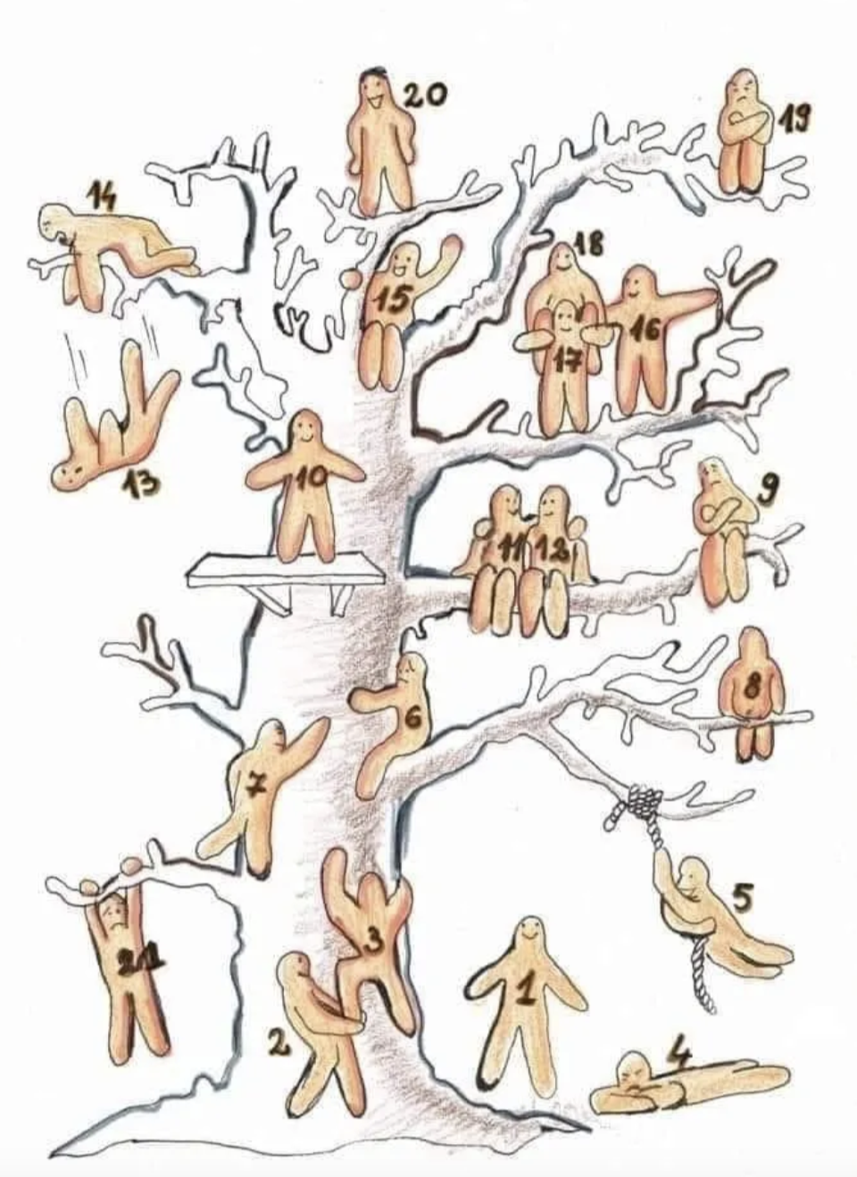
We are almost two weeks into the semester…
What Blob represents how you are feeling?

Slide 2
Student Response Apps: using technology to assess student learning

Slide 3
Opening Questions
(1) Why do you think teachers should assess learning?
(2) Based on your experiences, what are effective and/or ineffective assessments?

Slide 4
How Should Teachers Assess Student Learning?
“Unit Level”
Beginning of Learning Unit
End
of Learning Unit
Pre-assessment
Finding out
Formative
Keeping Track & Checking up
Summative
Making Sure
Notes:
3

Slide 5
How Should Teachers Assess Student Learning?
“Unit Level” (continued)
What is a pre-assessment and what are some examples?
Assessment that evaluates students’ strengths, opportunities for growth, prior knowledge/skills, and/or interests prior to learning unit;
used to inform planning and demonstrate growth
Quick!
No need to intimidate your students before the learning unit!
Do students need 20 questions to demonstrate they know how to add decimals?
Focused
Unit probably too large; every single lesson too much work for you!
…but Comprehensive
Cover spectrum of understanding
Sensitive/Empathetic
Explain rationale behind pre-assessment and expectations
Notes:
3

Slide 6
How Should We Assess Student Learning?
“Unit Level” (continued)
First & Final Thoughts
Prior to learning unit, ask students to share initial thoughts and personal interests; revisit at end of learning unit
Wonder Board
After introducing topics for learning unit, students post questions on display board; update throughout learning unit
Scale of Certainty
Students brainstorm what they know already and post ideas on display of certainty (“very uncertain” to “very certain”); discuss and update throughout learning unit
Concept Map
Students create “map” of ideas in learning unit; update as progress
KWL charts (“Know” “Want to know” ”Learned”)
Notes:
3

Slide 7
How Should We Assess Student Learning?
“Lesson Plan/Single Class Level” (continued)
What is a formative assessment and what are examples?
Assessment that evaluates students’ strengths, opportunities for growth, prior knowledge/skills, and/or interests during learning unit;
used to inform planning and demonstrate growth
Based on specific learning targets
Provides evidence of student learning
Informs instruction
Involves students
Provides specific & actionable feedback
Notes:
3

Slide 8
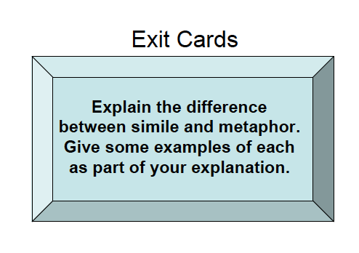
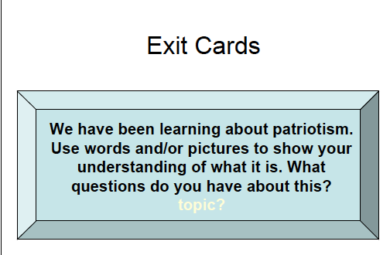

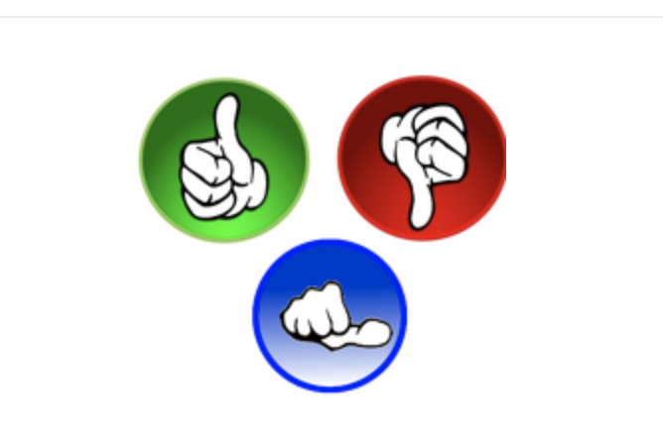
How Should We Assess Student Learning?
“Lesson Plan/Single Class Level” (continued)
“Signals”
Notes:
3

Slide 9
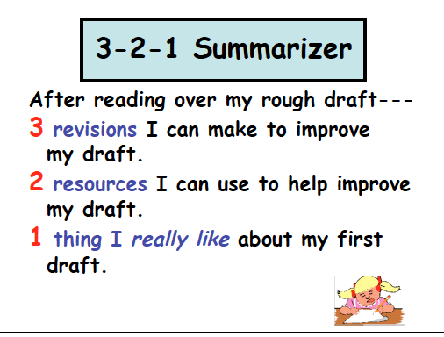
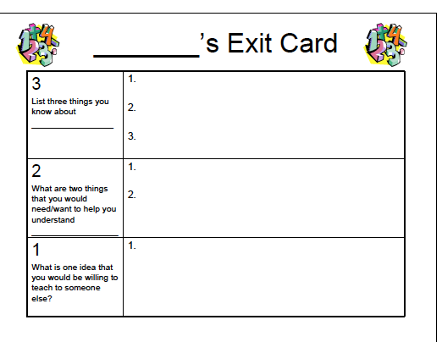
How Should We Assess Student Learning?
“Lesson Plan/Single Class Level” (continued)
Notes:
3

Slide 10
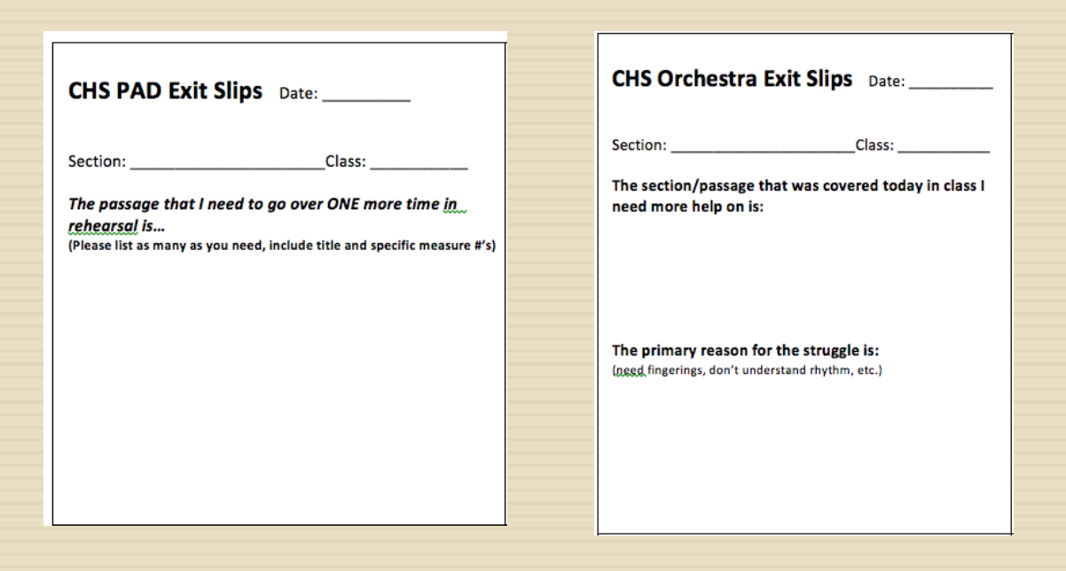
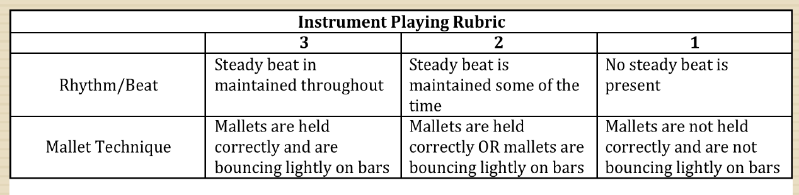
How Should We Assess Student Learning?
“Lesson Plan/Single Class Level” (continued)
Notes:
3

Slide 11
Just a few options for you to explore (there are many more!)
Plickers: Efficient formative assessment
Flipgrid; Video discussion platform
Kahoot: Engaging Assessment
Poll Everywhere: Efficient feedback and assessment
Socrative: On the fly assessment; note there are both teacher and student versions of this app, both are needed for it to work)
Mentimeter: Creative and interactive presentation; the word cloud option takes students’ responses and makes them visually and aesthetically interesting)
7. Google Forms (I use frequently because of ease-of-use; though any app is user friendly if you commit to learning it. Also consider other add-ons like Slides Poll)
8. Quizlet (recent student teachers using this app in their student teaching)
9. Nearpod (does more than allow you to create presentations!)
10. Pear Deck
11. Padlet: Digital canvas; multiple students can post to the came board at the same time
Notes:
🍐 This is a Pear Deck Text Slide
🍐 To edit the type of question, go back to the "Ask Students a Question" in the Pear Deck sidebar.

Slide 12
Next Steps:
Explore Student Response Apps: Challenge yourself!
Choose a student response app
Add an example to your website (follow the rubric!)

