Slide 1
Welcome to EDU 330: Developmental & Educational Psychology
What does research say about:
How do students think & learn?
What motivates students?
How should we assess student learning?

Slide 2
True or False?
1. Most children 5 years of age and older are natural learners; they know the best way to learn something without having to be taught how to learn it.
FALSE—Many students of all ages are quite naïve about the best ways to learn. They don’t know how to use effective elaboration strategies to make ideas their own.

Slide 3
True or False?
2. When we compare boys and girls, we find that both groups are, on average, very similar in their mathematical and verbal abilities.
TRUE—Despite commonly held beliefs to the contrary, boys and girls tend to be similar in their abilities to perform on both mathematical and verbal tasks.

Slide 4
True or False?
3. The best way to learn and remember a new fact is to repeat it over and over again.
FALSE—Repetition may be better than doing nothing, but students remember things longer when they connect them with things they already know and when they elaborate on them.

Slide 5
True or False?
4. Although students initially have many misconceptions about the world, they quickly revise their thinking once their teacher presents information that contradicts what they believe.
FALSE—Children typically have many misconceptions and hold on to them even in the face of contradictory instruction or evidence.

Slide 6
True or False?
5. Students often misjudge how much they know about a topic.
TRUE—Students are usually not the best judges of what they do and do not know. Even though students may spend a lot of time reading, they may know far less than they think they do because they they often read ineffectively.

Slide 7
True or False?
6. Taking notes during a lecture usually interferes with learning more than it helps.
FALSE—In general, students who take notes learn more material from a lecture than students who don’t. But…taking notes, without reflecting on the notes, is not very effective

Slide 8
True or False?
7. When a teacher rewards one student for appropriate behavior, the behavior of other students may also improve.
TRUE—When students observe other students being rewarded for certain behaviors, they are likely to behave in a similar way.

Slide 9
True or False?
8. Anxiety sometimes helps students learn and perform more successfully in the classroom.
TRUE— Cognitive ”disequilibrium” is a necessary component to learning.

Slide 10
True or False?
9. When we have children tutor their classmates in academic subject matter, we help only the students being tutored; the students doing the tutoring gain very little from the interaction.
FALSE—Research has shown those doing the tutoring often benefit as much as those being tutored.

Slide 11
True or False?
10. The ways in which teachers assess students’ learning influence what and how the students actually learn.
TRUE—What and how students learn depend, in part, on how they expect to their learning to be assessed.

Slide 12
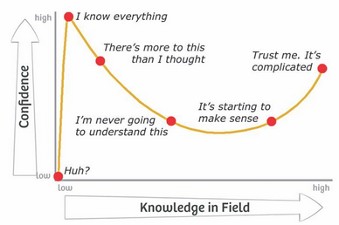
The Profession of Teaching: Paradox of Experience and Knowledge
Dunning-Kruger effect: The challenge of evaluating one’s own competence, which can lead to a overestimation of one’s own abilities

Slide 13
Reflection
To what extent did your responses align with the research findings?
Which finding(s) do find most surprising, interesting, and/or informative? Why?

