Slide 1
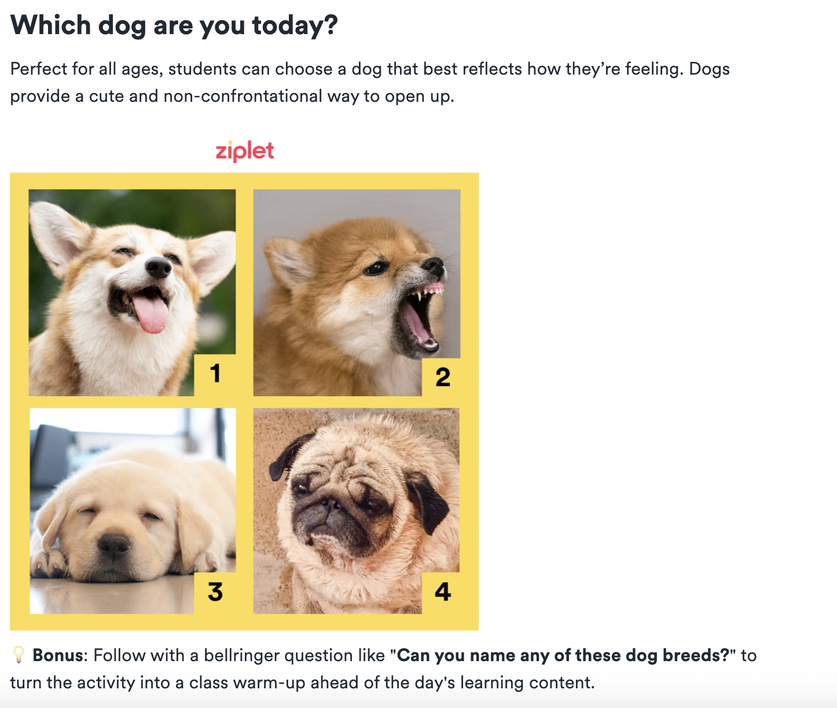
Emotional Check-In
It is the first week of the semester…
Modeling my teaching practices: What is the benefit of starting classes with emotional check-ins?

Slide 2
Self-Regulated Learning
EDU 330: Educational Psychology
Daniel Moos, PhD

Slide 3
Today’s Learning Outcomes
Define Self-Regulated Learning (SRL)
Identify why SRL is important
Discuss how to explicitly support SRL for your developmental group and content area

Slide 4
Student Views of SRL
Many students think “learning”…
Is passive
  it “happens” to them and largely a product of external factors, such as instructor and instructional activities
Many students think the lack of learning is attributed to…
Poor instruction (it is the instructor’s fault)
Lack of innate ability (they were not “born with it”)

Slide 5
How do you define SRL? (I)
Self-Regulated Learning is…
…the conscious planning, monitoring, and evaluation of one’s learning in order to meet learning goals
…multi-dimensional, multi-stage process
…needs to learned (ie it does not optimally develop in the absence of explicit instruction)

Slide 6
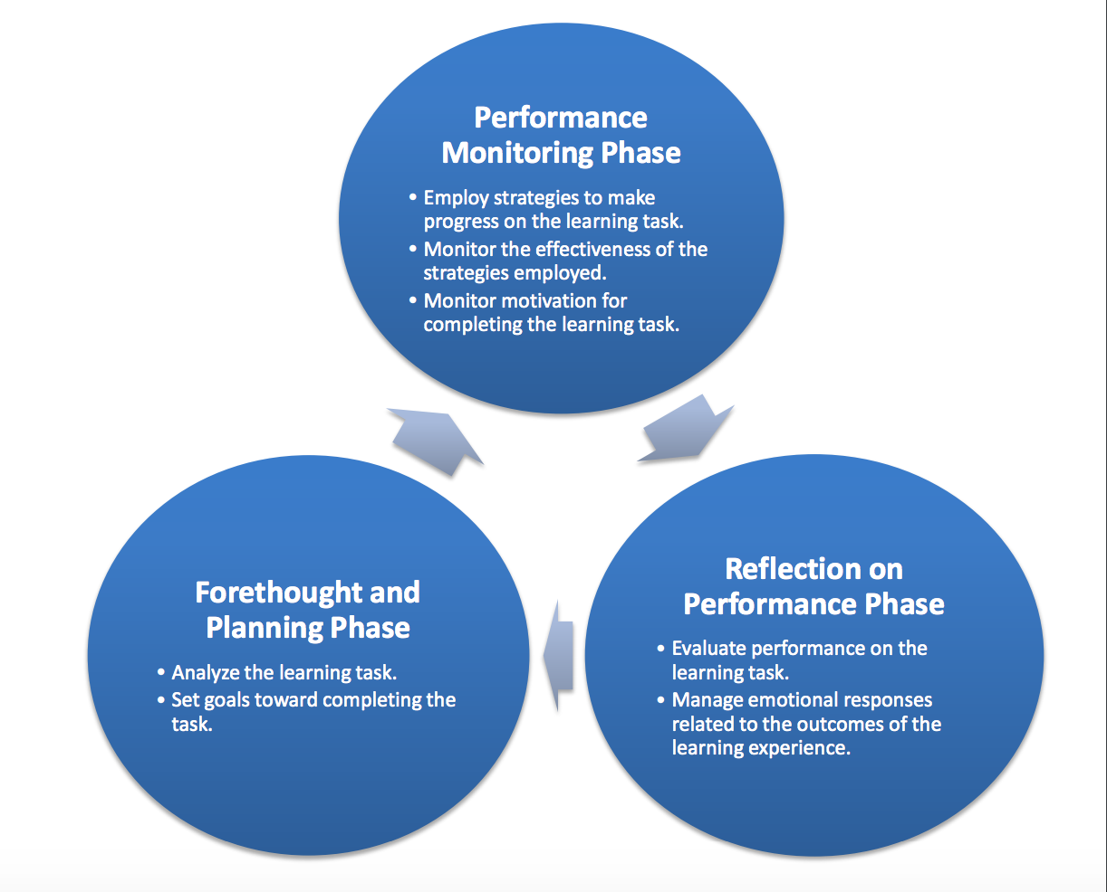
How do you define SRL? (II)
DURING
AFTER
BEFORE

Slide 7
What does SRL look like in practice? (I)
Assignment: Read an article and watch a video in preparation for class discussion on learning styles
Planning Phase BEFORE | Analyze the learning task (difficulty and interest) Activate prior knowledge | Skim the article (5 minutes) and identify length of video to determine: How long do you think this homework will take? What is your interest in completing the homework? (adjust strategies as necessary) What do you already know about this topic and what questions do you have about the topic? Identify what strategies you will use to ensure active learning

Slide 8
What does SRL look like in practice? (II)
Assignment: Read an article and watch a video in preparation for class discussion on learning styles
Monitor/Performance Phase DURING | Monitor: Effectiveness of strategies Monitor understanding Monitor motivation | About ½ way through article and video, ask yourself the following: What questions do you have about the content so far? Are your strategies helping you learn? What is your interest level?

Slide 9
What does SRL look like in practice? (III)
Assignment: Read an article and watch a video in preparation for class discussion on learning styles
Reflection Phase AFTER | Evaluate/reflect on performance and learning Evaluate/reflect on learning task | After completing the video/article, ask yourself the following: What did you learn from the video or article? What questions do you still have after reading the article or video? Were your strategies effective? Did the homework take as long as your predicted?

Slide 10
How do you support SRL in the classroom (I)
Strategy | Implicit (TELL STUDENTS WHAT TO DO) | Explicit (TELL STUDENT WHAT TO DO & WHY IT IS IMPORTANT)
Activate prior knowledge (planning phase of SRL) | Ask students right before you start a new topic: “What do you already know about this topic?” | Ask students: “What do you already know about this topic?” Follow up with: Thinking about what you already know about a topic (i.e. activating prior knowledge) will put you in a position to understand how your beliefs will affect your perception of the reading, an important first step in SRL.

Slide 11
How do you explicitly support SRL in the classroom (II)
Strategy | Implicit (TELL STUDENTS WHAT TO DO) | Explicit (TELL STUDENT WHAT TO DO & WHY IT IS IMPORTANT)
Monitor understanding | During the last 5 minutes of class, ask students to underline and put a “?” next to any notes for which they still have questions | Follow up with: Identifying areas for which you still have confusion will help focus your study and identify areas to seek help from peers and the teacher. This monitoring of your understanding is an important step in the SRL process.
How could a teacher implicitly support students monitoring of understanding?
How could a teacher explicitly support students monitoring of understanding?

Slide 12
How do you explicitly support SRL in the classroom (III)
Gallery Walk…
with specific strategies, assignments and pedagogies
Have you been asked to do this activity? If so, in what context?
How does this activity support SRL? What phases of SRL?
To what extent do you think this activity would be effective for your content area and/or developmental group?

Slide 13
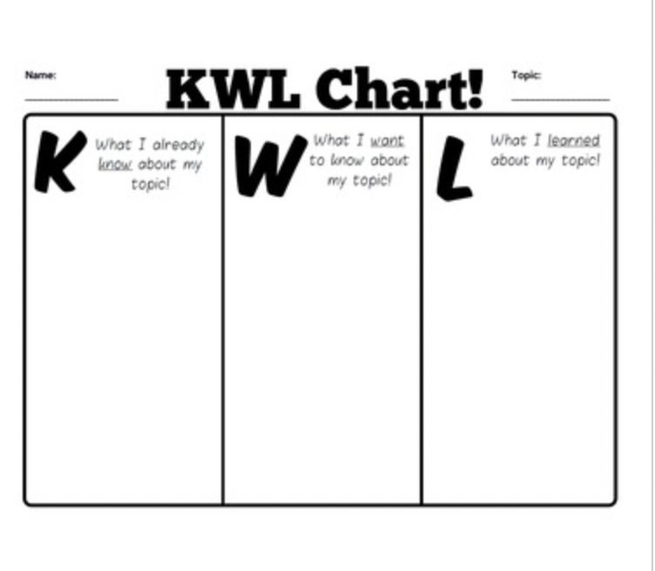

Slide 14
Wrappers
Class Discussion/ Lecture wrappers:
  What do you believe are the 3 most important points, concepts, topics (etc) from today’s class?
  Why do you believe these points, concepts, topic (etc) are the most important?
  Discuss in small groups and/or as class
  Convergence with regular opportunity
Assignment (exam, performance, assignments) wrappers:
  What score do believe you will earn on the the assignment? (or for ungrading/non-scored assignment – what type of feedback do you think you will receive?)
  How did you prepare for this assignment, performance, etc? (strategies, time, study environment)
  What worked well in preparing for this assignment and what should change for future assignments?

Slide 15
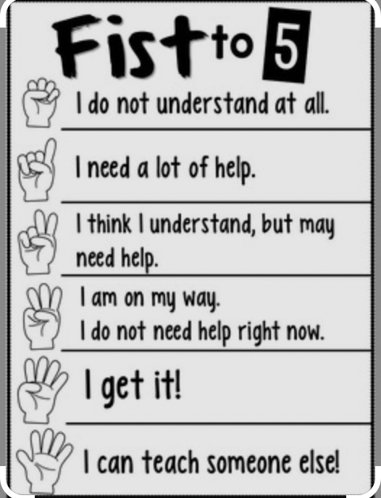
Signals
Thumbs up (“I understand”), Thumbs in the middle (“I understand, but have questions”), Thumbs down (“I do not understand”)
Exit slip with each objective from the class and images (or numbers) indicating level of comprehension. Students complete exit slip at the end of class.

Slide 16
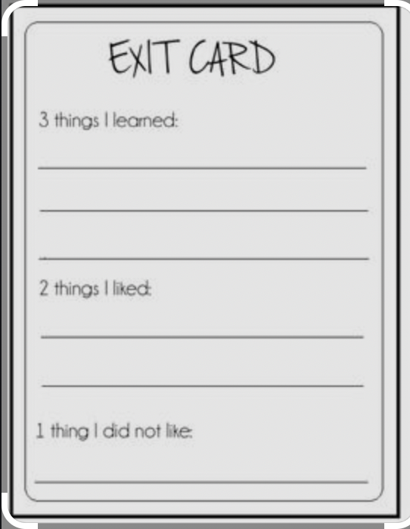

Exit Cards
I understand….
I do NOT understand….
What questions, ideas and/or feelings did this class raise for you?
What was your favorite moment of this class? Why? What was the least favorite moment of this class? Why?
Evaluate your participation in class today. What did you do well? What could you do differently next class?

Slide 17
Reading Reflection Prompts: Questions used to combat passive engagement with reading:
What was the main point?
(2) What did you find surprising?
(3) What did you find confusing?

Slide 18
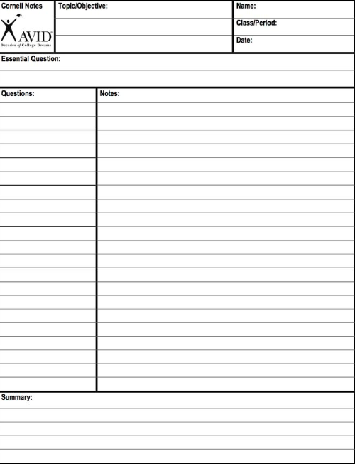
Structured Notes
Notes are divided into two columns.
The note-taking column on right: Content
The note-taking column on left: Questions about the content
The note-taking column on bottom: Summary of content

