Slide 1
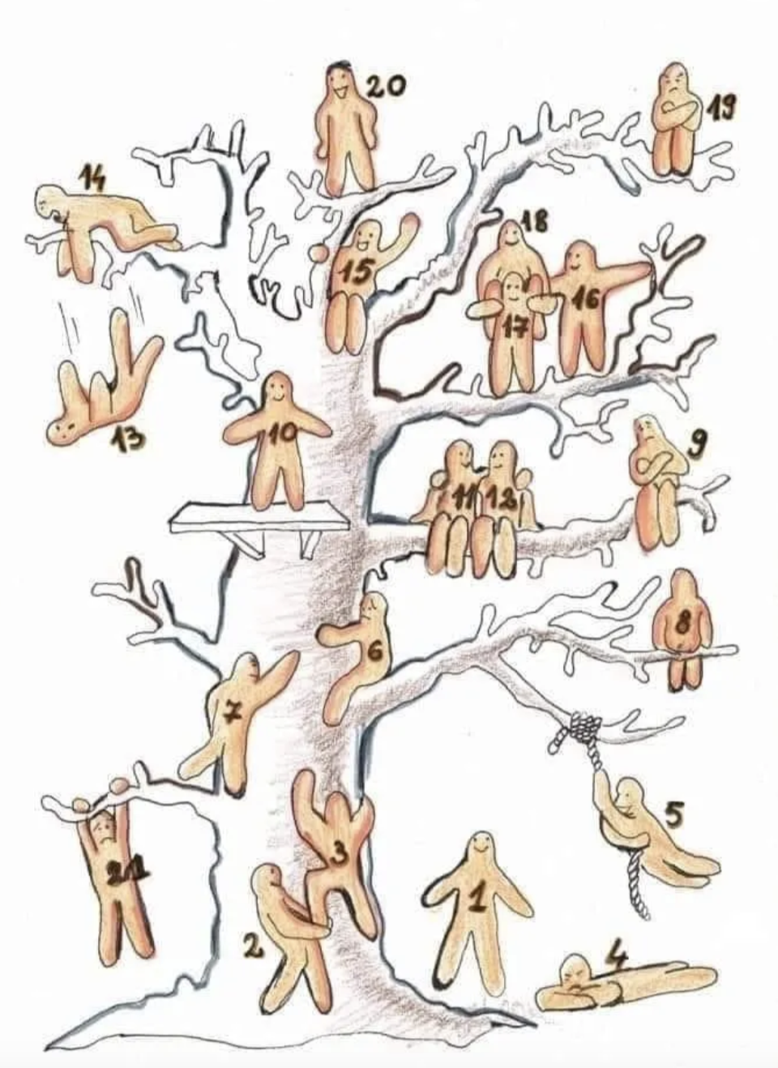
The end of the semester is in sight… how are you doing?
Choose one or both:
What Blob represents how you are feeling overall and why?
What Blob represents how you are feeling in EDU 330 (might be the same, might be different) and why?

Slide 2
Last chance….
To play rock-paper-scissors!
Find a partner outside of your pod
Best 2 out 3 (championship is 3/5)
Return to your original partner
Winner answers the following:
(1) How do you define reliability and validity?
(2) What is a strategy to ensure reliability?
(3) What is a strategy to ensure validity?
Notes:
3

Slide 3
Using Assessment to Inform Instruction
EDU 330: Educational Psychology
Daniel Moos, PhD

Slide 4
Learning Objectives
Understand the purpose of pre‑assessment and formative assessment
Design effective pre & formative assessments
Interpret assessment data to inform instruction

Slide 5
WHEN should you assess?
Beginning of Learning Unit
End
of Learning Unit
Pre-assessment
Find out what your students know
Formative
Keep track of what your students know
Summative
Make sure your students know

Slide 6
What is a pre-assessment?
Evaluates prior knowledge, interest/motivation and/or misconceptions
Informs pacing, grouping, and/or focus
Low‑stakes and purposeful
Quick!
No need to intimidate your students before the learning unit!
Focused
Unit probably too large; single lesson too much work for you!
Sensitive
Explain rationale behind pre-assessment and expectations

Slide 7
What are examples of pre-assessments?
Traditional diagnostic assessment / performance
Concept Map
Students create “map” of ideas in learning unit; update as progress
KWL charts
What a students knows (K) & wants to know (W). Completed as a pre-assessment.
What a students has Learned (L). Completed as a post-assessment/summative assessment.
Ranking
Rank concepts, skills, content based on anticipated difficulty and/or interest
First & Final Thoughts
Prior to learning unit, ask students to share initial thoughts and personal interests; revisit at end of learning unit
Wonder Board
After introducing topics for learning unit, students post questions on display board; update throughout learning unit. Great pacing strategy!

Slide 8
What is a formative assessment?
Based on learning targets & designed by teachers
Occurs during instruction
Offers evidence of student learning as it relates to learning targets
Provides feedback to teachers: Informs instruction
  Review formative assessment and modify whole class and/or individual student support (as needed)
Provides feedback to students: Offers actionable feedback
  Feedback on progress towards learning target
  Opportunity for students to use feedback

Slide 9
What are examples of formative assessments?
Examples of Quick Formative Assessment: Signals
Thumbs up / sideways / thumbs down → level of understanding
Fist to Five → self-rated confidence or mastery
Traffic light cards (red / yellow / green) → stop / unsure / ready
Hold up fingers (1–4) → multiple-choice understanding check
Whiteboards → everyone responds at once
Stand–sit or hand signals → quick yes/no checks
– Which signal would you feel most comfortable using?
– What are potential challenges in using signals as valid formative assessments and how might you minimize these challenges?

Slide 10
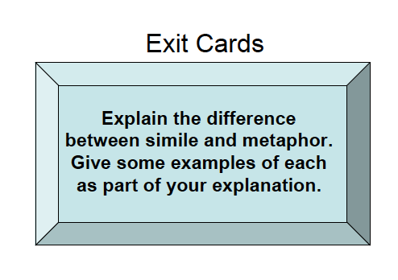
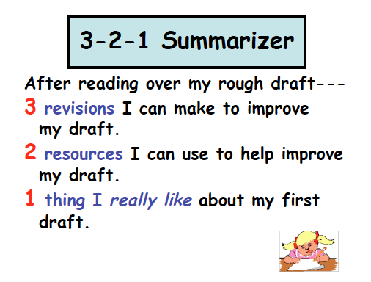
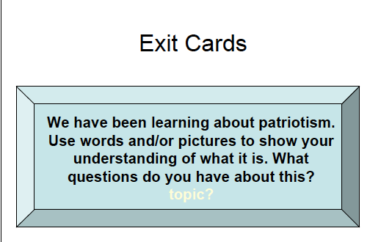
What are examples of formative assessments?
“On one side of the notecard, write one key idea you learned today. On the other side, write one question you still have about today’s class”

Slide 11
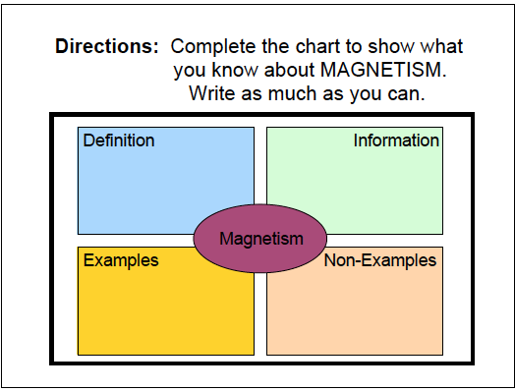
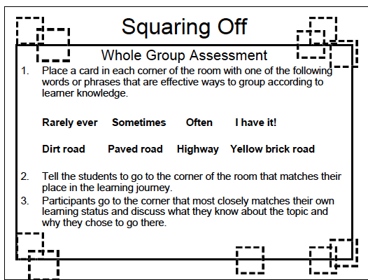
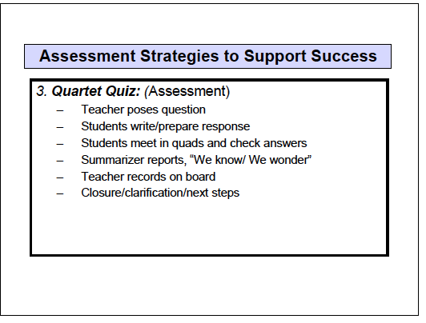
What are examples of formative assessments?

Slide 12
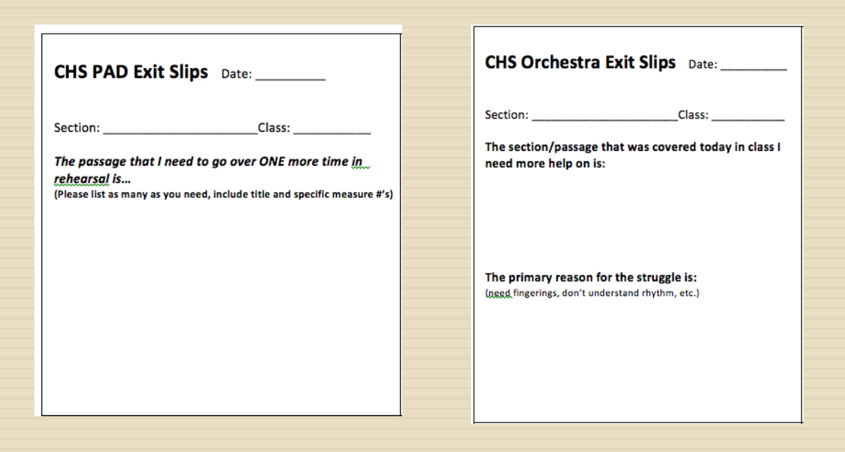
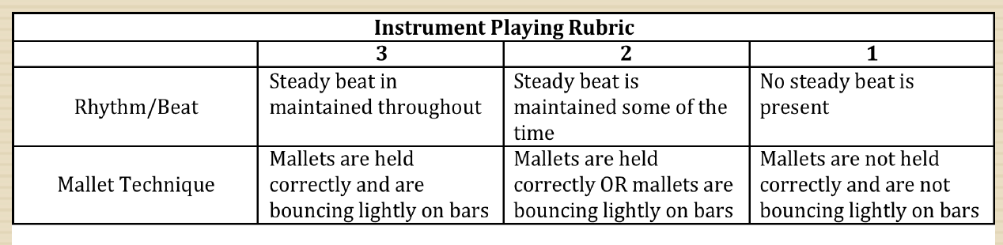
What are examples of formative assessments?

Slide 13
How can teachers use formative assessments?
Clear understanding → move forward or extend learning
Partial understanding → reteach with a new strategy
Misconceptions → pause and address explicitly
Low engagement → adjust task, pacing, or relevance

Slide 14
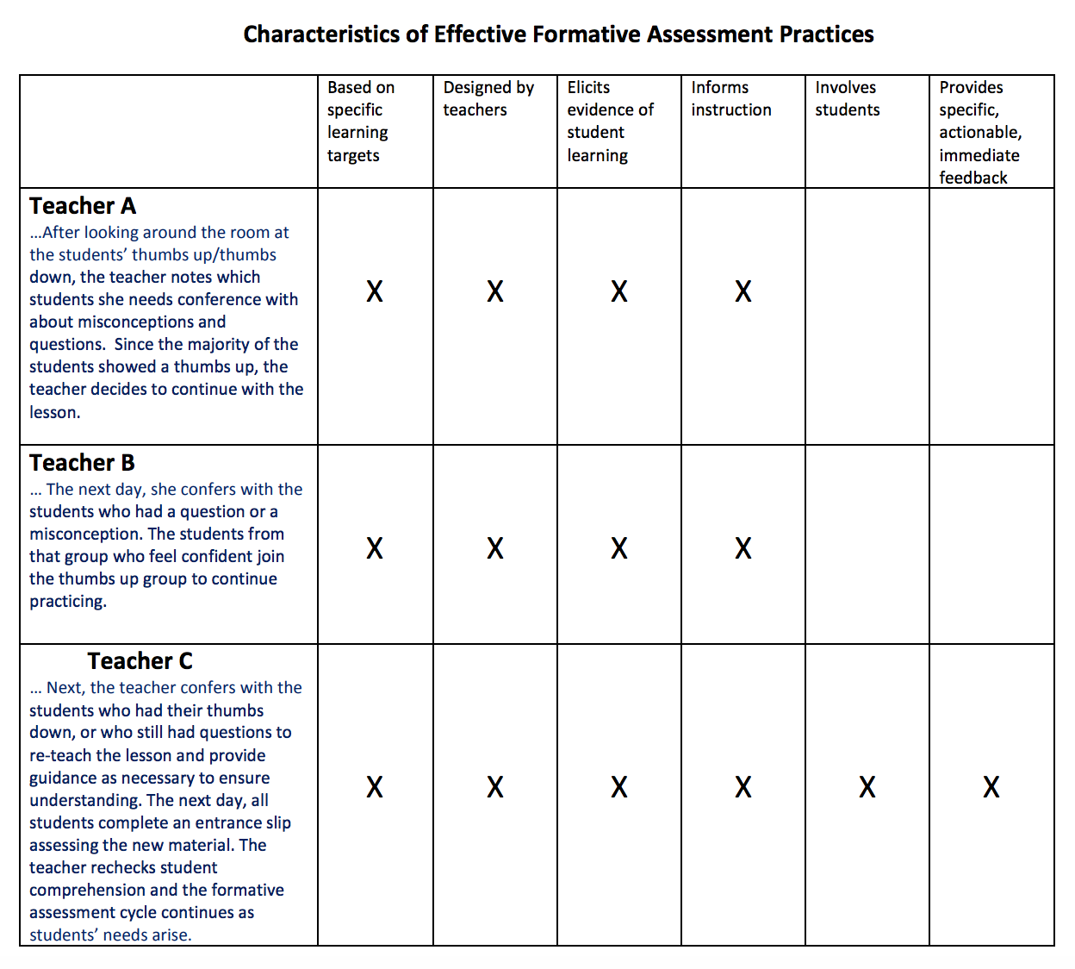
How can teachers use formative assessments?

Slide 15
Application Activity:
Meets Standard 10
Analyze a classroom assessment case study
Evaluate validity and reliability of assessment
Interpret student performance data
Decide instructional next steps based on interpretation of student performance data

