Slide 1
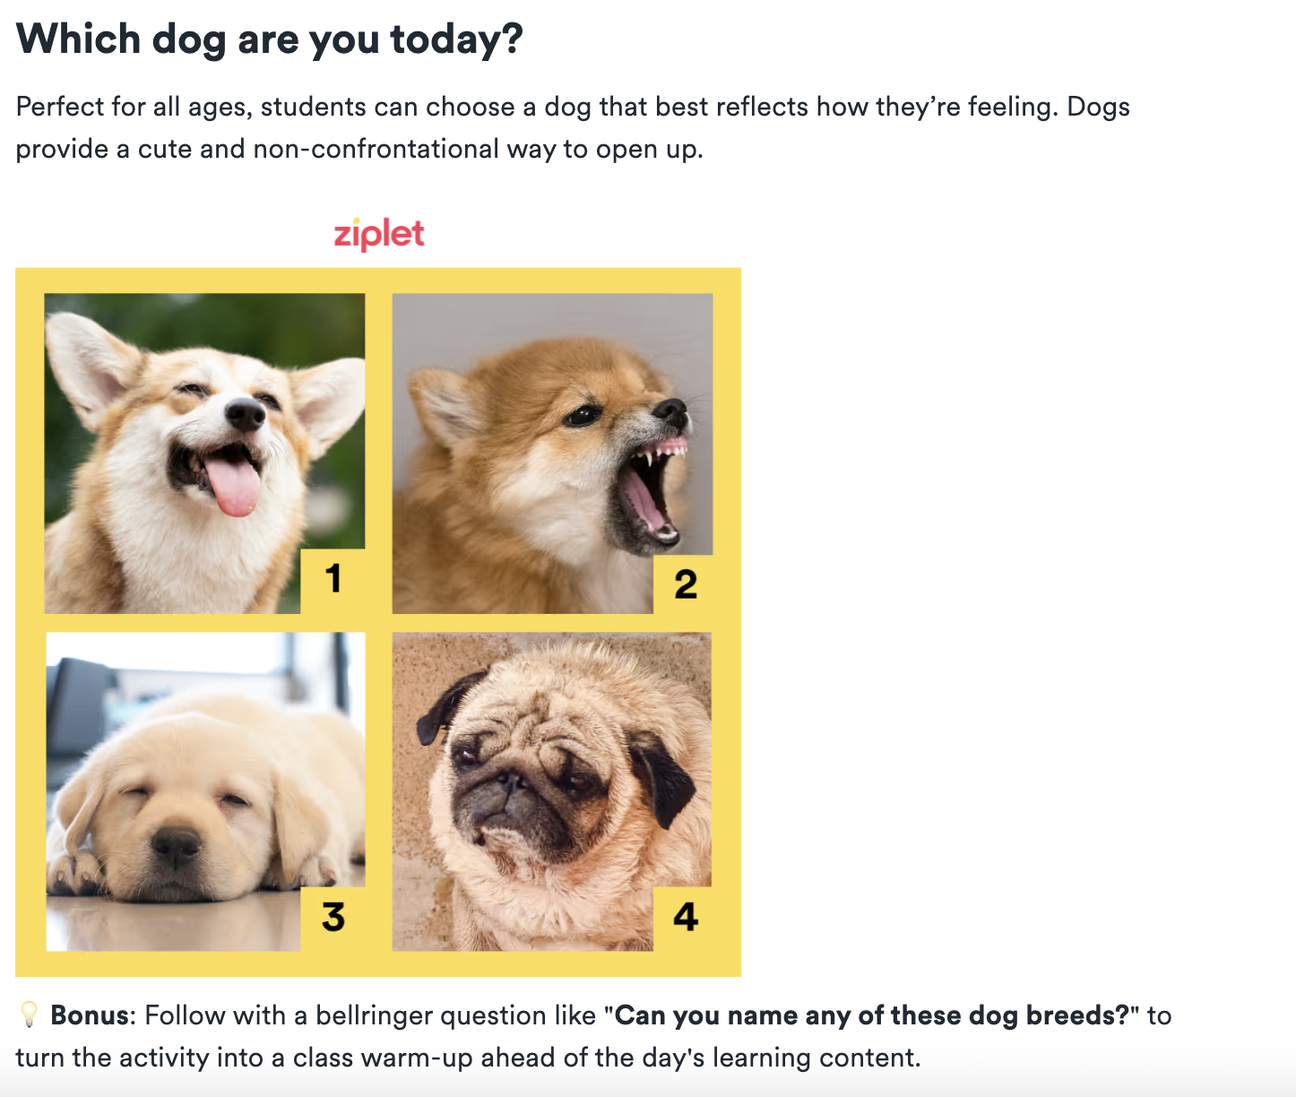
Before We Start Class…Emotional Check-In (about ½ way there!)
What dog are you today?

Slide 2
Social Media as a teaching tool
Things to consider for the classroom

Slide 3
Opening Questions & Activity:
What social media platforms are you most active on & what do you use them for?
How do you think teachers can use these platforms to enhance the learning experience?

Slide 4
Why use Social Media in the Classroom?
Meets students where they are
  Students already engage with content via short-form video, visuals, and discussion
  Leverages familiar tools to increase engagement and relevance
Authentic audience & purpose
  Students write, create, and reflect knowing someone beyond the teacher may see it – can increase motivation and quality of work
Supports multimodal learning
  Encourages video, audio, images, and text
  Supports diverse learners and multiple ways of demonstrating understanding
Builds communication & digital literacy skills
  Teaches students how to communicate responsibly in public or semi-public spaces
  Prepares students for civic, academic, and professional digital spaces
Community building
  Can strengthen classroom culture, belonging, and student voice
  Creates opportunities for collaboration and peer feedback

Slide 5
Key Consideration for Using Social Media in the Classroom
Using social media in the classroom is not about trends—it’s about intentional design and responsibility.
Purpose first, platform second
  What learning goal does this serve?
  Would another tool work just as well (or better)?
Equity & access
  Do all students have access?
  Are there alternatives for students who opt out or do not have access?
Privacy & safety
  FERPA and district policies matter
  Use closed platforms, pseudonyms, or teacher-managed accounts when appropriate
Boundaries & professionalism
  Clear norms for teacher–student interactions
  No personal accounts; professional use only
Digital citizenship is not optional
  Students need explicit instruction on:
    Appropriate posting
    Tone and audience
    Permanence of digital content

Slide 6
Examples of Social Media in the Classroom: Elementary & Middle School
Early Elementary (Grades K-1): A teacher uses a private class Flip (formerly Flipgrid) space where students record short video reflections, such as “What was your favorite part of today’s story?” or “Show us how you solved this math problem.” Families and classmates can respond with short videos or emojis.
Elementary School (Grade 4): A science teacher uses a private Instagram (or class Padlet with image posts) to document the class garden’s progress. Students take turns as “garden reporters,” uploading photos with captions explaining plant growth and observations.
Middle School (Grade 7): Science students create a TikTok video explaining the concept of photosynthesis.
Middle School (Grade 8): A Social Studies teacher uses a class Twitter simulation to “live-tweet” the Constitutional Convention, with students role-playing delegates. Each student account represents a historical figure, posting opinions and responding to peers as if debating in real time.

Slide 7
Examples of Social Media in the Classroom: Highschool
Early High School (Grade 9): History students create an Instagram account for a historical figure and post “artifacts” and “stories” from their perspective.
High School (Grade 10): An English literature teacher sets up a private class blog (WordPress) Edublogs, or Google Sites) where students publish short story drafts and leave structured peer feedback in the comments.
High School (Grade 12): An art teacher uses a Pinterest board where students curate visual inspiration for final projects. Peers provide comments on boards to encourage, critique, or suggest ideas.

Slide 8
Gallery Walk: Social Media & Ethical Considerations
Station #1: What are the risks or potential challenges of bringing social media into the classroom?
Station #2: How would you handle issues like cyberbullying or a student posting inappropriate content?
Station #3: What are the privacy concerns for both students and teachers with social media?
Station #4: How does the concept of a "digital footprint" apply to the classroom?
Station #5: How might the use of social media in the classroom affect existing inequities, such as the digital divide or access to technology?
What is a digital footprint & digital divide?

Slide 9
Gallery Walk: Ethical Considerations
Digital Footprint: Trail of data you left as a result of online activity: Record of internet usage, and it's something that can persist long after the original content is created or viewed.
Active digital footprints: Data that you intentionally share, such as social media posts, comments on blogs, or online profiles you create.
Passive digital footprints: Data that is collected without your direct knowledge, such as your browsing history, location data from your phone, or your IP address.
Digital Divide: The gap between those who have access to and a working knowledge of current technology, and those who do not.
It's not just about having a device; it also includes reliable internet access, the skills to use
the technology effectively, and the digital literacy to navigate it safely.
In the Classroom: Some students may have high-speed internet and their own laptop at
home, while others may only have access to a public library computer or a parent's phone, which can create significant inequities in their ability to complete assignments or participate in online learning.

Slide 10
Opening Questions…Gallery Walk
Individual process –>
Small group discussion –>
Individually reflect
What…(choose one)
Did you learn?
New perspective do you now have?
What new questions do you have?

Slide 11
Resources
Suggestions for integrating Instagram in the classroom
Cool ways educators can use this app include Museums and Science ‘grams
How teachers should use Facebook
Making better use of Facebook Groups in the classroom
12 ways teachers are using social media in the classroom right now
22 ways to use social media in the classroom
Twitter Chats (video), in particular, are popular with educators.
Suggestions for using snapchat in the classroom
YouTube, TikTok, and other video-based apps (using TikTok in the classroom)

Slide 12
Now, just like always: pick a social Explore Social Media uses as a teaching tool, create something for your websites...
...AND, somewhere on your work, add your opinion whether you think social media can work in your future teaching context and why you think that.

