Slide 1
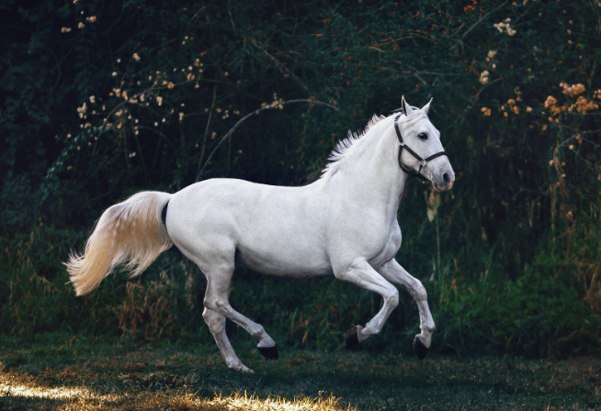
Riddles from Annie Moos
A cowboy rode into town on Friday. He stayed for three nights and rode out on Friday. How is this possible?
The cowboy rode in and out on a horse name is Friday.

Slide 2

Riddles from Annie Moos
What starts with a T, ends with a T and is full of T?
A Teapot

Slide 3
Riddles from Annie Moos
Which word in the dictionary is spelled incorrectly?
Incorrectly

Slide 4

Riddles from Annie Moos
I am an odd number. Take away a letter and I become even. What number am I?
Seven

Slide 5
A few essential reminders for all core technology items:
Stretch yourselves when you explore core technology categories throughout the semester
Use the rubric….every time
Add each new app you select, for each new category, somewhere on your website
Test to make sure your links work!

Slide 6
Presentations + Infographics
“Slides” or “Notes” -- visual ways to share information with others
EDU 241

Slide 7
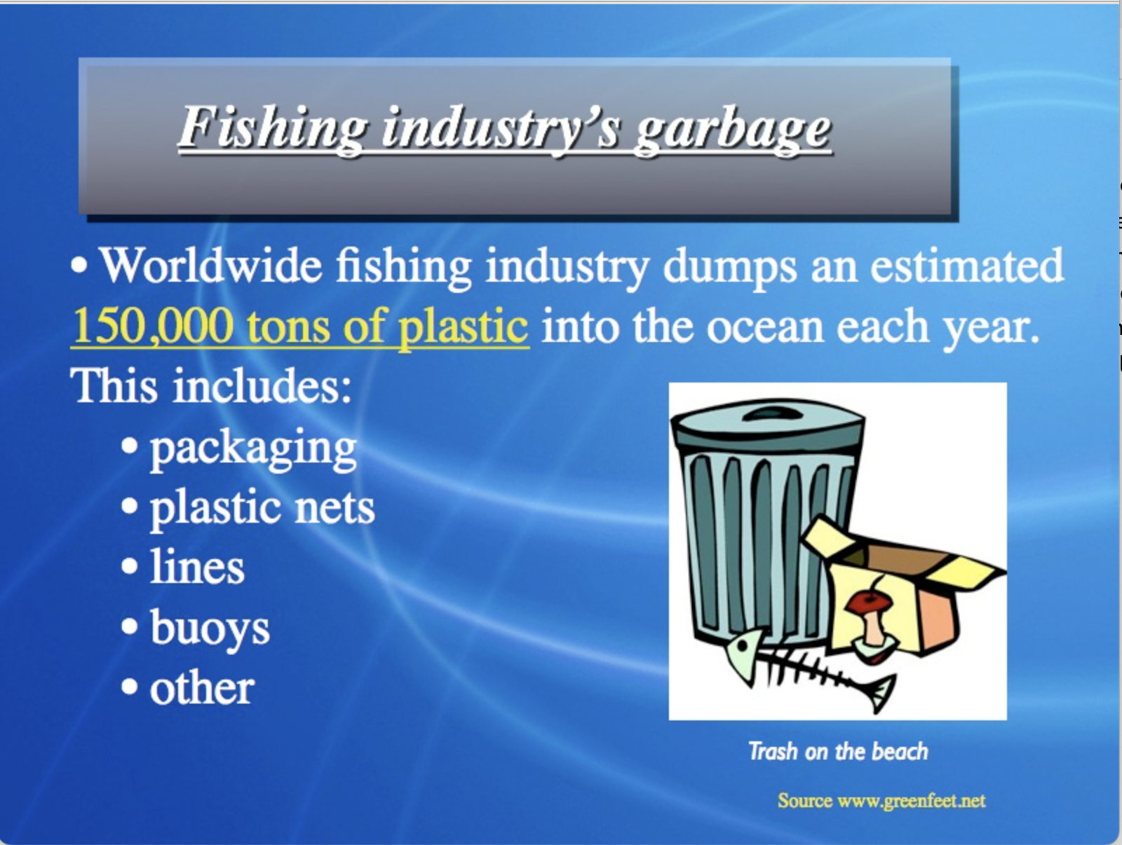

Slide 8
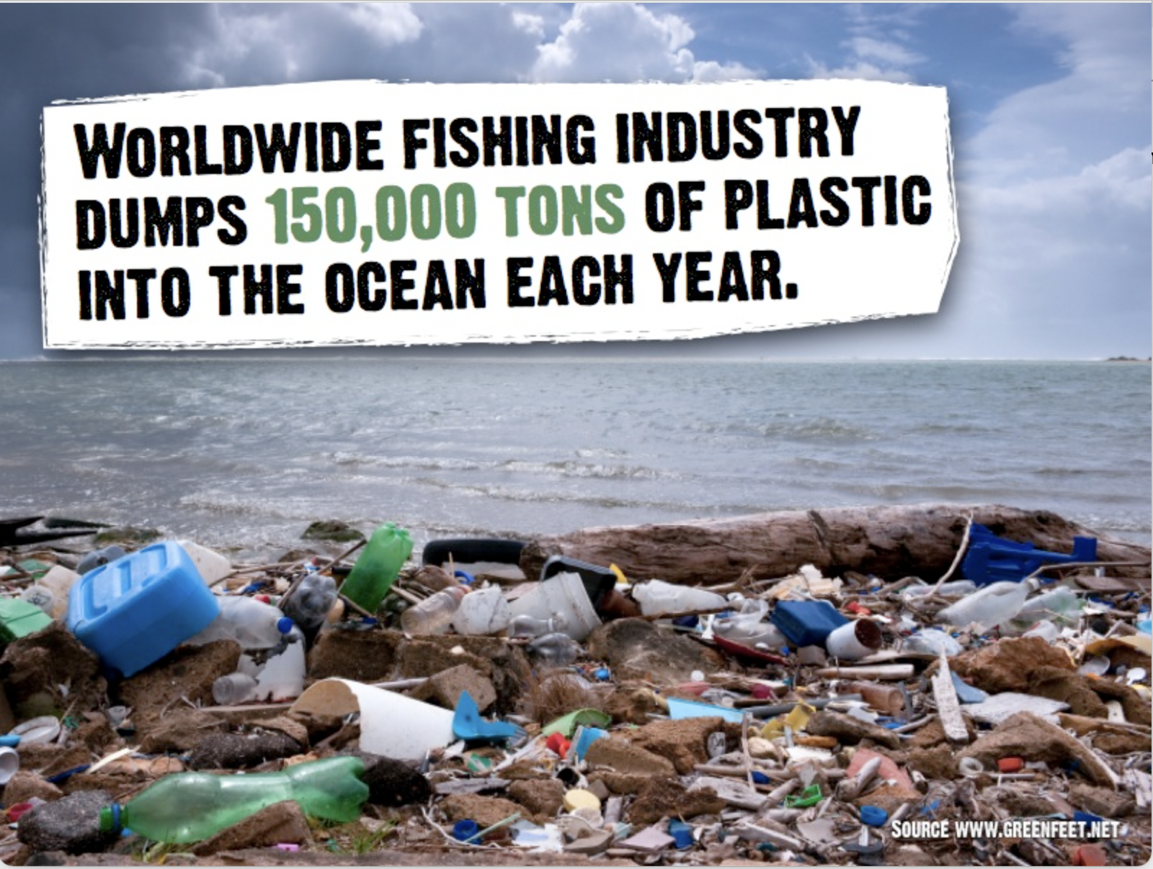

Slide 10
What is an Infographic?
What do you notice about this infographic designed for a high school science class on wind and sustainability?
How does it differ with a powerpoint presentation?

Slide 11
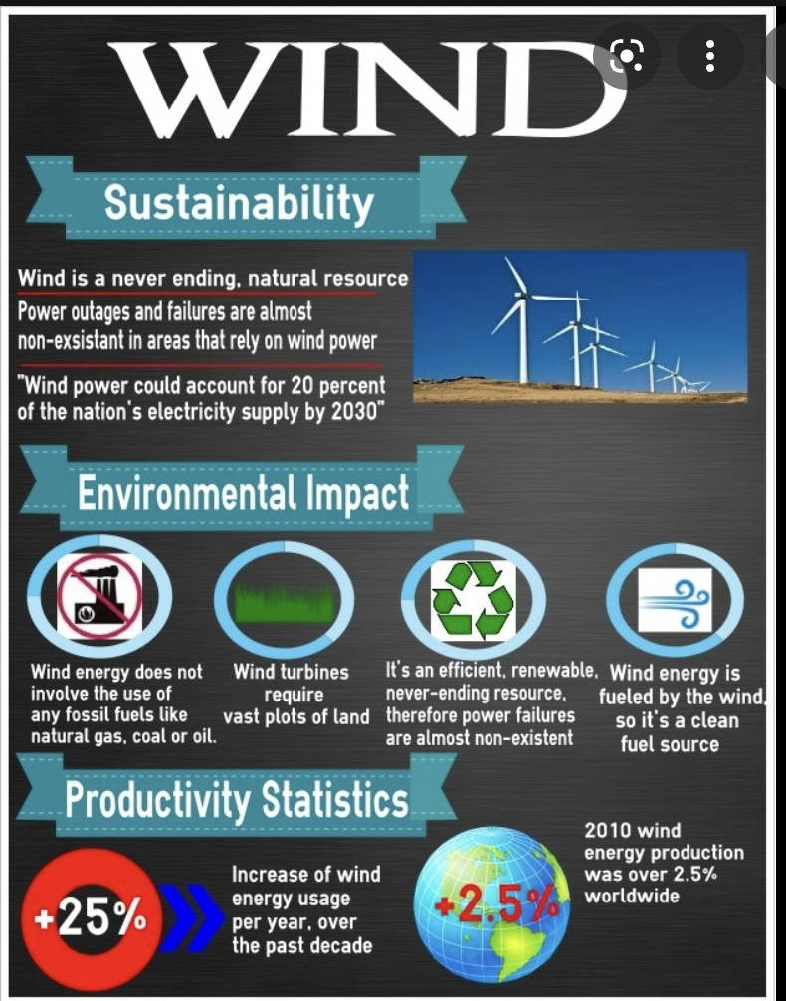

Slide 12
What is an Infographic?
Visual Representation of information in a graphic form
Designed to quickly communicate a message
Simplify presentation of a large amount of data and/or information

Slide 13
How do I make an Infographic?
Canva (templates!)
Easle.Ly
Infogram
Piktochart
Venngage
There are also templates for infographics in presentation apps like PowerPoint and Prezi

Slide 14
Memes
GIFs
and
More ways to represent information visually...

Slide 15
What is a meme?
Definition is hard to nail down…. (easy to see, hard to define)
……that is then usually spread through online social platforms.
…often associated with an image or video that communicates a specific idea, concept or message…

Slide 16
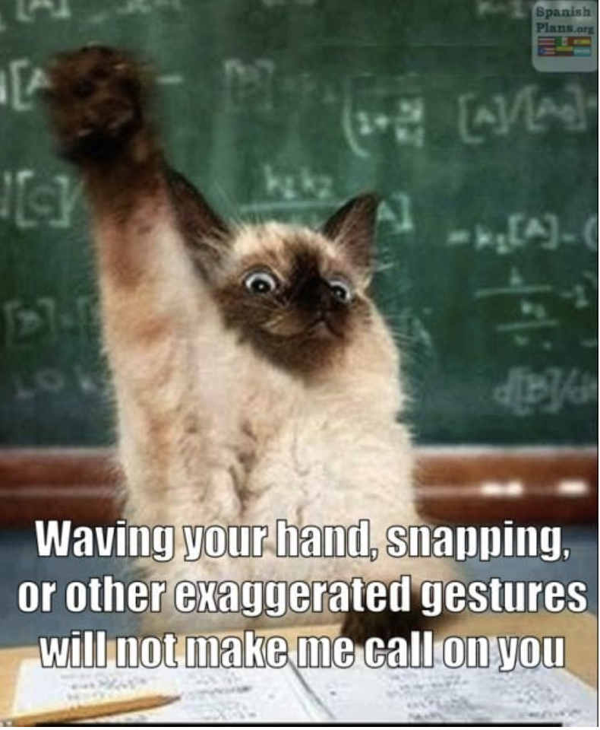
Memes for the classroom: Teacher creates memes to for classroom rules

Slide 17
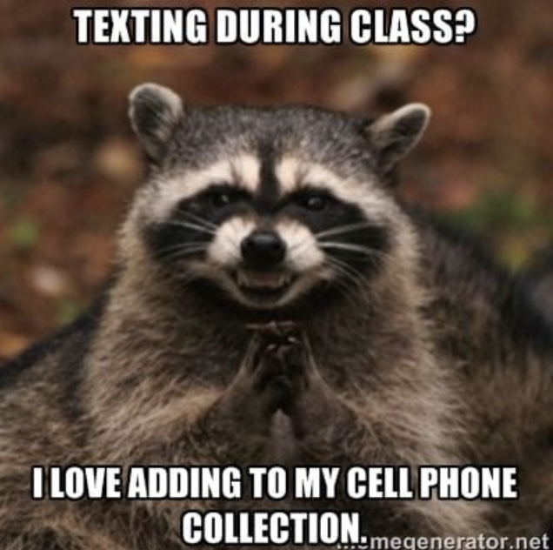
Memes for the classroom: Teacher creates memes for classroom rules

Slide 18

Memes for the classroom: Teacher creates memes to review rules grammar

Slide 19
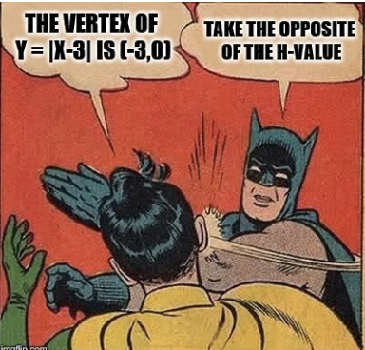
Memes for the classroom: students create memes to review rules (math)

Slide 20
Apps for both Meme & GIF-making abound:
Web- or app-based free meme generators are plentiful, find one you like or refer to this article for ideas.
Likewise, there are lots of free GIF (animated image) creating apps, too, including Clips, Image Play, or Giphy, or get more ideas from this article here.

Slide 21
Pintrist inspiration:
A variety of amazing infographics are pinned to this board here

Slide 22
What you’ll make for this Core Technology Skill:
1. One infographic….AND
2. One Meme or GIF (that you create)
For the Infographic, follow the rubric….
What is an infographic?
What are two pros and cons?
How can you use infographic in the classroom?

Slide 23
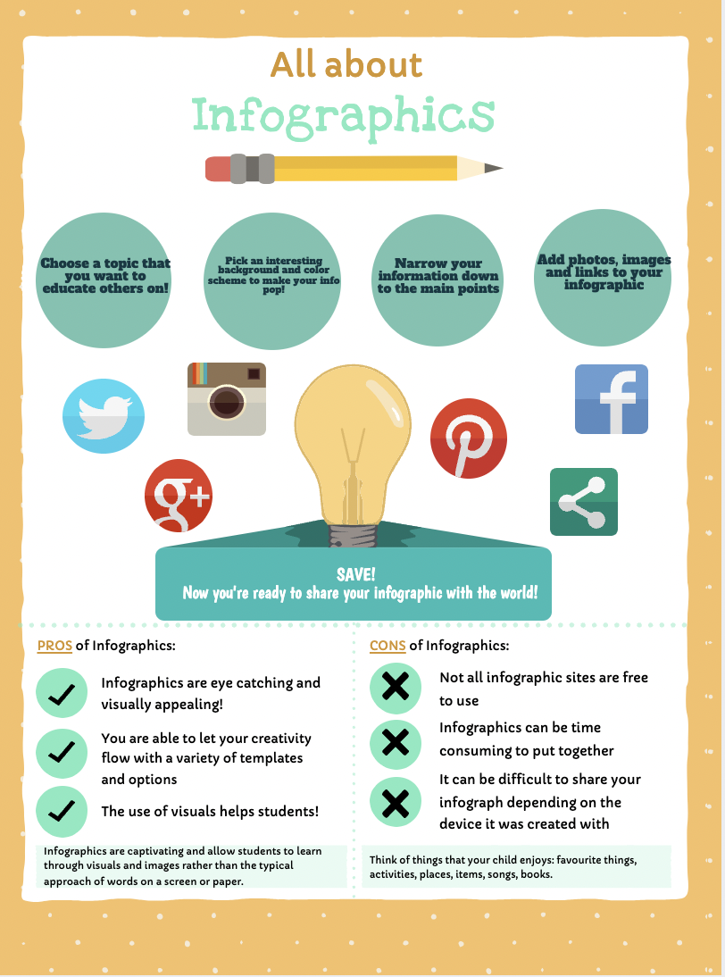
What you’ll make for this Core Technology Skill:
For the Infographic, follow the rubric…. Option #1

Slide 24
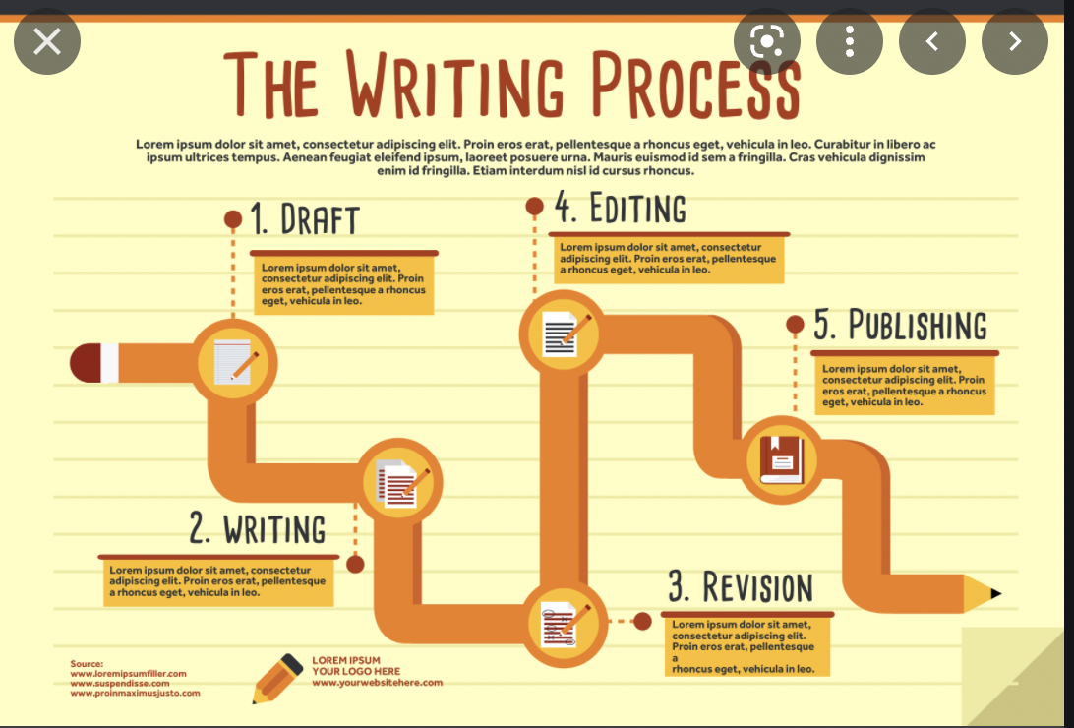
What you’ll make for this Core Technology Skill:
For the Infographic, follow the rubric…. Option #2
+ Short description of pros and cons in your website

Slide 25
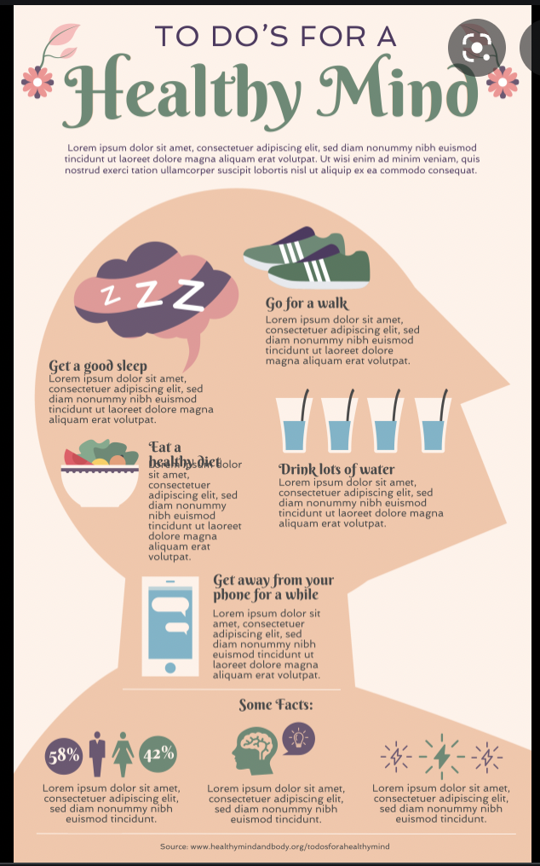
What you’ll make for this Core Technology Skill:
For the Infographic, follow the rubric…. Option #2
+ Short description of pros and cons in your website

Slide 26
What you’ll make for this Core Technology Skill:
1. One infographic….AND
2. One Meme or GIF (that you create, not share)
For the Meme or GIF, you do NOT need to follow the rubric. Rather, create a Meme or GIF that could be used for your future classroom.
Make sure your Meme and GIF are linked to your website.

Slide 27
Questions?

