Slide 1

Before we start class…
Tell us something good!
Share something good or positive that is happening your life right now.
Modeling my teaching…
What is the benefit of asking students to share something good or positive that is happening in their lives?

Slide 2
EDU
Writing Your Best Résumé
Raise your hand if you have recently worked on your resumé
Find someone who has not written a resumé or has not recently worked on a resumé….
Share your experiences writing a resumé
Identify questions you have about writing resumés

Slide 3
Résumé Facts
  Usually 1-page in length – teachers are the exception. How long do you think recruiters spend looking at a resumé?
Recruiters spend about 3-5 seconds reviewing a resume
Hiring managers spend 3-5 minutes reviewing a resume
Resumes are persuasion papers and need to be relevant
Include keywords that your employer is looking for (HR softwares)
Include work experiences if they are relevant, focus on field experiences
GIVE PROOF/EVIDENCE!
Resumes are your key to landing interviews

Slide 4
HR Software
Mirror the language used in the position description and do not rely on creativity.
Online applicant tracking systems, Human Resources software, and even search committees are known to scan resumes and for key words and phrases
Conduct a job description/ resume audit (make word clouds of each). Do they align with your resume?
Jobscan – scans resume and job postings for keywords

Slide 5
Think Like a Hiring Manager!
What would you look for in a teacher? (individually brainstorm characteristics and experiences)
Group share – create a master list of top characteristics and experiences
Class Share

Slide 6
Résumé Cautions
Be cautious when using templates and color!
  Templates in Word and Google Docs can download and print incorrectly with messy formatting
  Keep a running document that includes all experiences and copy and paste from there – useful so you won’t forget experiences, especially when applying for jobs way down the road, grad school, grants, etc.
  Always download as a PDF to submit

Slide 7
Formatting
Headings between sections should be consistent:
Bold print
Italics
Bullets
Indentations
Font:
Easy to read (Times, Cambria, Arial, etc.)
Main content : 11-12 size
Section header: up to size 13
Name header: up to size 18

Slide 8
Header Examples
First & Last Name
Minneapolis, MN 55401 | 507-933-7575
johndoe@email.com | linkedin.com/in/johndoe11
First & Last Name
St. Peter, MN | 555-666-7777 | student@gustavus.edu

Slide 9
Education
Degree (Bachelor of Arts)
Major(s)/Minor(s)
Name and location (City, State) of Institution
Graduation date (Month Year)
GPA (major or overall, specify) – if greater than 3.0 - OPTIONAL
Also include where relevant:
  Study Abroad
  Academic Honors
  Awards
  Scholarships

Slide 10
Education Examples
Bachelor of Arts, Gustavus Adolphus College, St. Peter, MN. May 2024
Elementary Education Major
GPA 3.25 Dean’s List: Fall 2022, Spring 2023
Gustavus Adolphus College | St. Peter, MN
Bachelor of Arts expected May 2026
Elementary Education Major
GPA 3.89 | Dean’s List: Spring 2021, Spring 2022

Slide 11
Experience Formatting
Position title
Name of the organization
Location (City, State)
Dates of experience (Month Year - Month Year)
Description (2-5 bullet points). Begin with an action verb

Slide 12
Field Experience
Teaching/Classroom Experiences
  Student teaching, practicum, job shadows
  Highlight experience to show variety
    Differentiation of teaching methods
    504 and IEP experience
    Grades, schools, cities…show diversity!

Slide 13
“Work” Experience
  Principals and hiring staff want to see experience and the skills that come along with the world of work
  What are relevant skills? Where have you shown them?
  Does not need to be paid work! Any work with children and young adults: childcare/nannying, Sunday School teaching, coaching, lifeguarding are a few examples
  Employment or Community Service or Leadership as names of section

Slide 14
Leadership, Campus / Community Involvement
Campus Involvement:
  Student Organizations, Athletic Teams, Arts/Music
  Depth vs. breadth
Community Involvement:
  Volunteering – number of hours, events held
Be sure to indicate leadership roles within organizations

Slide 15
Skills and Abilities
Shape your experiences to show you have the skills and abilities the school is looking for.
NACE Career Readiness Competencies
Critical thinking
Problem solving
Oral and written communications
Teamwork/collaboration
Digital technology
Leadership
Professionalism/work ethic
Career management
Global/intercultural fluency

Slide 16
Optional Sections
Other sections to consider if relevant:
Language Skills (think: fluency)
Scholarships and Awards (often under education)
Research and Presentations (sometimes under education)

Slide 17
Experience Descriptions:
What do you notice about these descriptions (formatting, phrasing, etc)?
Human Resources Intern January 2015
Angie’s BOOMCHICKAPOP Mankato, MN
Worked with team of 3 interns to create a Production Operator training module that will be used for all new hires within the manufacturing facilities to increase employee retention rates
Created an infographic to promote safety training for 200 corporate employees
Supported candidate selection for 3 open positions, created onboarding manuals for all new employees, and participated in creating materials for the company’s wellness program
Gustavus Women’s Soccer St. Peter, MN
Varsity Athlete & Mentor August 2014-Present
Attained a varsity letter as first year student
Selected as athletic mentor by Athletic Department staff to provide guidance for incoming first year teammates
Serve as member of off-season leadership team to develop and implement team goals for upcoming seasons

Slide 18
Experience Descriptions
Use the WHO acronym
  What did I do?
  How did I do it?
  the Outcome
  Example: Facilitated weekly peer-based and confidential wellbeing group coaching sessions for six students.
Use action verbs to start: Purdue Owl for ideas
  https://owl.english.purdue.edu/owl/resource/543/02/

Slide 19
Do not include:
An objective / summary
  Save this information for a cover letter
A photo of yourself
  HR policy / Text Only Readers
Skills that are expected of all college students

Slide 20
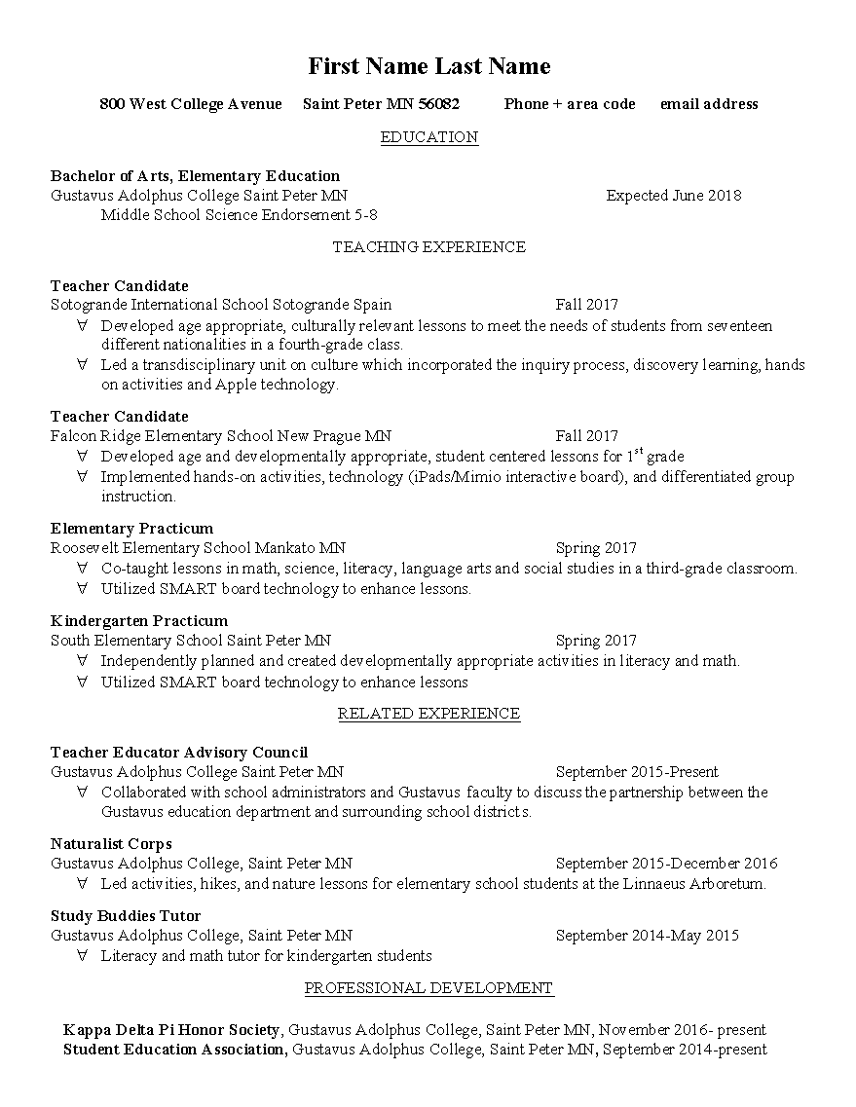
Example 1: Gustavus Elementary Education grad, 2018

