Slide 1
Questions from Annie Moos
Choose one to answer….
If you could be any animal, what animal and why?
If a genie grants you one wish, what do you wish for you and why?
If you could pick up one new skill instantly, what would it be and why?

Slide 2
Online/hybrid learning tools
Core Technology Skill: EDU 241

Slide 3
Learning Objectives
Learning Objective: Develop foundational understanding of effective online and hybrid teaching models and tools.
Agenda:
  Models: Defining Hybrid vs. Online Learning.
  Essential Tools: Categories of technology (LMS, Sync, Async).
  Best Practices: The Pedagogical Shift required for success, supported by real-world examples.

Slide 4
Defining the models
Online Learning: 100% remote instruction. All interactions, content delivery, and assessments occur digitally.
Hybrid/Blended Learning: A formal combination of face-to-face (F2F) and online instruction.
  Key Point: The "blending" must be meaningful. It’s about leveraging the best of both environments, not just doing the same things F2F and online.

Slide 5
Common Hybrid Models
Flipped Classroom:
  Content delivery (lectures, videos, readings) happens online before class.
  Application, discussion, and problem-solving happen in person.
  Goal: Maximize the value of synchronous time.
Rotation Model:
  Students rotate on a fixed schedule between different learning stations (e.g., small group instruction with the teacher, individual online work, collaborative project time).

Slide 6
Essential Tool Category 1: The LMS (Learning Management System)
LMS (we have already discussed!): The "hub" or "central organizing force" of your course (e.g., Schoology, SeeSaw, Moodle, Canvas, Google Classroom).
Function:
  Centralized content delivery (syllabus, readings, videos).
  Assignment submission and grading.
  Announcements and student-teacher communication.
Why it matters: Provides structure and predictability, reducing cognitive load for students navigating the course.

Slide 7
Essential Tool Category 2: Asynchronous Interaction
Asynchronous Tools (Anytime/Anywhere): Communication and collaboration tools that don't require real-time presence.
  Examples:
    Discussion Boards: For depth, reflection, and peer-to-peer critique.
    Video Response Tools (e.g., Flip): For allowing students to express understanding visually and verbally.
    Collaborative Documents (e.g., Google Docs): For group writing or brainstorming that happens over time.
Focus: Building community and encouraging reflection outside of scheduled class time.

Slide 8
Essential Tool Category 3: Synchronous Interaction
Synchronous Tools (Real-Time): Live interaction platforms (e.g., Zoom, Google Meet).
  Function:
    Live lectures and whole-class discussions.
    Virtual "office hours" and real-time Q&A.
    Break-out rooms for small-group activities.
Tip: Keep synchronous sessions active with polls, chat responses, and short activities. Avoid long, passive lectures to combat screen fatigue.

Slide 9
Case Study 1: Flipped Mastery in High School Math
Scenario: A high school Algebra teacher uses a flipped model where all instructional videos are on the LMS and completed as homework (”lectures” occur outside of the classroom).
Online Component: Students watch videos and complete a low-stakes mastery quiz. They must score 80% to "unlock" the next unit.
In-Person Component: The teacher spends 100% of class time coaching, running small intervention groups, and facilitating collaborative problem-solving.
Takeaway: Technology enables differentiation and mastery-based progression, making F2F time higher value.

Slide 10
The Pedagogical Shift
Key Idea: Technology is a means, not an end. The question is not "What can this tool do?" but "How does this tool help my students meet the learning objective?”
Shift from: Information Delivery (Teacher-focused)
Shift to: Facilitation and Instructional Design (Student-focused)

Slide 11
Designing for Engagement
Chunking: Break online content (especially video) into smaller, manageable pieces (e.g., 5-7 minute videos max) with embedded checks for understanding.
Variety: Mix text, video, interactive quizzes, and collaborative tasks to keep interest high.
Clear Instructions: Be explicit about what students need to do online versus in-person. The expectations for each setting must be crystal clear.

Slide 12
Fostering Student Autonomy
Encourage Self-Pacing: Use online resources to allow students to review core content as needed.
Feedback Loops: Use online quizzes and assignment tools to provide timely, specific feedback so students can correct their understanding immediately. This helps students take ownership of their learning process.

Slide 13
Case Study 2: The Rural Access Challenge
Scenario: A rural district implements a hybrid English class, but 40% of students lack reliable broadband at home.
Initial Problem: Discussion board deadlines are missed; students struggle to stream videos.
Solution: The teacher pre-loads required videos and documents onto flash drives or personal school tablets for offline viewing, and uses text-only discussion prompts accessible via low-bandwidth apps.
Takeaway: Effective hybrid teaching requires proactive problem-solving for access, not just ideal design.

Slide 14
Equity & Accessibility
Access (The Digital Divide): Always consider students who have limited Wi-Fi access, outdated devices, or shared computers.
Accessibility: All digital materials must be accessible. This includes using closed captions on videos, ensuring screen-reader compatibility, and using high-contrast text.
Actionable Tip: Always have a low-tech/offline backup or alternative path for critical learning activities.

Slide 15
Your Assignment for this week….
IT is different!
You can work in small groups
Step #1: Choose your content area & grade Level
Step #2: Choose a topic that would work with this content and grade level
Step #3: Choose a hybrid approach to teaching this topic
  Flipped Classroom: Content delivered online; application and coaching delivered in person.
  Station Rotation: Students cycle through stations, at least one of which is an online/digital station.
  Another Hybrid Approach: A formal combination of face-to-face (F2F) and online instruction.
Step #3: In a narrative format (1-2 paragraphs), describe how you would implement your chosen hybrid model for a specific unit or topic in your content area (example coming…). Make sure to:
  Describe one key instructional activity you would use for Online/Asynchronous component, including the tool you would use
  Describe one corresponding activity you would use for the In-Person/Face-to-Face component, explaining how it builds directly on the online work
Step #4: : In a narrative format (1 paragraph), justify why this hybrid approach is effective. Why is your chosen model (Flipped OR Rotation OR Another Hybrid Approach) the best way to teach this material compared to a purely F2F class?

Slide 16
Your Assignment for this week….
IT is different!
You can work in small groups
Describe one key instructional activity you would use for the Online/Asynchronous component, including the tool you would use
  If using the Flipped Model: For homework, students will watch a screencast on proper essay structure using Flip and answer one open-ended prompt."
  If using the Station Rotation Model: Students, rotating through four learning centers, will spend 15 minutes at the 'Digital Lab' station using a class set of tablets to access an interactive PhET simulation on force and motion, completing an observation log sheet afterward.
Describe one corresponding activity you would use for the In-Person/Face-to-Face component, explaining how it builds directly on the online work
  If using the Flipped Model: No direct instruction in class. Instead, students will immediately apply the structure from the video to peer-edit a paragraph using paper copies. I, as the teacher, will individually help students who struggled with the open ended-prompt from homework.
  If using the Station Rotation Model: Following the Digital Lab station, the 'Teacher-Led' station would involve the students debriefing the simulation results with the instructor and using physical materials (like toy cars and ramps) to test a specific hypothesis generated during the digital observation.

Slide 17

Resources
What tools can be used to deliver lessons remotely?
Learning Management System tools (e.g. Seesaw, Schoology, etc)
Discussion boards (e.g. Padlet)
Screen casting tools (Nearpod),
PearDeck (can be used asynchronously)
Hyperdocs (check out this video)

Slide 18
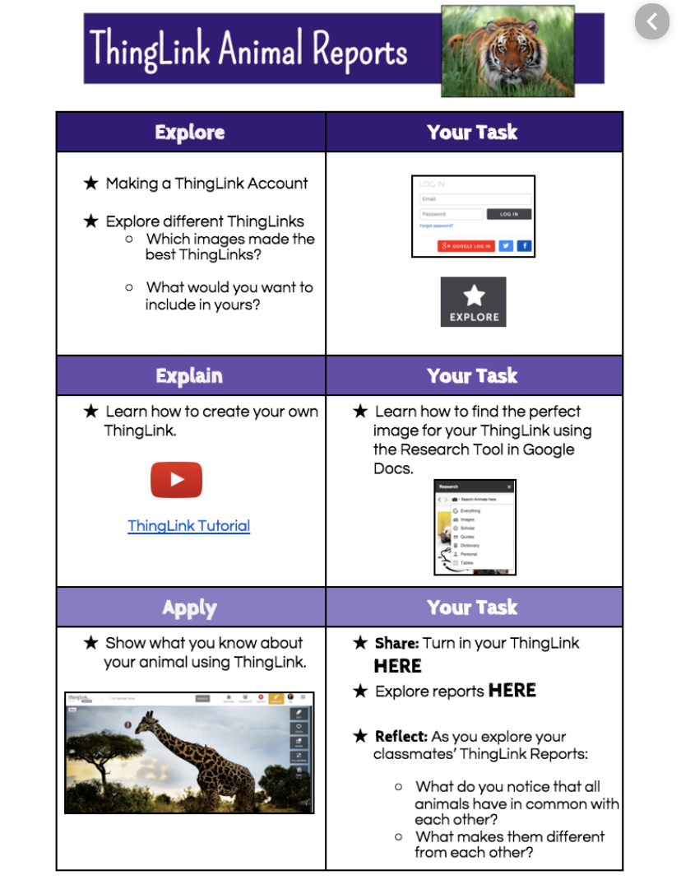
Hyperdoc example

Slide 19
(3) Remote lesson delivery
Hyperdocs templates:
Teachers Give Teachers
Templates by content area
Hyperdoc Google Slides

Slide 20
(4) Cool Tools
Jamboard
Podcasting
Perusall
Video (Adobe Spark, Flipgrid)
See the document linked on the course website (today’s class) for additional resources…

