Slide 1
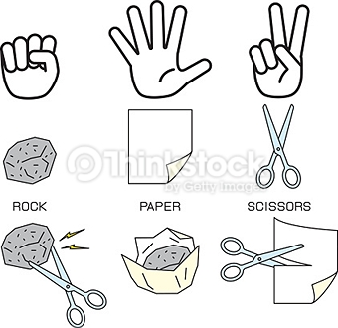
Please stand up
Find a partner from a different table
Play Rock-Paper-Scissors
Best 2 out of 3
Win? Raise your hand & Find another winner to play
Lose? Find someone to cheer on
Keep going into we have an EDU 330 Champion!
Return to original partner
Winner gets….
To Teach!

Slide 2
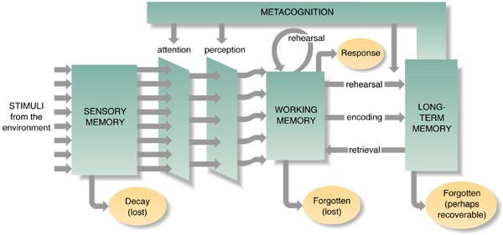
TEACH
(teacher claps twice)
OKAY
(Students clap twice)
First student “teaches” second student
(second student actively listens)
Second student starts with “this is what I heard”, summarizes and then adds and modifies

Slide 3
What is Metacognition and why is it important?
Selective Attention example #1:
Selective Attention example #2:
  Write your name as many times as possible in 15 seconds
  Multiply number by 4; what is your number?
  Teachers present content about an average of 110 word per minute during a lecture
  Presentation rates substantially faster than what students can write… in other words, students cannot write down everything!
Notes:
8

Slide 4
What is Metacognition?
Metacognition is 'thinking about thinking’
  “Okay, I am starting to understand this…” (a 7th grade math student)
  “I need to practice this section more!” (a 10th grade band student)
  “I do not know what to do here…” (a 3rd grader at a learning station)
Metacognition involves awareness and control of one’s cognitive processes.
Two key components:
  Knowledge of cognition
  Regulation of cognition

Slide 5
Knowledge of Cognition
Includes knowledge about…
  Strategies: understanding approaches to learning
    “I know it is helpful to stop the video and make sure I understand the material by reviewing my notes. I should jot down questions for class”
  Tasks: understanding task demands and what is required to complete them
    “I know that reading this newspaper article for homework will be more difficulty than reading my textbook”
  Self/Knowledge: understanding what one knows and what one does not know (strengths/ weaknesses)
    “I know that I understand that plants need sunlight, but I do not know why.”
What is one personal example of how you demonstrated awareness of strategies, tasks, self/knowledge?

Slide 6
Regulation of Cognition
Includes abilities to:
  Plan (set goals, choose strategies)
  Monitor (check understanding, track progress)
  Evaluate (reflect on outcomes, adjust strategies)

Slide 7
Classroom Strategies for Teaching Metacognition
Model metacognitive thinking aloud
Teacher verbalizing their thinking at each step, including…
choices to consider/ decisions in the learning process
questions they ask themselves
uncertainty they might feel
check their work
adjust their approach

Slide 8
Classroom Strategies for Teaching Metacognition
Model metacognitive thinking aloud
Why this strategy is effective…
It makes hidden thinking visible — students often only see the final answer, not all the reasoning that led there.
It gives them a model of metacognitive regulation (planning, monitoring, evaluating) that they can emulate.
It supports them in becoming more self-aware learners: noticing when they don’t understand, asking questions, deciding to change strategy, etc.

Slide 9
Classroom Strategies for Teaching Metacognition
Model metacognitive thinking aloud
Example from an Elementary Classroom
Can you think of a topic from your content area that would lend itself well for modeling a metacognitive think-aloud?
OR
Have you had a teacher model metacognitive thinking aloud?

Slide 10
Classroom Strategies for Teaching Metacognition
Teach students how to plan, monitor & evaluate
Teach Students How to Plan
Goal setting: Have students write “Before I start, my goal is…” in journals.
Strategy checklist: Provide a list of strategies (e.g., underline key words, make an outline, draw a diagram) and ask students to choose which they’ll use before starting.
Think-aloud modeling: Teacher verbalizes: “First I’ll skim the text to get the big idea. Then I’ll highlight unfamiliar terms.”

Slide 11
Classroom Strategies for Teaching Metacognition
Teach students how to plan, monitor & evaluate
Teach Students How to Monitor
Self-questioning prompts: Give students cards or posters with questions like “Does this make sense?” “What should I do next?” “Am I stuck?”
Traffic light system: While working, students hold up red (confused), yellow (unsure), green (confident) cards to reflect on understanding.
Mid-task pause: Stop halfway through a lesson and ask students to summarize progress so far in 1–2 sentences.

Slide 12
Classroom Strategies for Teaching Metacognition
Teach students how to plan, monitor & evaluate
Teach Students How to Evaluate
Exit tickets: Ask students to answer “What strategy worked best today? What would you change next time?”
Error analysis: After math problems or writing drafts, have students circle mistakes and explain how they’ll fix them. Ask music students to identify sections that need more rehearsal.
Reflection journals: Weekly reflection: “What did I learn? How well did I stick to my plan? What will I do differently?”

Slide 13
Classroom Strategies for Teaching Metacognition
Encourage & support peer teaching
For the “teacher”:
  Explaining content to a peer supports the student’s planning (how to present), monitoring (their peer’s understanding), evaluation (their explanation).
  It makes their own thinking visible — gaps in knowledge become clearer when they struggle to explain.
For the “learner”:
  Listening to a peer’s reasoning models another way of thinking.
  Asking clarifying questions helps the learner practice monitoring their own understanding.

Slide 14

Classroom Strategies for Teaching Metacognition
Use formative assessments
Exit Cards
I understand….
I do NOT understand….

Slide 15
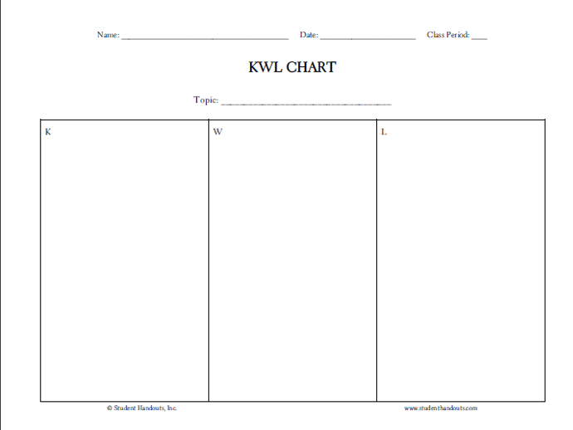
Classroom Strategies for Teaching Metacognition
KWL Charts
what they know (K);
want to know (W);
have learned (L)

