Slide 1
Tell Me Something Good!
Share something good or positive that is happening in your life right now.

Slide 2
What does a “fair” or “equitable” education system mean to you?
Think of a teacher whom you would describe as “fair” or “equitable”…
What characteristics define this teacher?

Slide 3
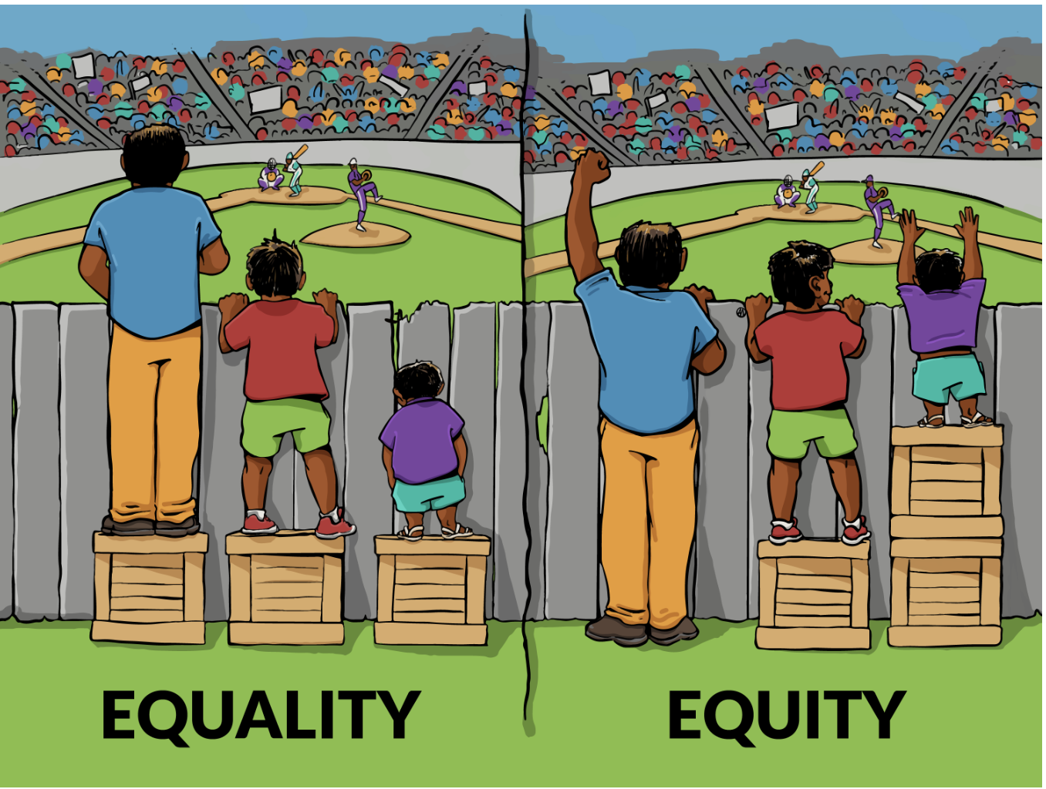
"Fair doesn't mean giving every child the same thing, it means giving every child what they need."
Rick Lavoie
What do you think the difference is between “equality” and “equity”?

Slide 4
Differentiation:
Increasing access for all learners; equitable access for all learners

Slide 5
Differentiating……CONTENT (I)
Lesson plans should cover standards set by school, district or state
Does every student come in with the same proficiency related to the standard (or standards)?
How do you differentiate the content? How do you provide equitable access to content?

Slide 6

Differentiating……CONTENT (II)
Leveled reading:
Uses assessment tools to determine reading diagnostics (comprehension, fluency, etc)
Matches students to books
Books categorized into levels of difficulty
Students can also self-regulate difficulty

Slide 7
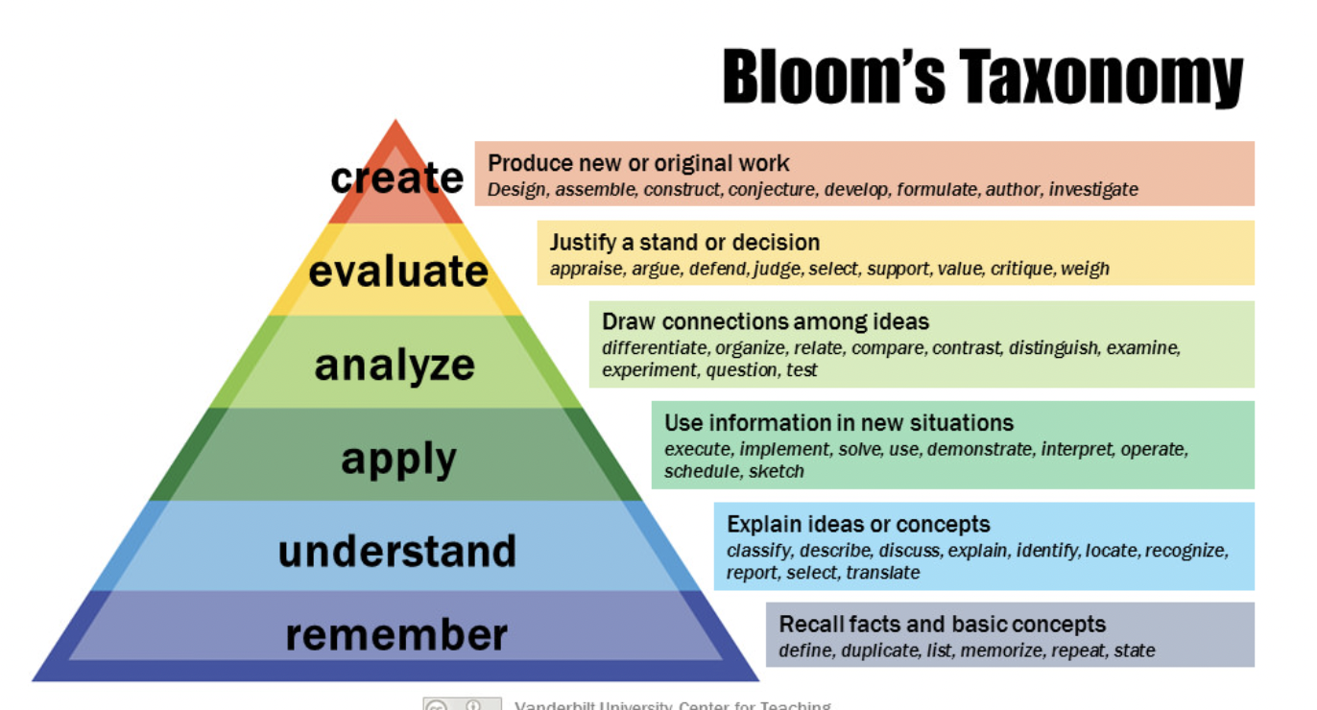

Slide 8
Differentiating……CONTENT (III)
Differentiate based on ”challenge level”
Teachers create groups based on student needs (via Bloom’s Taxonomy)
Group 1: Students who need content reinforcement or practice will complete one activity that helps build understanding. (remember, understand)
Group 2: Students who have a firm understanding will complete another activity that extends what they already know. (apply, analyze, evaluate, create)

Slide 9
Differentiating……PROCESS
The process of learning: How are you asking the students to learn?
Does every student learn the same way?
How do you differentiate the process?

Slide 10
STERNBERG’S TRIARCHIC THEORY OF INTELLIGENCE (I)
Intelligence
Analytical
Creative
Practical
Using prior knowledge to solve new problems, learn new information, make judgments (i.e. analyze)
Applying knowledge to novel & unique situations (i.e. creative)
Adapting to environment, selecting new environment
(practical)

Slide 11
STERNBERG’S TRIARCHIC THEORY OF INTELLIGENCE (II)
Content Area Declarative Knowledge | Analysis | Creative | Practical
Language Arts Describe character personality in a novel | Compare the personality of Harry Potter with Ron Weasley | Write short story with Harry Potter as main character | Describe how you would use Harry Potter’s leadership skills
Mathematics Recall formula Distance = Rate X Time | Solve word problem using D = R x T formula | Create your own math word problem using formula | Show how to use formula to estimate driving from 1 city to another
Social Studies Identify factors that led to US Civil War | Compare arguments of opposing sides in US Civil War | Write a page of journal from the viewpoint of soldiers on one side | Discuss the applicability of lessons to today’s world
Science Name main types of bacteria | Analyze how immune system fights bacteria | Suggest ways to cope with increasing immunity of bacteria to antibiotics | Suggest 3 steps to reduce chances of bacterial infection

Slide 12
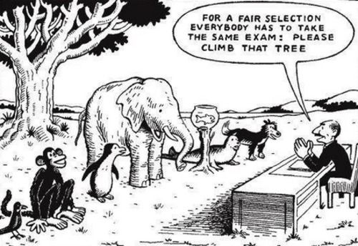
Differentiating……PRODUCT

Slide 13
Differentiating……PRODUCT (I)
“Everybody is a genius. But if you judge a fish by its ability to climb a tree, it will live its whole life believing that it is stupid.”
Albert Einstein (maybe)
Think of a class where you have been given the opportunity to demonstrate what you in know in different ways

Slide 14
Differentiating……PRODUCT (II)
Differentiating the product in ART
Do you want students to be able to differentiate between historical art periods, such as impressionism and art nouveau? Assessment options are:
(1) Students create works of art in a chosen medium that represent styles from different periods of art from history.
(2) Students write compare and contrast essay to compare two different art periods.
(3) Students design a poster using elements from a particular period of art.

Slide 15
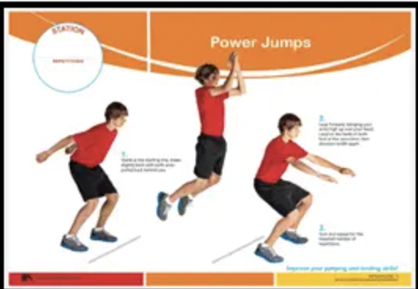
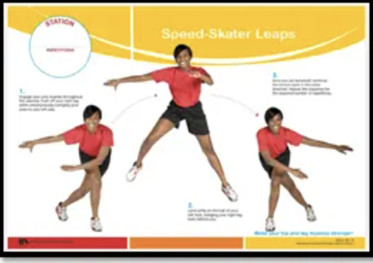
Differentiating……PRODUCT (III)
Differentiating the product in Physical Education
Do you want students to be able to develop balance and landing skills?
Power Jumps
Speed Skater Leaps

Slide 16

MN Teacher Standards:
3R: ...teachers must: identify and apply technology resources to enable and empower learners with diverse backgrounds, characteristics, and abilities.
4K: … teachers must: use educational technology to broaden student knowledge about technology, to deliver instruction to students at different levels and paces, and to stimulate advanced levels of learning

Slide 17
Given all of this:
It’s your job to ensure equitable access for all students. So this week, you’ll find some high- or low-tech-based tools to help you accomplish this goal!

Slide 18
Accessibility considerations:
Device settings (have you ever looked at all the options here? Quite amazing, actually!)
Access for specific dis/abilities (i.e. captions, wireless connections to accessibility devices, reading and writing aids, etc.)
Language supports (i.e. translators, embedded dictionaries)

Slide 19

Assistive Technology (AT)
Considerations:
AT replaces something or fills in gaps (i.e. voice to text, speech readers, speech simulators)
Other gaps to fill may include resources or materials (i.e. no internet at home, not enough textbooks for every student in the class)
Again, can be high-, medium-, or low-tech, and should be chosen based on individual students plus the demands of your classroom or content area (i.e. tools to assist students with writing tasks, mobility needs, vision or hearing needs, etc.)

Slide 20

Accessibility exemplar*: Tap Tap See
*Shared with permission

Slide 21
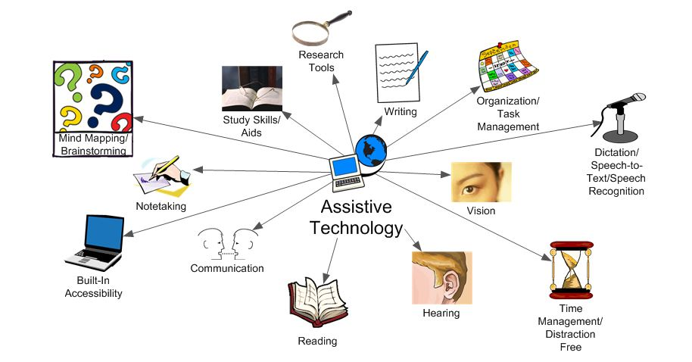
Assistive Technology ideas:
Consider tools that put something there that otherwise isn’t (i.e. captioning, voice-to-text or text-to-voice (or communication devices that create speech by the user touching buttons), translators, etc.

Slide 22
Some resources for you….
How to use technology to differentiate instruction in the classroom
3 Ways to Support Differentiation with Technology
Enhancing Learning Through Differentiated Technology (with specific technology platforms)
IXL
9 Tips for Using Technology to Differentiate Instruction in 2024

Slide 23
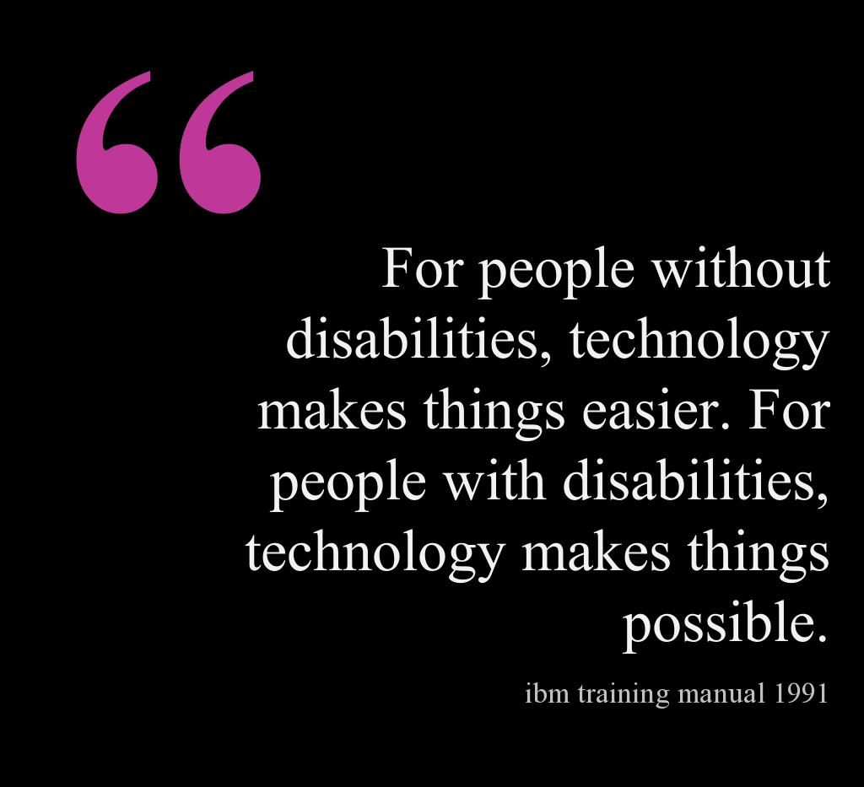

Slide 24
Same as always:
Find an app/tool to support a specific learning need or a specific app/tool that allows you to differentiate content, process or product
Tell me about the app/tool; use screen shots: Who does it serve, how does it work, what are the pros/cons of that app/tool
Tell me how you as the teacher would use it, particularly highlighting your content area/grade level you plan to teach and why your app would work in that context
Add to your website!

Slide 25
Questions?

