Slide 1
Opening Questions…Gallery Walk
STATION #1: The Digital Divide & Equity: Do you believe the reliance on technology leaves some students behind? Why or why not? (plus probing questions)
STATION #2: Social & Emotional Development: To what extent do you think technology affects the social and emotional development of students? (plus probing questions)
STATION #3: The Teacher’s Burden: To what extent do you think the reliance on technology creates or magnifies challenges faced by teachers (e.g., academic integrity/cheating)? (plus probing questions)
STATION #4: The "Instant Access" Paradox: To what extent do you believe the “instant access of information” afforded by technology affects the development of essential learning skills? (plus probing questions)
STATION #5: Beyond the Classroom: In what ways do you believe technology has affected our society (beyond the classroom)? (plus probing questions)

Slide 2
Opening Questions…Gallery Walk
Individual process –>
Small group discussion –>
Individually reflect
What…(choose one)
Did you learn?
New perspective do you now have?
What new questions do you have?

Slide 3
Learning Management Systems (LMS)
Apps & Sites to Consider...

Slide 4
Think-Pair-Share
What are some ways/things a teacher needs to “manage”?

Slide 5
Class participation
Time (Small group work)
Noise Level

Slide 6
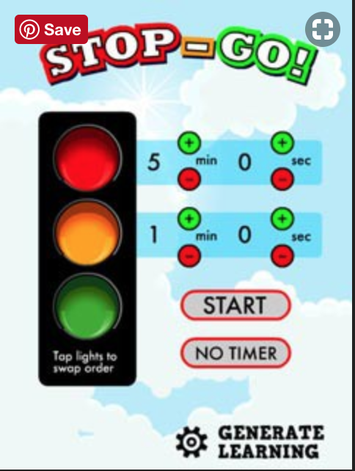

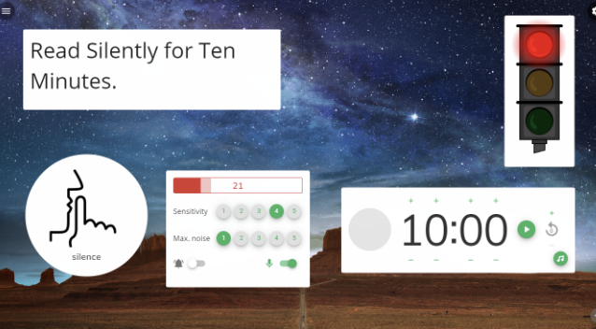
There are a range of Learning Management Tools (LMTs) from “light” apps that…
gauge classroom noise…
work timers…
randomly draw student names…

Slide 7
Student Work
Student Grades
Student Communication

Slide 8
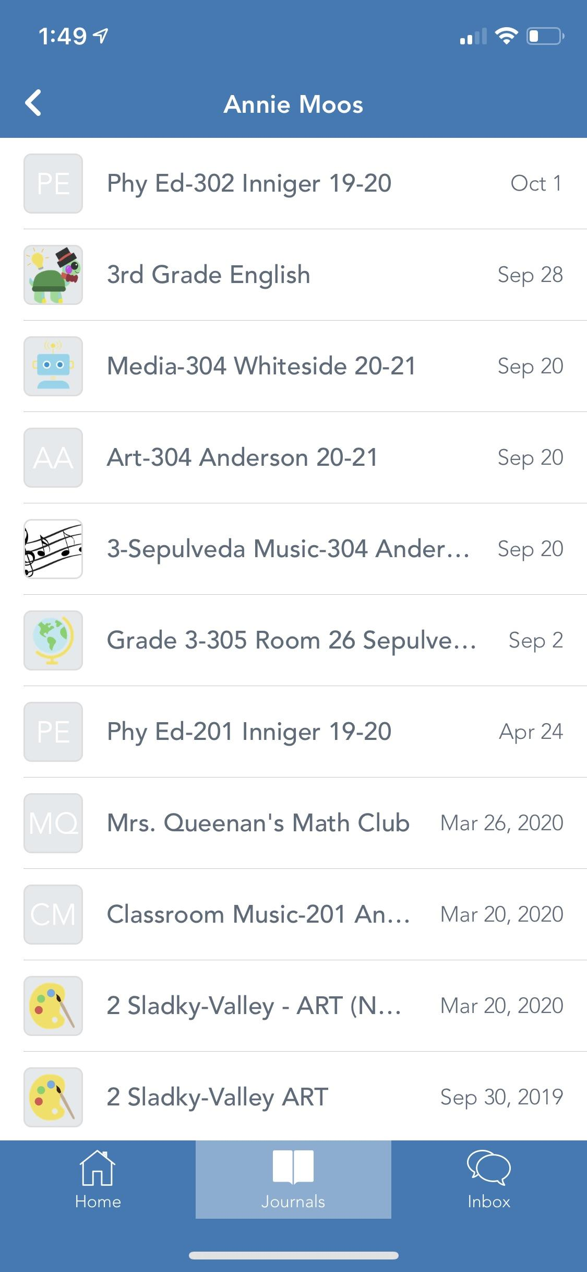
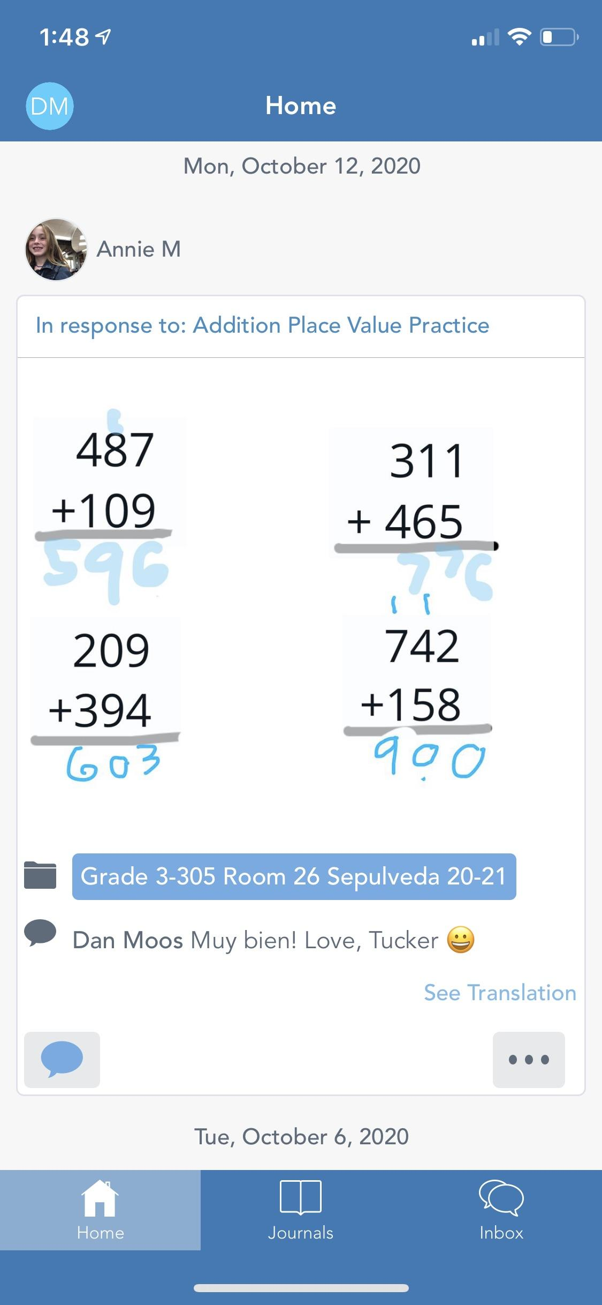
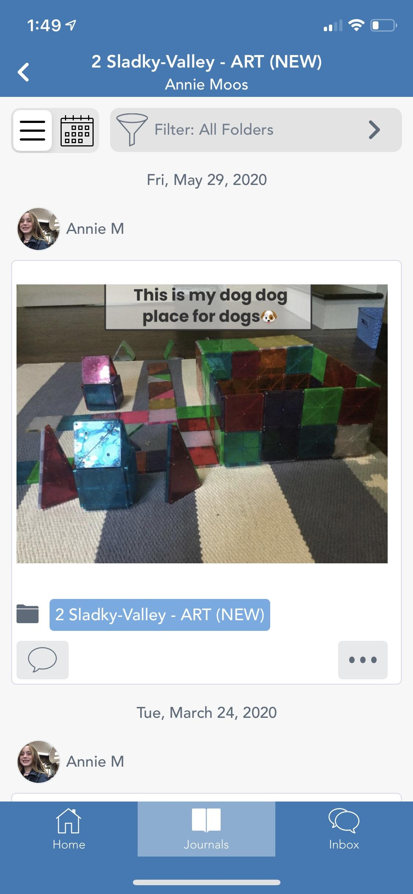
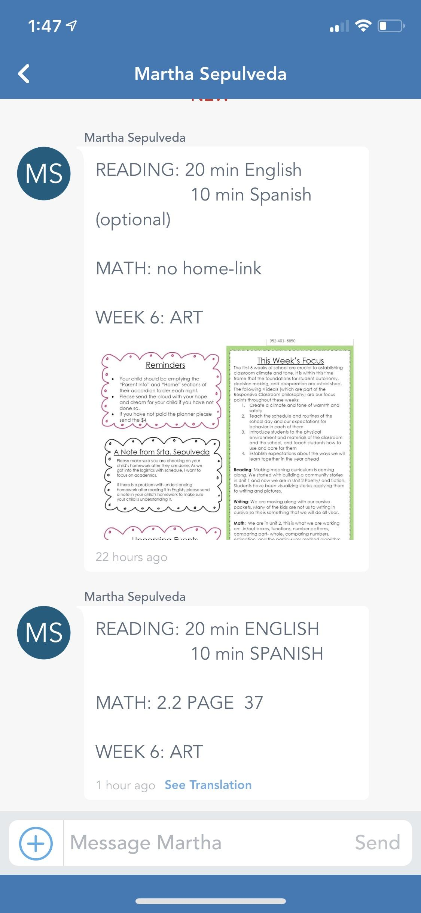
...to more involved apps
...Such as with Seesaw
Access to work done at school
Access to work done at home
Access to homework
Access to classes

Slide 9
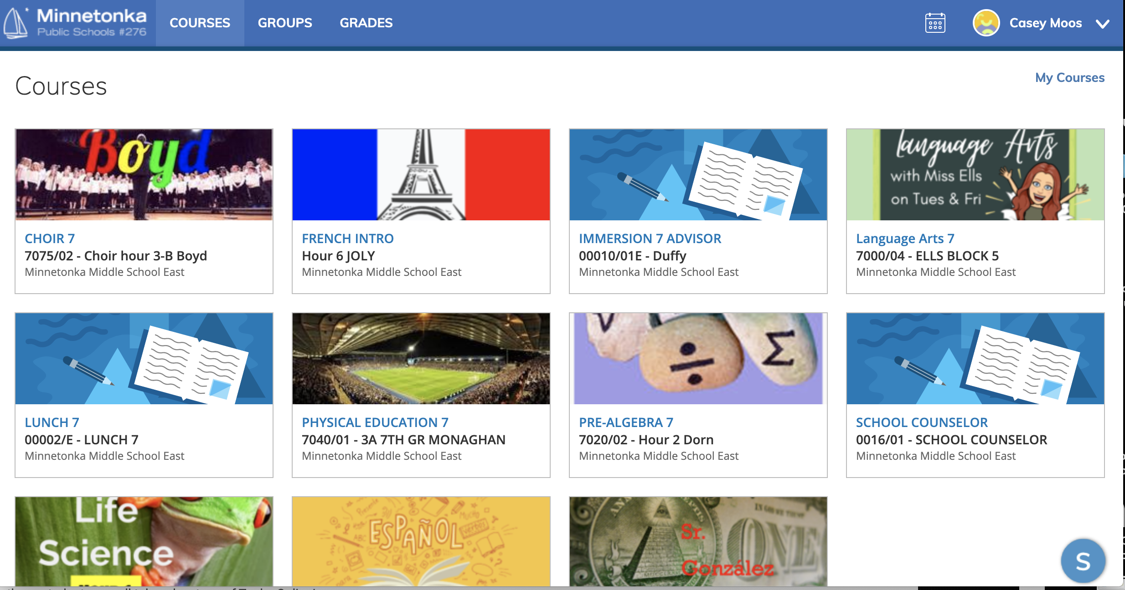
...to more involved apps
...Such as with Schoology

Slide 10
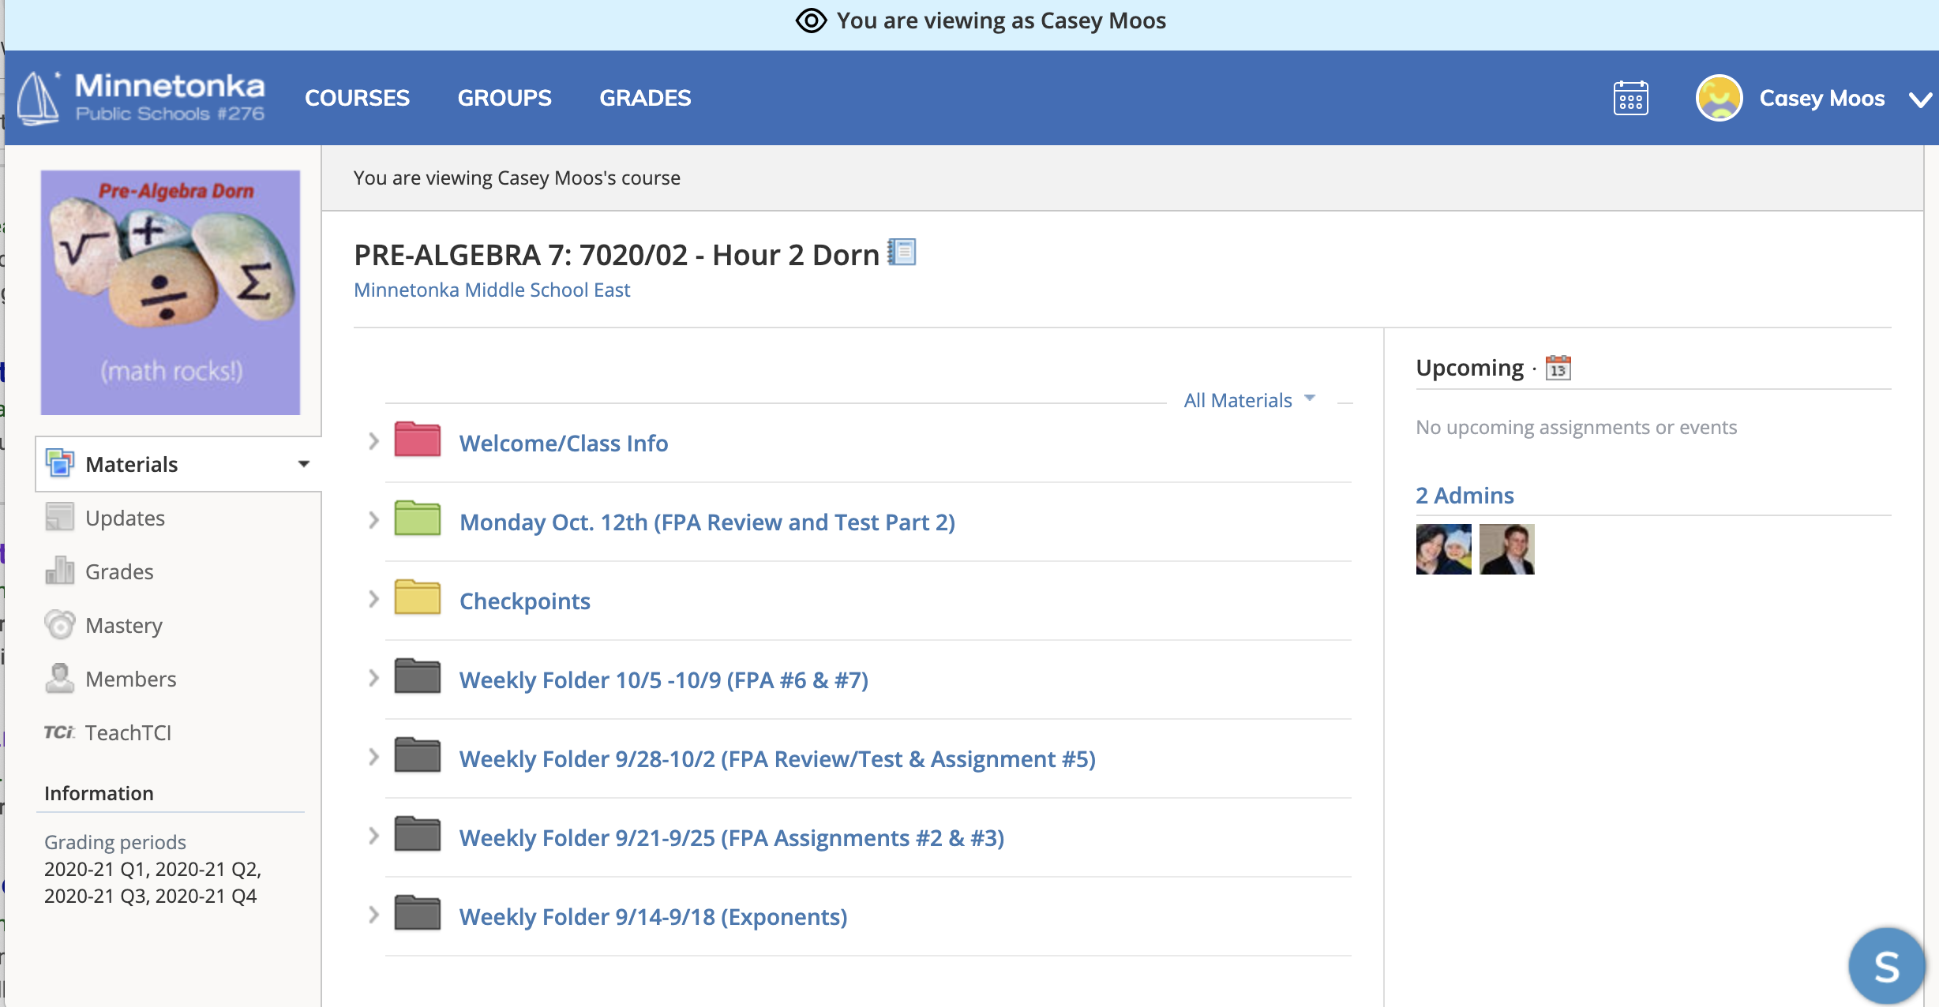
...to more involved apps
...Such as with Schoology

Slide 11
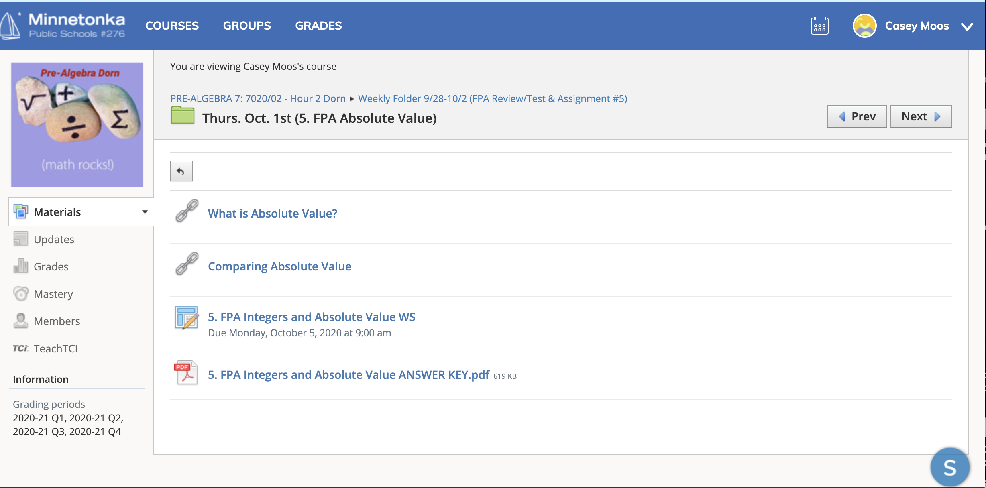
...to more involved apps
...Such as with Schoology

Slide 12
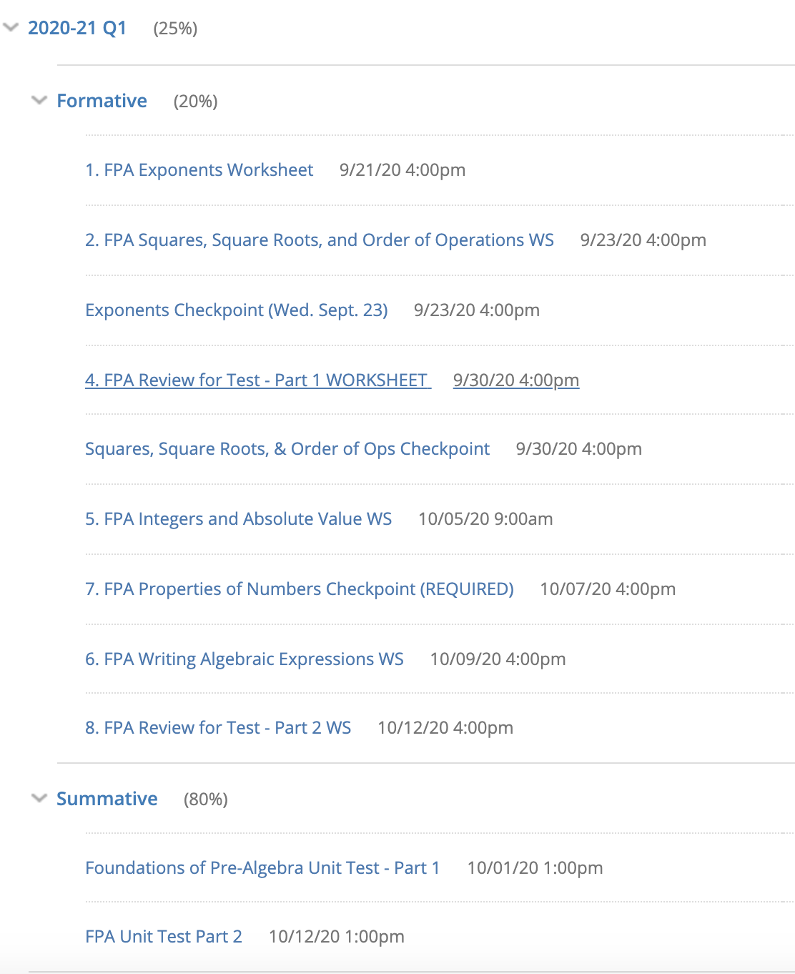
...to more involved apps
...Such as with Schoology

Slide 13
...to more apps…
...Such as with Google Classroom, Socrative, Moodle, Class Dojo (best for elementary-aged students), and several others.
*Typically you’ll be expected to use the larger management system adopted by the school that hires you, so plan now to be asked to go to trainings and other professional development to learn the software/app.
*You can get video and other information about these larger apps on YouTube to see more about what they can do. (i.e. Google Classroom here or Schoology here)

Slide 14
Other resources for Classroom management apps:
Teacher-recommended apps (note: I see Class Dojo used often, but generally more in elementary settings)
Apps for tech-savvy teachers
Kathy Schrock’s Guide to Everything (see what she suggests for a variety of management tool uses)

Slide 15
For your App exploration
&
Adding to your Website:

Slide 16
1.
If you pick the “light” tools, you must choose a minimum of THREE to describe and post to your website.

Slide 17
2.
If you choose a more involved app like Schoology, you only need to report on (and prepare a model for) ONE.
Unfortunately, Schoology and Seesaw are no longer offering free trials of the platform. So, if you choose either Schoology or Seesaw for this week's EDU 241 assignment:
(1) Research the platform via videos/articles (enough to address the rubric criteria: Describe the platform, at least two pros/cons, and how you could use the platform in your classroom). Here are two videos to get you started:
Overview of Schoology
Overview of Seesaw
(2) Add a document (word document, google slide, prezi, powerpoint, etc) that addresses the rubric criteria.

Slide 18
When you create your portfolio/website item:

Slide 19
Remember to:
Use the app to teach about the app (as much as possible). When that is NOT possible, be sure to use plenty of screenshots or images to explain and demonstrate what the app(s) can do.
Use the rubric to explain the rest (pros/cons/uses)
Upload to your websites as usual & make sure the images or links work

Slide 20
Questions?

