Slide 1
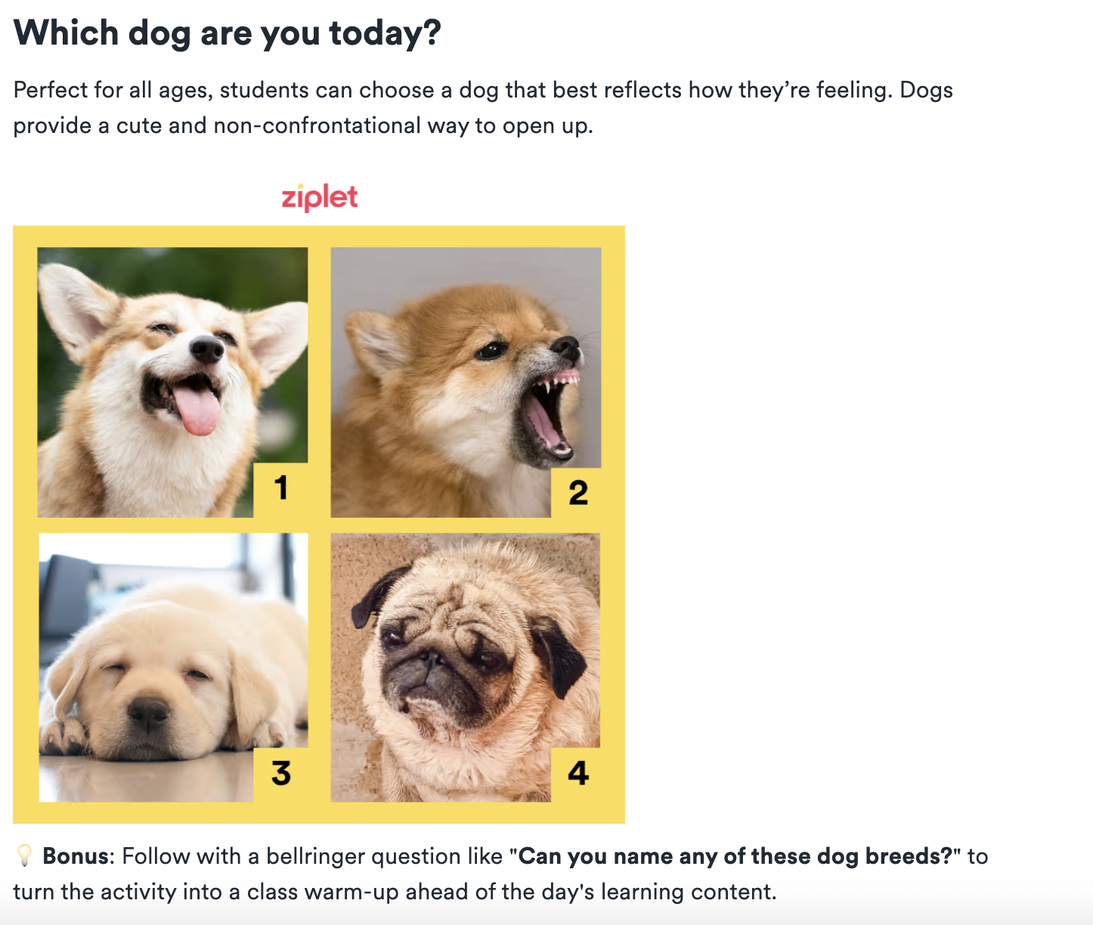
Before We Start Class…Emotional Check-In
Modeling my teaching: What is the benefit of the occasional emotional check-ins with students?

Slide 2
Opening Questions & Activity:
Activity #1: Individually respond to…
What Social Media Platforms do you use? Why?
(2) In your opinion, what are the pros of Social Media in the classroom or your personal life? Why?
(3) In your opinion, what are the cons of Social Media in the classroom or your personal life? Why?
Activity #2: Small group discussion in atrium…
Discuss your group’s responses
Record the following on the large sheet: (1) Pros/Cons; (2) List of Social Media platforms your group uses; (3) At least one Social Media Platform you think could be used effectively in the classroom and how
Activity #3 : Rotate and Respond

Slide 3
Social Media as a teaching tool
Things to consider for the classroom

Slide 4
Pros of Social Media in the Classroom:
Kids love and use social media already
It’s an easy way to communicate with parents, students & colleagues
You can connect curriculum and content to virtually anything on social media (plus make it more interesting to many students)
You can help kids be thoughtful and compassionate users of social media (i.e. reducing cyberbullying by modeling appropriate ways to treat others online)

Slide 5
Cons of Social Media in the Classroom:
Kids use social media so much anyway that this much extra screen time can be counterproductive
It is difficult to monitor what students are doing/how well (or not) they are using the apps
The temptation for students to go off task is high
Students need to be taught digital citizenship (just because students know how to use technology, does not mean they know how to use technology appropriately)

Slide 6
App-specific resources:
Do you know what-all these apps offer?!

Slide 7
Facebook
Create Facebook group for your class (privacy settings…)
Document activities/field trips (this generation loves documenting…)
Teach Digital Citizenship skills (commenting, sharing online content appropriately)
Share relevant content & Post events
Make global connections with students across the world!

Slide 8
Twitter, Instagram & Pinterest
Twitter as a class message board (character limit offers opportunity to think critically & concisely about communicating)
  Post reminders
  Share inspirational quotes
  Tweet as a historical figure
Instagram for photo essays (”digital” story telling)
Create a class-specific Pinterest board (students can pin websites, books or video on a single topic)

Slide 9
Resources
A review of Instagram (especially features to consider with kids)
Suggestions for integrating Instagram in the classroom
Cool ways educators can use this app include Museums and Science ‘grams
How teachers should use Facebook
Making better use of Facebook Groups in the classroom
12 ways teachers are using social media in the classroom right now
22 ways to use social media in the classroom
Twitter Chats (video), in particular, are popular with educators.

Slide 10
Other possible Social Media to explore on your own:
Snapchat & suggestions for using snapchat in the classroom
LinkedIn (possibly relevant for older students but more likely useful for YOU as professionals); here’s a link for LinkedInLearning, which is for-pay career-building courses
Buzzfeed (i.e. have students create quizzes based on things they’ve learned in your class)
YouTube, TikTok, and other video-based apps (using TikTok in the classroom)
Pinterest
Check out this article for even more

Slide 11
Now, just like always: pick a social Explore Social Media uses as a teaching tool, create something for your websites...
...AND, somewhere on your work, add your opinion whether you think social media can work in your future teaching context and why you think that.

