Slide 1

Riddles from Annie Moos
A cowboy rode into town on Friday. He stayed for three nights and rode out on Friday. How is this possible?
The cowboy rode in and out on a horse name is Friday.

Slide 2

Riddles from Annie Moos
What starts with a T, ends with a T and is full of T?
A Teapot

Slide 3
Riddles from Annie Moos
Which word in the dictionary is spelled incorrectly?
Incorrectly

Slide 4

Riddles from Annie Moos
I am an odd number. Take away a letter and I become even. What number am I?
Seven

Slide 5
The Science of “Forgetting”
EDU 330: Educational Psychology
Daniel Moos, PhD

Slide 6
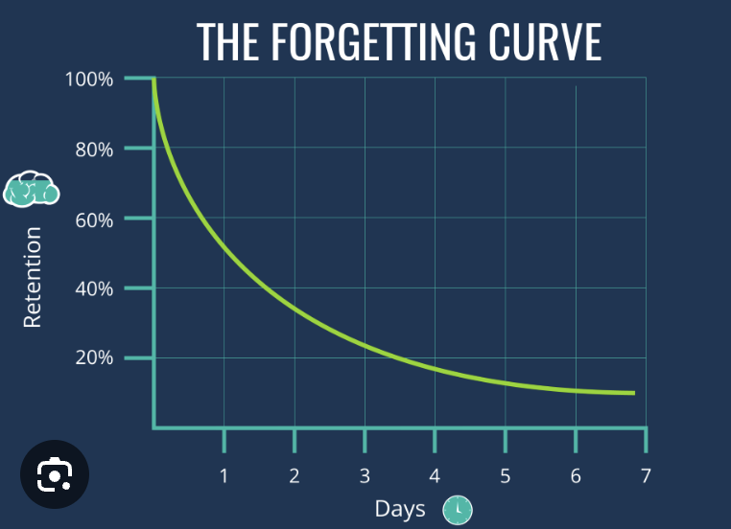
The original “Forgetting Curve”
What does this graph suggest about retention & recall over time?

Slide 7
The Updated Theory of Forgetting (I)
Storage Strength
Memory/information is stored in long term memory
Does not fade over time
Retrieval Strength
The ability to access memory/information from Long Term Memory
Retrieval strength can be improved through regular maintenance
Retrieval strength can fade – it needs regular maintenance.
Forgetting
Accessibility problem
The memory/information exists in storage, but retrieval strength too low to retrieve.

Slide 8
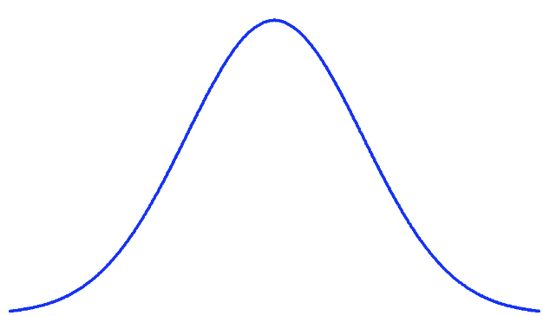
The Updated Theory of Forgetting (II)
Desirable Difficulty: “Some ‘breakdown’ must occur for us to strengthen learning when we revisit the material. Without a little forgetting, you get no benefit from further study. It is what allows learning to build, like an exercised muscle.” (Carey)
Building a muscle…
You lift a weight that challenges the muscle, which causes micro-tears and breakdown in the muscle
Given the correct recovery time, the muscle will repair itself in response to the stress (bigger & stronger)
Too much recovery– no growth
Correct recovery– Optimal growth
Not enough recovery – no growth
Spaced Repetition Approach to Studying: Optimizing time between study sessions to maximize retrieval strength and thus performance

Slide 9
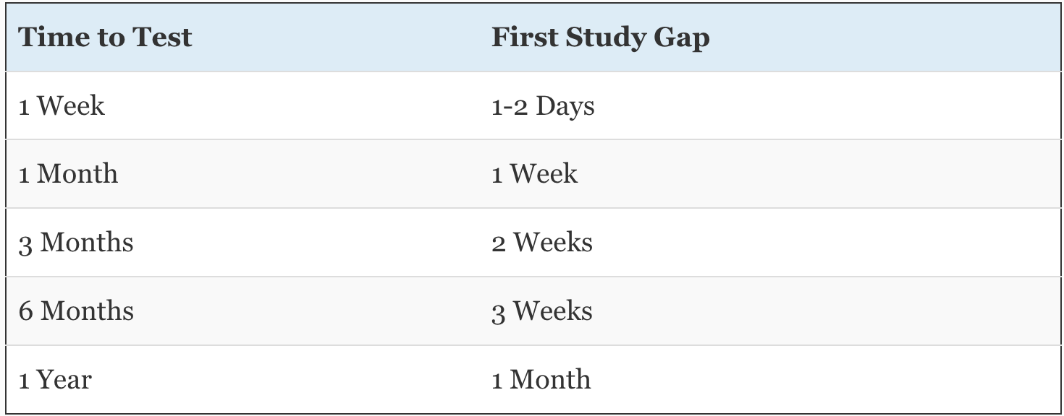
Spaced Repetition Approach
Note: these times are approximate

Slide 10
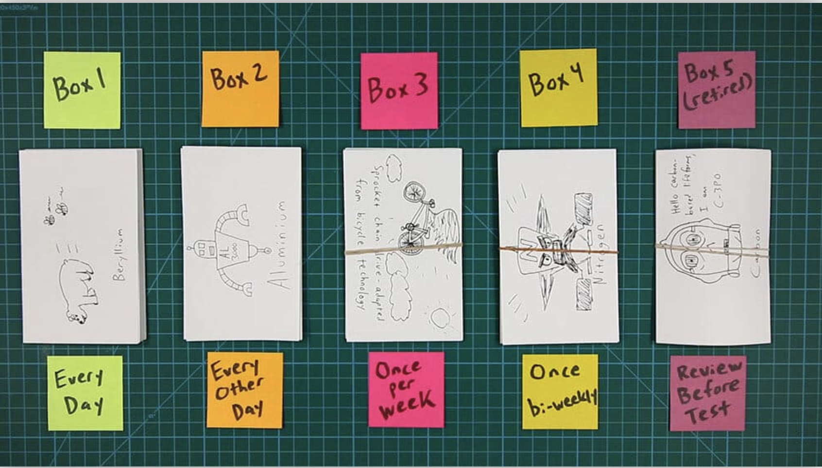
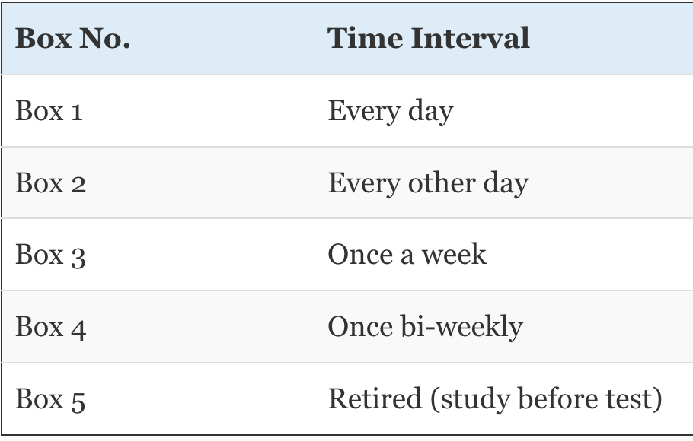
The Analog Spaced Repetition System (I)
Every card starts out in Box 1.
When you get a card right, it moves to the next box.
If you get a card wrong, it goes back to Box 1 – no matter where it was.

