Slide 1
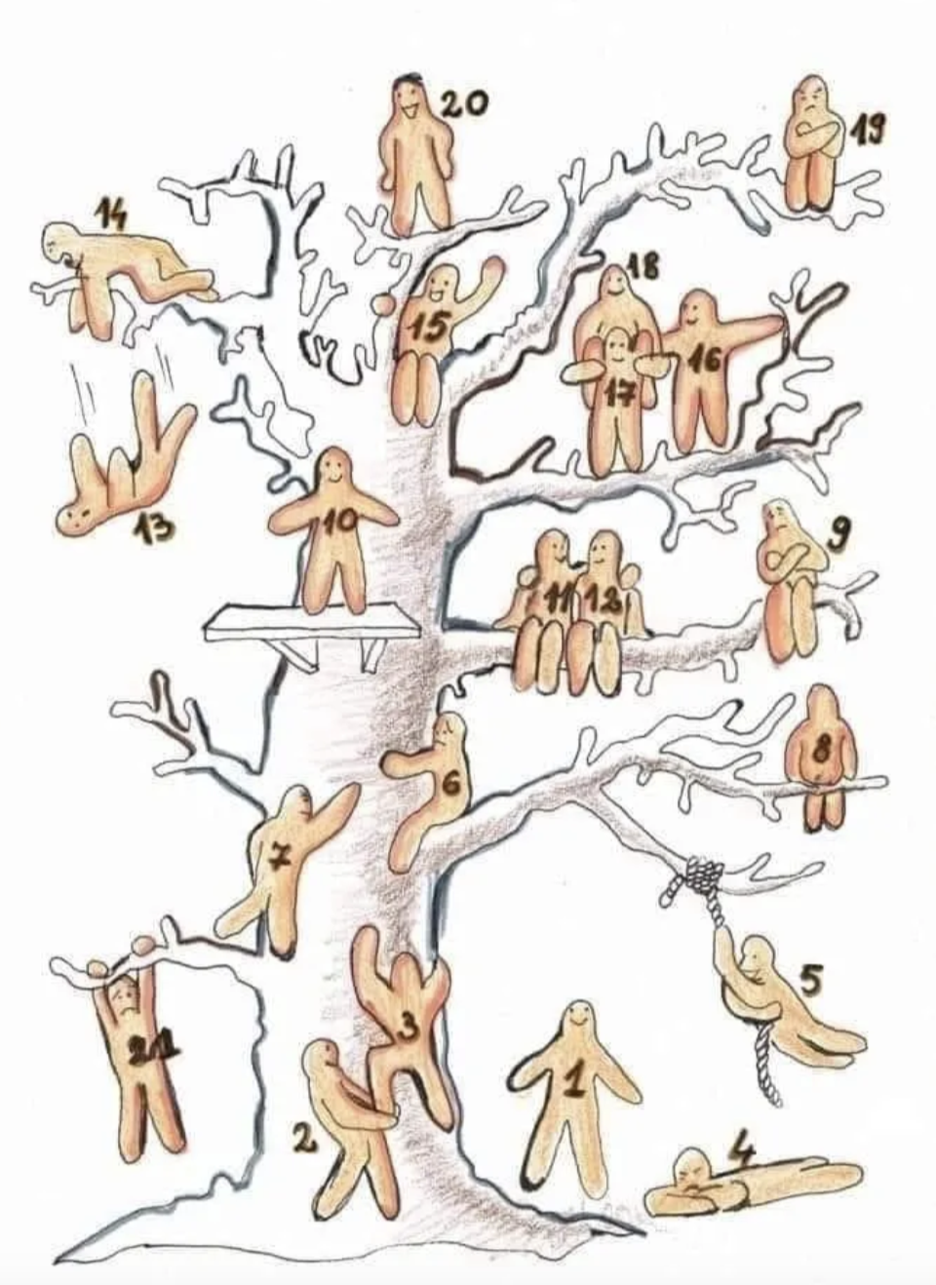
Just a few more EDU 241 classes….
What Blob represents how you are feeling?

Slide 2
Artificial Intelligence & Education
EDU 241

Slide 3
Opening Question: Turn & Talk
What is the first thing that comes to mind when you hear “artificial intelligence”?

Slide 4
What is Artificial Intelligence (AI)?
Artificial Intelligence (AI):
A field of computer science that enables machines to perform tasks typically requiring human intelligence, such as learning and problem-solving.
Generative AI:
A specific type of AI that can create new, original content, like text, images, or code. It learns patterns from vast amounts of data to generate something new.
Analogy:
Think of it like "predictive text on a massive scale" that learns from its training to create something new. (“H-e-l-l” and phone will suggest Hello)

Slide 5
How is AI being used in Education (teachers)?
Teacher’s Assistant (lesson planning & differentiation):
Quickly generate lesson plans, differentiate content for various learning levels, and create assessments based on specific learning objectives.
Saves time and introduces alternative perspectives.
Administrative Tasks:
Assist with administrative task such as drafting parent emails and creating rubrics.
Data Analysis:
Analyze student data to identify learning trends and inform instructional decisions.

Slide 6
How is AI being used in Education (teachers)?
Brisk (link) : Create guided notes, rubrics, lab worksheet, syllabi, differentiation
Eduaide: (link): Lesson plans, learning activities, worksheets, games & quizzes
MagicSchool (link) : Course planning, assignments, rubrics, games, Youtube summaries

Slide 7
How is AI being used in Education (teachers)?
Diffit (link) : Reading & writing strategies, text analysis, concept maps, summaries, note-taking
ColleagueAI (link) : Generate slides, podcasts, images, leading discussions, syllabi, reference letters
SchoolAI (link): Rubrics, worksheets, course outlines, reference letters, text translators

Slide 8
How is AI being used in Education (students)?
Personalized Tutor:
24/7 guidance on complex problems or offering simplified explanations of difficult concepts.
Writing & Research Support:
Brainstorming, outlining essays, generating writing prompts, or summarizing long texts to aid comprehension.
Language Learning Support:
Provide real-time feedback on pronunciation and grammar.

Slide 9
How is AI different than Search Engines?
For Students:
Essay on Great Gatsby
For Teachers:
Lesson Plans on nouns

Slide 10
Let’s Explore AI!
Remember:
AI is a tool - the quality of the output depends on the quality of their input.
Look for potential errors, inaccuracies or biases in AI’s responses
Use the provided prompt to explore either ChatGPT or Gemini
Try different wording, add constraints and vary input (“be concise”, “use bullet points”, “provide more or less information on____”, etc) to see how results change
Feel free to work by yourself or in a small group
Class debrief after each prompt:
How did the AI's response change when you rephrased your prompt or added more detail?
What was the most impressive thing the AI did?
Did the AI get anything wrong or give you a response that felt "off"? If so, what was it?
In what ways was the AI's response helpful for the task? In what ways was it not helpful?

Slide 11
Let’s Explore AI: Prompt #1 (teacher support/saving time)
You are a 4th-grade teacher.
Create a 45-minute lesson plan on the water cycle that includes a hands-on activity and an assessment.
Vary input to see how results change
How did the AI's response change when you rephrased your prompt or added more detail?
What was the most impressive thing the AI did?
Did the AI get anything wrong or give you a response that felt "off"? If so, what was it?
In what ways was the AI's response helpful for the task? In what ways was it not helpful?

Slide 12
Let’s Explore AI: Prompt #2 (differentiate instruction)
Prompt AI to explain the process of photosynthesis.
First, ask for a basic explanation that a student new to the topic could understand.
Then, ask it to provide a more detailed and complex explanation that would challenge a student who has already mastered the basics.
Vary input to see how results change
How did the AI's response change when you rephrased your prompt or added more detail?
What was the most impressive thing the AI did?
Did the AI get anything wrong or give you a response that felt "off"? If so, what was it?
In what ways was the AI's response helpful for the task? In what ways was it not helpful?

Slide 13
Let’s Explore AI: Prompt #3 (AI Creativity)
Draft a short story about a talking platypus. The story should have three plot twists.
Vary input to see how results change
How did the AI's response change when you rephrased your prompt or added more detail?
What was the most impressive thing the AI did?
Did the AI get anything wrong or give you a response that felt "off"? If so, what was it?
In what ways was the AI's response helpful for the task? In what ways was it not helpful?

