Slide 1
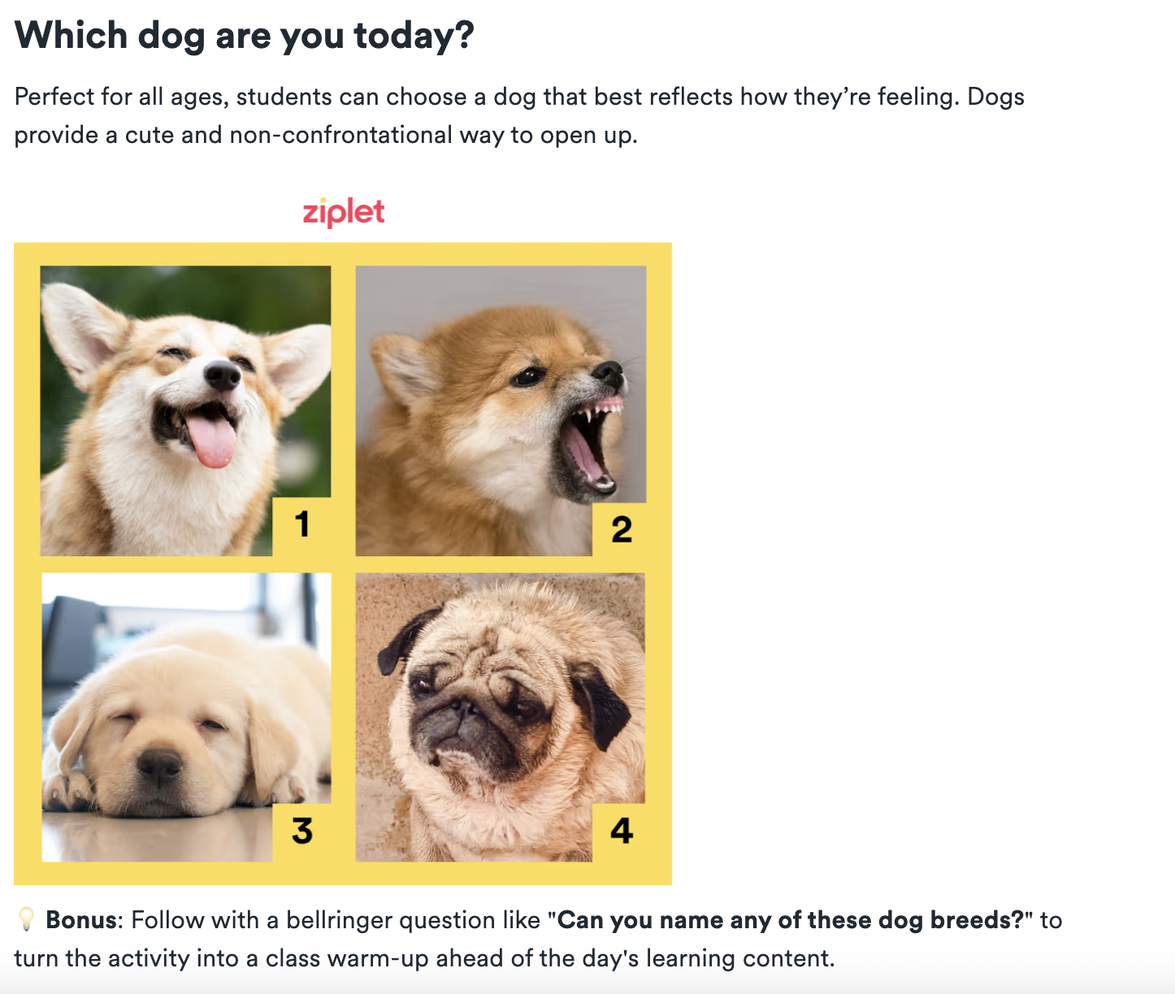
Before We Start Class…Emotional Check-In
What dog are you today?

Slide 2
Social Media as a teaching tool
Things to consider for the classroom

Slide 3
Opening Questions & Activity:
What social media platforms are you most active on & what do you use them for?
Brainstorm as many ways as possible that a teacher could use social media platforms (e.g., Twitter, Instagram, class blogs) to support learning, rather than just for entertainment.
Categorize each use as one of the following: Content Delivery, Collaboration, Assessment, Community Building

Slide 4
Gallery Walk: Ethical Considerations
Station #1: What are the risks or potential challenges of bringing social media into the classroom?
Station #2: How would you handle issues like cyberbullying or a student posting inappropriate content?
Station #3: What are the privacy concerns for both students and teachers with social media?
Station #4: How does the concept of a "digital footprint" apply to the classroom?
Station #5: How might the use of social media in the classroom affect existing inequities, such as the digital divide or access to technology?

Slide 5
Gallery Walk: Ethical Considerations
Digital Footprint: Trail of data you left as a result of online activity: Record of internet usage, and it's something that can persist long after the original content is created or viewed.
Active digital footprints: Data that you intentionally share, such as social media posts, comments on blogs, or online profiles you create.
Passive digital footprints: Data that is collected without your direct knowledge, such as your browsing history, location data from your phone, or your IP address.
Digital Divide: The gap between those who have access to and a working knowledge of current technology, and those who do not.
It's not just about having a device; it also includes reliable internet access, the skills to use
the technology effectively, and the digital literacy to navigate it safely.
In the Classroom: Some students may have high-speed internet and their own laptop at
home, while others may only have access to a public library computer or a parent's phone, which can create significant inequities in their ability to complete assignments or participate in online learning.

Slide 6
General Examples of Social Media in the Classroom
Project-Based Learning & Creative Expression
  Instagram & TikTok: Students create short videos or carousels (multi-photo posts) to demonstrate their understanding of a topic.
    For a history class, students could create an Instagram account for a historical figure and post "artifacts" and "stories" from their perspective.
    For a science class, a student could create a short TikTok video explaining a concept like photosynthesis using a popular trend.
  Blogging: Students create individual or class blogs to serve as digital journals or portfolios. They can post weekly reflections on readings, share their research, and receive feedback from peers in the comments. This is a great way to practice writing skills and develop a strong "digital footprint" in a controlled environment.

Slide 7
General Examples of Social Media in the Classroom
Communication & Collaboration
  Private Facebook Groups: Teachers can create a private group for a class to share announcements, post homework assignments, or host real-time Q&A sessions. Students can ask questions outside of class time and collaborate on group projects.
  Twitter (now X): The character limit of Twitter supports concise writing; teachers can use it for "micro-blogging" assignments, such as a "Twitter essay" where students explain a complex topic in a series of short, linked tweets. Teachers can also use a class-specific hashtag to facilitate discussions and share relevant links or articles.

Slide 8
General Examples of Social Media in the Classroom
Media Literacy & Digital Citizenship
  Evaluating Information: Students can be tasked with fact-checking a viral post, analyzing a source's credibility, and presenting their findings.
Connecting Beyond the Classroom
  YouTube: Teachers can use it to supplement lessons with videos from popular educational channels like TED-Ed. Students can also be assigned to create their own educational videos to present to the class, developing skills in scriptwriting, video production, and public speaking.
  Connecting with Experts: Teachers can use social media to connect their students with professionals and experts.
    An English class could host a live Q&A with an author on Instagram Live, or a science class could interview a scientist via a private video call.

Slide 9
Specific Examples of Social Media in the Classroom
Early Elementary (Grades K-1): A teacher uses a private class Flip (formerly Flipgrid) space where students record short video reflections, such as “What was your favorite part of today’s story?” or “Show us how you solved this math problem.” Families and classmates can respond with short videos or emojis.
Elementary School (Grade 4): A science teacher uses a private Instagram (or class Padlet with image posts) to document the class garden’s progress. Students take turns as “garden reporters,” uploading photos with captions explaining plant growth and observations.
Middle School (Grade 8): A Social Studies teacher uses a class Twitter simulation to “live-tweet” the Constitutional Convention, with students role-playing delegates. Each student account represents a historical figure, posting opinions and responding to peers as if debating in real time.
High School (Grade 10): An English literature teacher sets up a private class blog (WordPress, Edublogs, or Google Sites) where students publish short story drafts and leave structured peer feedback in the comments.
High School (Grade 12): An art teacher uses a Pinterest board where students curate visual inspiration for final projects. Peers provide comments on boards to encourage, critique, or suggest ideas.

Slide 10
Resources
Suggestions for integrating Instagram in the classroom
Cool ways educators can use this app include Museums and Science ‘grams
How teachers should use Facebook
Making better use of Facebook Groups in the classroom
12 ways teachers are using social media in the classroom right now
22 ways to use social media in the classroom
Twitter Chats (video), in particular, are popular with educators.
Suggestions for using snapchat in the classroom
YouTube, TikTok, and other video-based apps (using TikTok in the classroom)

Slide 11
Now, just like always: pick a social Explore Social Media uses as a teaching tool, create something for your websites...
...AND, somewhere on your work, add your opinion whether you think social media can work in your future teaching context and why you think that.

