Slide 1

Classroom Assessment:
Reliability & Validity
EDU 330: Educational Psychology
Daniel Moos, PhD

Slide 2

What do you see?
Please do not say it out loud…

Slide 3
How does this activity connect to today’s class on assessment?
You decide what the frame of reference (old or young person) to observe
This frame of reference dictates your story
____________________________
A teacher decides a frame of reference (type of assessment) to observe student learning & behavior
This assessment determines the teacher’s understanding of learning & behavior
“Valid” and “reliable” assessments offer a more accurate understanding of learning & behavior

Slide 4
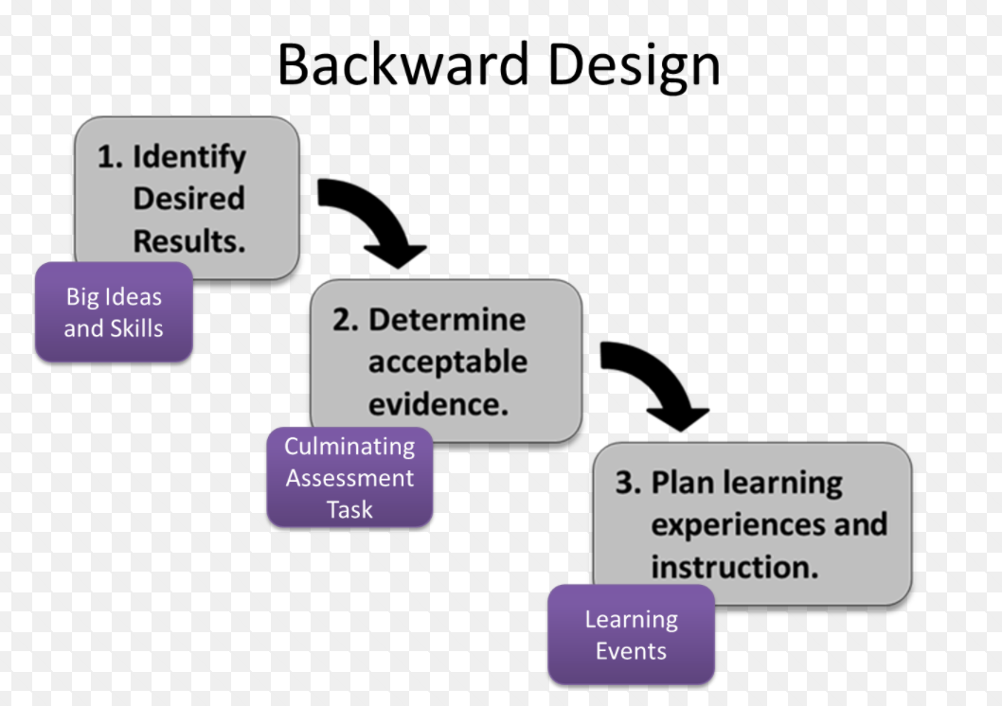
How Should We Assess Student Learning?
Incorporate valid & reliable assessments
Notes:
3

Slide 5


1. The Core Definitions
If you remember nothing else, remember these two words.
Reliability
Validity
Does the assessment produce CONSISTENT results?
Does the assessment measure the TRUTH?
I am evaluating all of my students consistently and fairly?
Does this assignment actually measure what I taught? Or is it measuring other variables (eg reading speed or handwriting)?
Educational Psychology: Assessment 101

Slide 6



A real-world example of validity & reliability
Imagine my dog Tucker weighs exactly 60 lbs and you weigh Tucker on the same scale five times.
Scenario A:
60, 60, 60, 60, 60
Is this scale reliable? Is this scale valid?
Result: Highly Reliable (consistent), Highly Valid (accurate)
•
Scenario B:
40, 65, 45, 55, 50.
Is this scale reliable? Is this scale valid?
Result: Low Reliability (inconsistent) and Low Validity (inaccurate)
•
Scenario C:
70, 70, 70, 70, 70.
Is this scale reliable? Is this scale valid?
Educational Psychology: Assessment 101
Result: Highly Reliable (consistent), Low Validity (inaccurate)
•

Slide 7
What can teachers do to ensure their assessments are valid?
  1. Deconstruct the standards (i.e. break the standards into learning targets)
  2. Align learning targets and potential assessment items
  3. Offer multiple types of assessments to students
Notes:
3

Slide 8
What can teachers do to ensure their assessments are reliability?
  1. Grade item by item (allows teacher to apply the same set of criteria to all students)
  2. Grade anonymously (help combat biases, which can positively or negatively affect evaluations)
  3. Design a rubric or checklist (assists teacher in focusing on the same criteria for all students)
Notes:
3

Slide 9
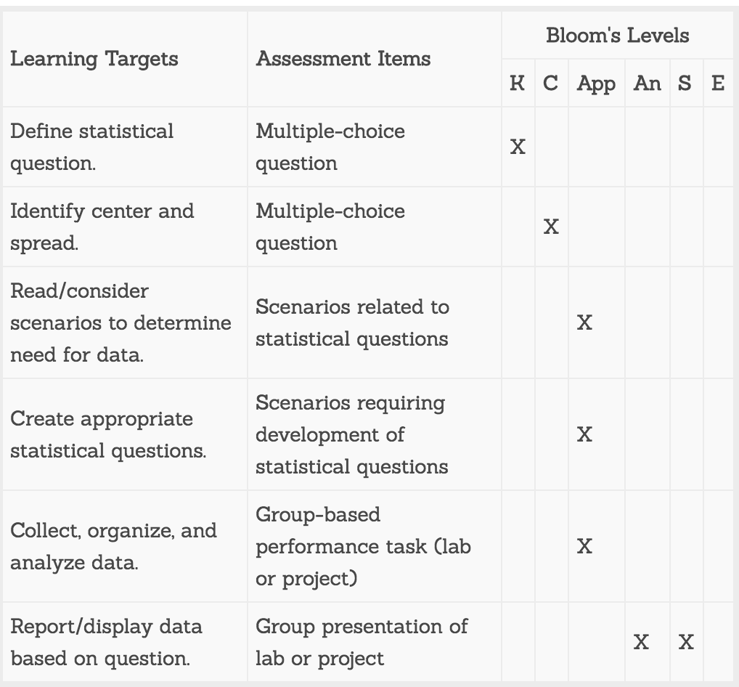
What can teachers do to ensure their assessments are valid & reliable?
The teacher aligned the assessments with the learning targets. Does that process assist with validity or reliability?
What could the teacher do to ensure reliability when evaluating these assessments?
Knowledge, Comprehension, Application, Analysis, Synthesis, & Evaluation
Notes:
3

Slide 10
In Your Classroom: What are threats to reliability & validity
Threats to Reliability
Threats to Validity
•
Ambiguous Questions and/or evaluation tools: Students guess because the wording is confusing and/or your evaluation tool does not support consistent evaluation
•
Poor Content Match: EG: You taught the Civil War, but the test is mostly about the Revolutionary War.
•
•
Construct Irrelevance: EG: A math word problem is so wordy that it becomes a reading test, not a math test.
•
Grader Drift & Bias: You grade easier after lunch than before lunch and/or biases towards towards a students
•
Bias: References that only some cultural groups understand.
Environment & personal factors: It's too hot, too loud, or you are hANGRY!
Educational Psychology: Assessment 101

Slide 11

Rubrics: One strategy to ensure validity & reliability
For RELIABILITY
For VALIDITY
A specific rubric ensures that grading is consistent.
A specific rubric ensures we are grading the right thing.
•
It prevents "Grader Drift" (grading harder before lunch).
•
It prevents us from grading "handwriting" when we meant to grade "scientific understanding."
•
It ensures Student A gets the same grade as Student B for the same work.
•
It forces the teacher to align the criteria with the Learning Objectives.
Educational Psycology: Assessment Design

Slide 12


The Anatomy of a Rubric
Moving beyond "It just feels like a B"
An analytic rubric has three specific parts. Understanding these parts is the first step to Reliability.
1. Criteria (The Rows)
2. Levels (The Columns)
What are the essential skills or knowledge you are measuring?
The scale of mastery.
Example: 4 (Exemplary), 3 (Proficient), 2 (Developing), 1 (Beginning).
Example: Thesis Statement, Organization, Evidence.
3. Descriptors (The Cells)
Specific descriptions of what performance looks like at each level.
This is where reliability lives or dies.
Educational Psychology: Assessment Design

Slide 13
Four Steps to Building It
How to draft a rubric from scratch
1. Identify the Learning Target: What standard are you assessing? (e.g., "Students can support a claim with evidence.")
2. Select Your Criteria: Break that target into 3-5 distinct sub-skills. (e.g., "Relevance of Evidence," "Citation Format," "Integration of Quote").
3. Define the Extremes FIRST:
Write the descriptor for the Top Score (Target/Perfect).
Write the descriptor for the Lowest Score (Missing/Wrong).
4. Fill in the Middle: Describe the gap. What is the difference between ”Exceeds Expectations" and "Almost there"?

Slide 14


The Golden Rule of Descriptors
Avoid subjective adjectives to increase Reliability
🚫 The Danger Zone (Low Reliability)
✅ The Safe Zone (High Reliability)
Use observable, concrete language:
Avoid vague, subjective words:
•
"Includes 3 distinct sources"
•
"Creative"
•
"Connects claim to evidence using a 'because' statement"
•
"Interesting"
•
"Good effort"
•
"Zero grammatical errors"
•
"Adequate"
Why? My definition of "interesting" is different than yours.
If two teachers read the descriptor, would they give the same score?
Educational Psychology: Assesment Design

Slide 15
Warm-Up Example: The "Cookie"
Improving Validity through specific language
The Task: Bake a Chocolate Chip Cookie
Criteria | Bad Descriptor (Vague) | Good Descriptor (Specific)
Texture | The cookie tastes good and has a nice texture. | Cookie is chewy in the center and crisp on the edges. It does not crumble when held.
Chocolate Distribution | There is a fair amount of chocolate. | Every bite contains at least one chocolate chip. Chips are evenly distributed, not clumped.
Appearance | The cookie looks yummy. | Cookie is golden-brown. Diameter is between 3 and 4 inches.
Choose one criteria. Write a “bad” descriptor and a “good” descriptor
What differentiates the “bad” and “good” descriptors?
Review: The column on the right allows for Inter-Rater Reliability. The column on the left is purely opinion.
Educational Psychology: Assessment Design

Slide 16
Actual Classroom Example
High School English: Persuasive Research Essay
Criteria | 4: Exemplary | 3: Proficient (Target) | 2: Developing
Use of Evidence (Validity: Assessing Research Skills) | Incorporates 3+ distinct sources. Every claim is supported by direct textual evidence. Quotes are embedded naturally into sentences. | Incorporates 2 distinct sources. Most claims are supported by textual evidence. Quotes may stand alone as separate sentences ("dropped quotes"). | Incorporates 1 or fewer sources. Claims rely on opinion rather than evidence. Citations are missing or incorrect.
Analysis / Commentary (Validity: Assessing Critical Thinking) | Commentary explains how the evidence proves the claim. Commentary is at least 2x the length of the evidence. | Commentary summarizes the evidence rather than analyzing it. Connection to the claim is present but may be generic. | Commentary is missing or merely repeats the evidence. No clear connection to the main claim.
What is the difference between "Proficient" and "Exemplary”?
*Why this works: A second teacher could count the sources and check the citation format to arrive at the exact same score (High Reliability).

Slide 17
Application #1: 4 Corners Discussion
Topic #1: Effort should be assessed and used to evaluate students
Commit to a position: A (strongly agree), B (agree), C (disagree), D (strongly disagree)
Discuss:
Reliability, Validity, Growth/Fixed mindset, Controllable/Uncontrollable attributions
Does content and/or developmental factors matter?
Topic #2: Class participation should be assessed and used to evaluate students
Commit to a position: A (strongly agree), B (agree), C (disagree), D (strongly disagree)
Discuss:
Reliability, Validity, Content, Developmental factors?

