Slide 1
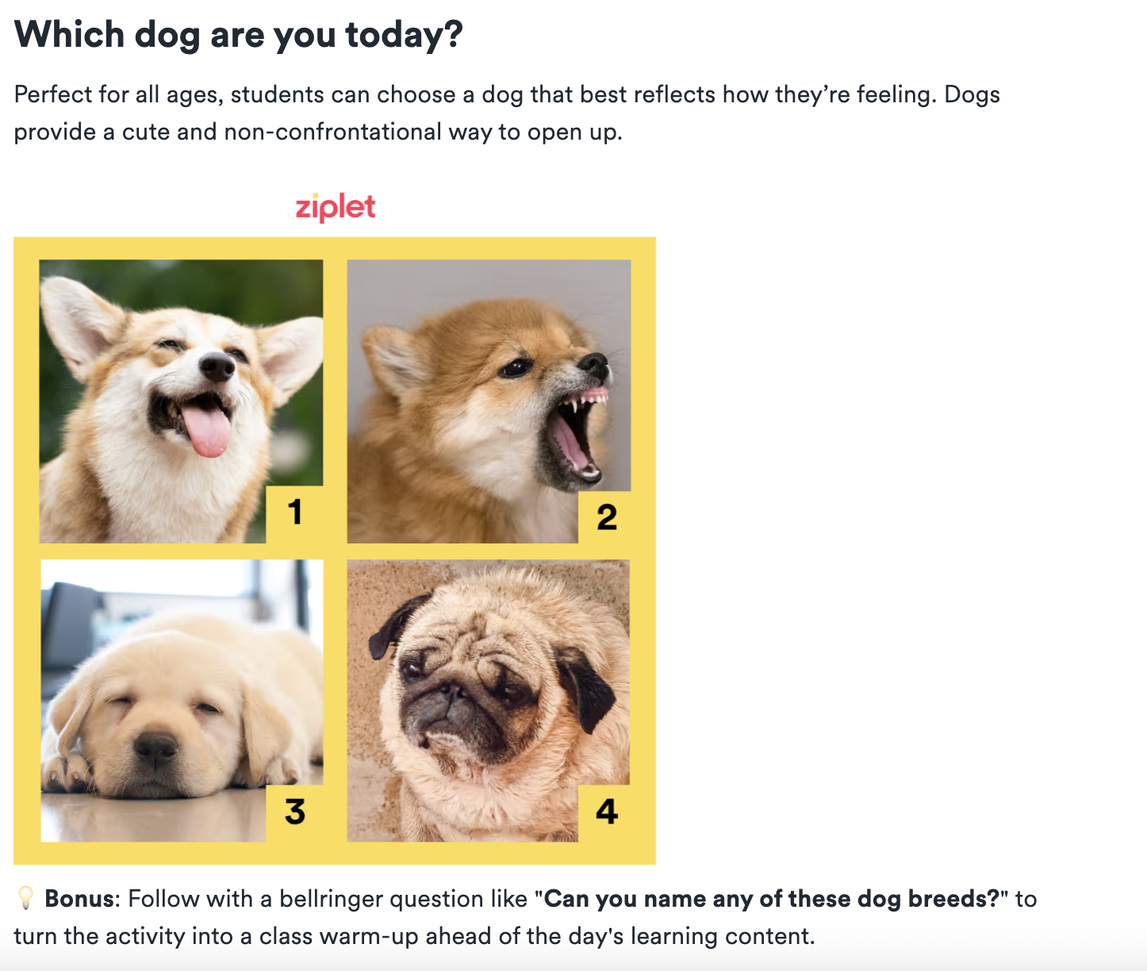
Before We Start Class…Emotional Check-In
What dog are you today?

Slide 2
Social Media as a teaching tool
Things to consider for the classroom

Slide 3
Opening Questions & Activity:
What social media platforms are you most active on, and what do you use them for?
Come up with as many ways as you can think of that a teacher could use specific social media platforms (eg Twitter, Instagram, Class Blog, etc) for learning rather just entertainment.
Categorize each use as one of the following: Content Delivery, Collaboration, Assessment, Community Building

Slide 4
Gallery Walk: Ethical Considerations
Station #1: What are the risks or potential challenges of bringing social media into the classroom?
Station #2: How would you handle issues like cyberbullying or a student posting inappropriate content?
Station #3: What are the privacy concerns for both students and teachers with social media?
Station #4: How does the concept of a "digital footprint" apply to the classroom?
Station #5: How might the use of social media in the classroom affect existing inequities, such as the digital divide or access to technology?

Slide 5
Gallery Walk: Ethical Considerations
Digital Footprint: Trail of data you left as a result of online activity: Rrecord of internet usage, and it's something that can persist long after the original content is created or viewed.
Active digital footprints: Data that you intentionally share, such as social media posts, comments on blogs, or online profiles you create.
Passive digital footprints: Data that is collected without your direct knowledge, such as your browsing history, location data from your phone, or your IP address.
Digital Divide: The gap between those who have access to and a working knowledge of current technology, and those who do not.
It's not just about having a device; it also includes reliable internet access, the skills to use
the technology effectively, and the digital literacy to navigate it safely.
In the Classroom: Some students may have high-speed internet and their own laptop at
home, while others may only have access to a public library computer or a parent's phone, which can create significant inequities in their ability to complete assignments or participate in online learning.

Slide 6
Specific Examples of Social Media in the Classroom
Early Elementary (Grades K-1): A teacher uses a private class Seesaw account to share student work with parents and allow families to leave encouraging comments.
Elementary School (Grade 4): A science teacher uses a private class Instagram account to document the growth of a class garden.
Middle School (Grade 8): A Social Studies teacher uses Twitter to "live-tweet" a historical event, such as the Constitutional Convention, from the perspective of a delegate.
High School (Grade 10): An English literature teacher uses a private class blog to share and provide feedback on short story drafts.
High School (Grade 12): An art teacher uses a class Pinterest board to have students create visual inspiration boards for their final projects and provide peer feedback.

Slide 7
Resources
A review of Instagram (especially features to consider with kids)
Suggestions for integrating Instagram in the classroom
Cool ways educators can use this app include Museums and Science ‘grams
How teachers should use Facebook
Making better use of Facebook Groups in the classroom
12 ways teachers are using social media in the classroom right now
22 ways to use social media in the classroom
Twitter Chats (video), in particular, are popular with educators.

Slide 8
Other possible Social Media to explore on your own:
Snapchat & suggestions for using snapchat in the classroom
LinkedIn (possibly relevant for older students but more likely useful for YOU as professionals); here’s a link for LinkedInLearning, which is for-pay career-building courses
Buzzfeed (i.e. have students create quizzes based on things they’ve learned in your class)
YouTube, TikTok, and other video-based apps (using TikTok in the classroom)
Pinterest
Check out this article for even more

Slide 9
Now, just like always: pick a social Explore Social Media uses as a teaching tool, create something for your websites...
...AND, somewhere on your work, add your opinion whether you think social media can work in your future teaching context and why you think that.

