Slide 1
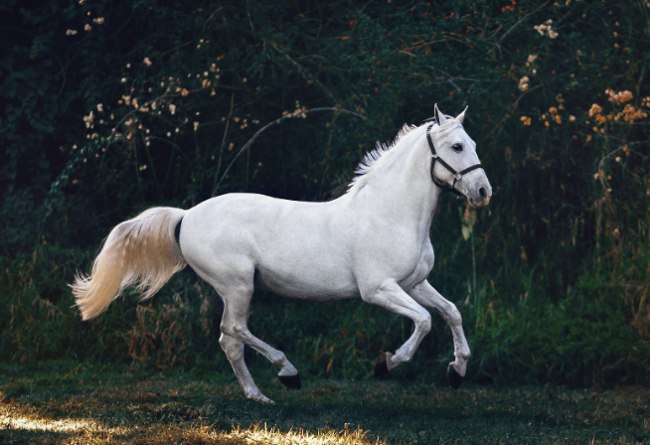
Riddles from Annie Moos
A cowboy rode into town on Friday. He stayed for three nights and rode out on Friday. How is this possible?
The cowboy rode in and out on a horse name is Friday.

Slide 2

Riddles from Annie Moos
What starts with a T, ends with a T and is full of T?
A Teapot

Slide 3
Riddles from Annie Moos
Which word in the dictionary is spelled incorrectly?
Incorrectly

Slide 4

Riddles from Annie Moos
I am an odd number. Take away a letter and I become even. What number am I?
Seven

Slide 5
A few essential reminders for all core technology items:
Stretch yourselves when you explore core technology categories throughout the semester
Use the rubric….every time
Add each new app you select, for each new category, somewhere on your website
Test to make sure your links work!

Slide 6
Presentations + Infographics
“Slides” or “Notes” -- visual ways to share information with others

Slide 7
What are the “do’s” and “don not’s” of presentation design with technology?

Slide 8
Bullet Points: Do’s
Use bullet points that are…
Uniform
Not distracting
Lined up

Slide 9
Bullet Points: Do Not’s
Have way TOO much information (no paragraphs!)
  Inconsistent (types, font size, spacing)
Should not rely on “fancy” transitions

Slide 10
Backgrounds: Do’s
Should…
Be visually appealing
Match the theme of your presentation
Differ in color from your text

Slide 11
Backgrounds: Do Not’s
Should not…
Be Too Busy
Change each slide
Distract!

Slide 12
Color Choices: Do’s
Choose light colored font on a dark background
Choose dark colored font on a light background

Slide 13
Color Choices: Do Not’s
Choose a color that is similar to background
Change color midsentence to make it exciting

Slide 14
Font Choice: Do’s
Choose fonts that are…
Uniform in size
Easily read
Do not distract from the content

Slide 15
Font Choice: Do’s (continued)
Font choices:
Arial – clean, widely available
Calibri – default in many PowerPoint versions
Verdana – very readable, works for smaller text
Helvetica – professional, modern
Open Sans – clean and easy on the eyes

Slide 16
Font Choice: Do’s (continued)
Font size:
Title: 36-44 (bold)
Main Bullet: 24-32
Sub-Bullet: 20-24
Captions/Labels: 18-20
Can the audience read the font from 10+ feet away?

Slide 17
Font Choice: Do’s (continued)
Accessibility Considerations
High contrast text (dark text on light background or vice versa)
Avoid overly decorative fonts (Comic Sans, Papyrus, etc.)
Consider fonts designed for dyslexia (e.g., OpenDyslexic) if accessibility is a priority

Slide 18
Font Choice: Do Not’s
Do NOT choose fonts that….
Are distracting (but seemingly exciting!)
ARE DONE IN ALL CAPITALS
Change size randomly

Slide 19
What is an Infographic?
What do you notice about this infographic designed for a high school science class on wind and sustainability?

Slide 20
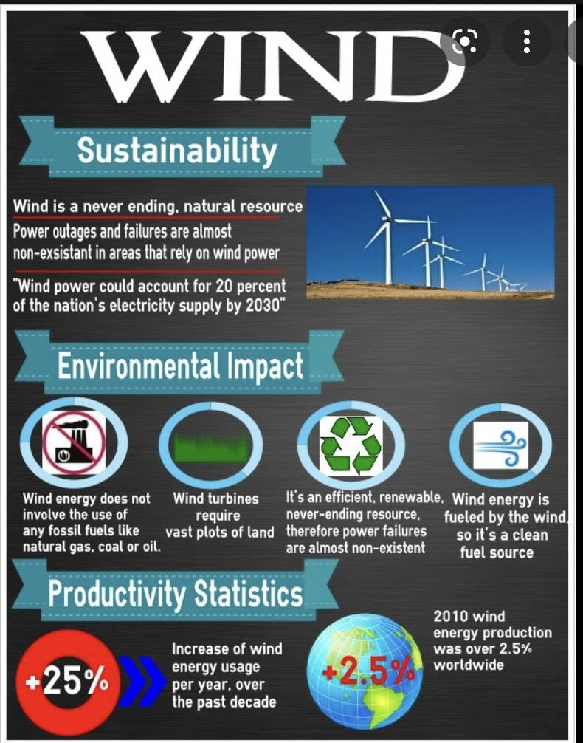

Slide 21
What is an Infographic?
Visual Representation of information in a graphic form
Designed to quickly communicate a message
Simplify presentation of a large amount of data and/or information

Slide 22
Memes
GIFs
and
More ways to represent information visually...

Slide 23
What is a meme?
Definition is hard to nail down…. (easy to see, hard to define)
……that is then usually spread through online social platforms.
…often associated with an image or video that communicates a specific idea, concept or message…

Slide 24
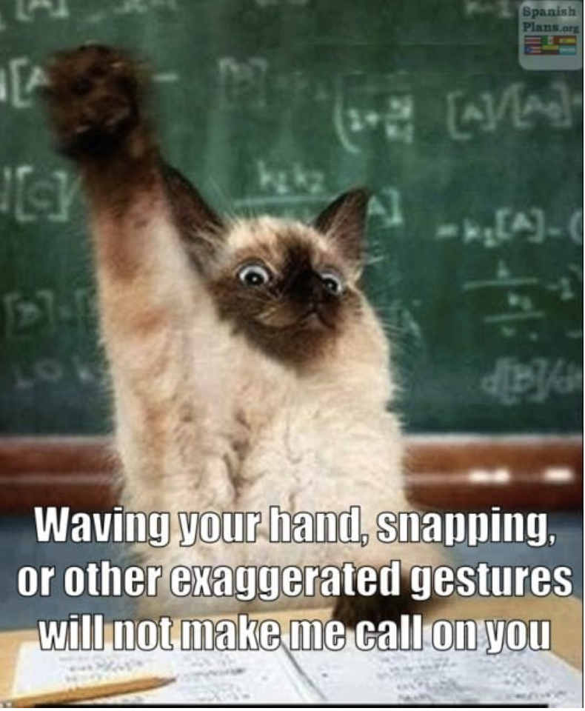
Memes for the classroom: Teacher creates memes to for classroom rules

Slide 25
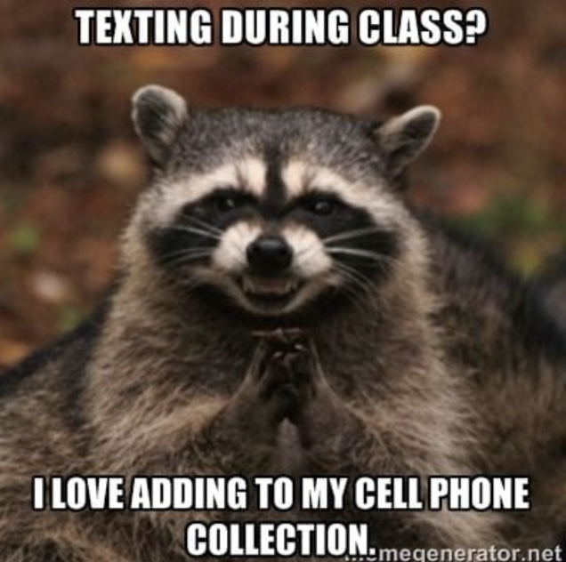
Memes for the classroom: Teacher creates memes for classroom rules

Slide 26
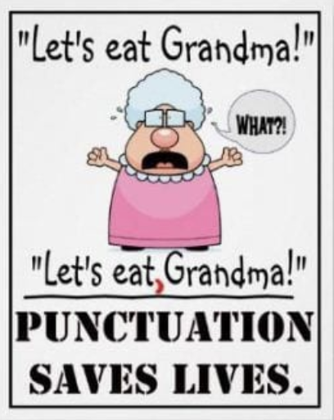
Memes for the classroom: Teacher creates memes to review rules grammar

Slide 27
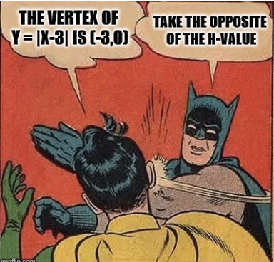
Memes for the classroom: students create memes to review rules (math)

Slide 28
What you’ll make for this Core Technology Skill:
1. One infographic….AND
2. One Meme or GIF (that you create)
For the Infographic, follow the rubric….
What is an infographic?
What are two pros and cons?
How can you use infographic in the classroom?

Slide 29
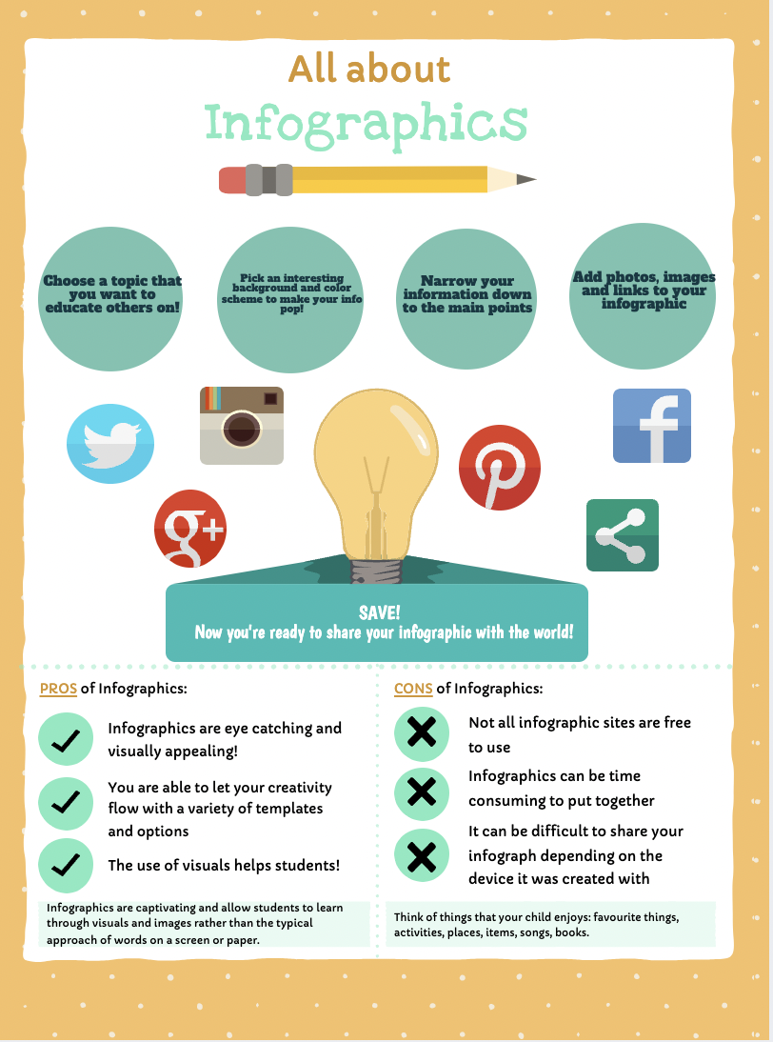
What you’ll make for this Core Technology Skill:
For the Infographic, follow the rubric…. Option #1

Slide 30
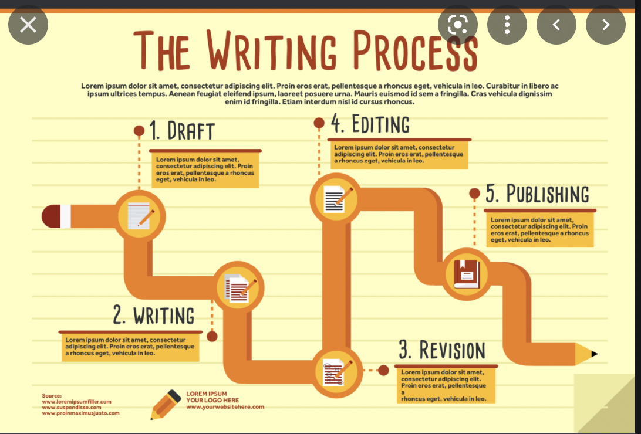
What you’ll make for this Core Technology Skill:
For the Infographic, follow the rubric…. Option #2
+ Short description of pros and cons in your website

Slide 31
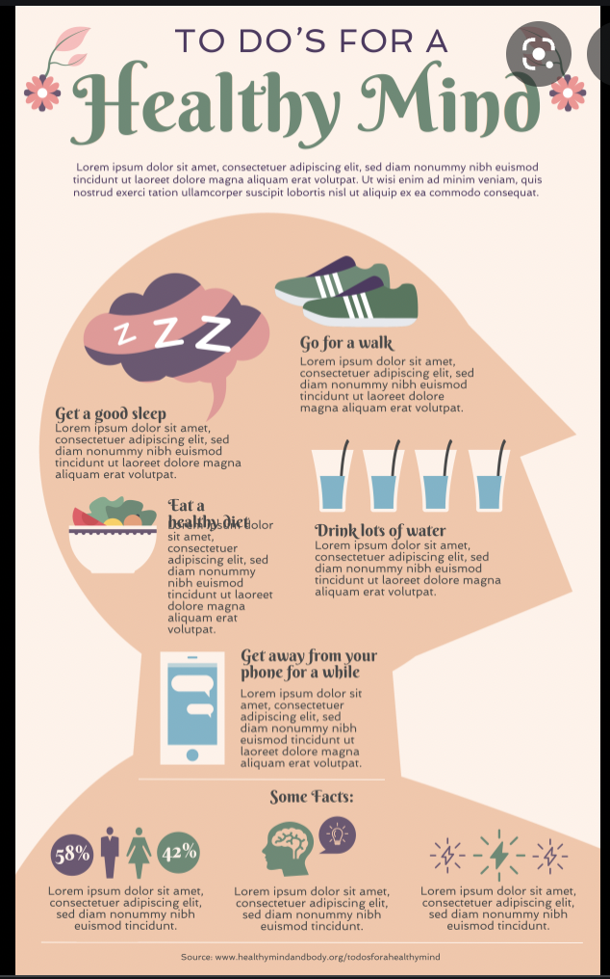
What you’ll make for this Core Technology Skill:
For the Infographic, follow the rubric…. Option #2
+ Short description of pros and cons in your website

Slide 32
What you’ll make for this Core Technology Skill:
1. One infographic….AND
2. One Meme or GIF (that you create, not share)
For the Meme or GIF, you do NOT need to follow the rubric. Rather, create a Meme or GIF that could be used for your future classroom.
Make sure your Meme and GIF are linked to your website.

Slide 33
How do I make an Infographic and meme?
Canva (templates!)
Infogram
Piktochart
Venngage
There are also templates for infographics in presentation apps like PowerPoint and Prezi
Search for “meme generator”

Slide 34
Questions?

