Slide 1
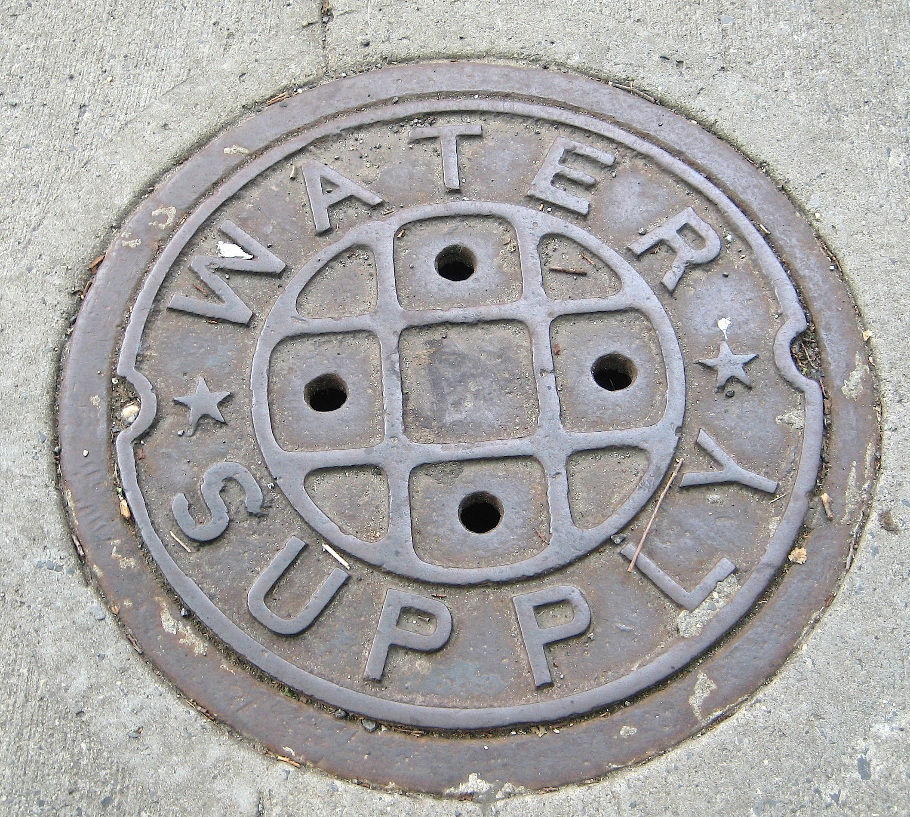
Why is a manhole cover round?

Slide 2
Information Processing Theory
EDU 330: Educational Psychology
Daniel Moos, PhD

Slide 3
“Phraseology” example
Tall in the the saddle
Guiding Question: What does this activity suggest about the role of prior knowledge and experience in learning?

Slide 4
“Numbers” example
3
1
8
6
0
5
4
7
0
1
2
7
2
0
2
6
Guiding Question: What does this activity suggest about the importance of organization in learning? What does this activity suggest about the maximum number of items we can learn at one time? Implications for teachers?

Slide 5
“Months” example
As quickly as you can…
…state the months of the year
…state the months of the year, alphabetically
Guiding Question: What does this activity suggest about relationship between the original context of learning and the ability to retrieve knowledge? Implications for teachers?

Slide 6
“Riding a bike” example
On a scale of 1 (very poorly) to 5 (very easily), how well can you ride a bike?
Turn to your neighbor and discuss how you would teach someone who does not know how to ride a bike
On a scale of 1 (very hard) to 5 (very easy), describe the difficulty level you just experienced in describing how you might teach someone to ride a bike
Guiding Question: What does this activity suggest about: (1) the impact of expertise on retrieving related knowledge?; and (2) the challenges “experts” might face in teaching novices? Implications for teaching?

Slide 7
“Color” example
As quickly as you can, quietly say the COLOR and not the pronunciation of the following words (from left to right):
Example: Yellow Blue
RED BLACK BLUE BLACK YELLOW
BLACK RED YELLOW BLUE BLACK
RED BLACK BLUE BLACK YELLOW
RED YELLOW BLUE BLACK RED
Guiding Question: What does this activity suggest about the role of “attention” and “perception” in learning? Implications for teachers?

Slide 8
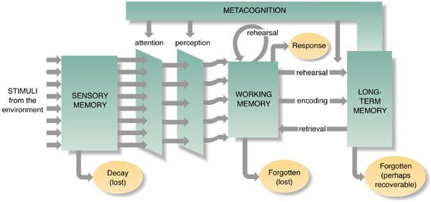
Information Processing Theory (IPT)

Slide 9
What are effective teaching strategies based on the assumptions of Information Processing Theory?

Slide 10
Applying IPT to the classroom
Begin a lesson with an attention getter (”Hook” or “Anticipatory Set”) to create emotional resonance
History: The "Unfair" Tax (American Revolution)
The Hook: Start the class by announcing a "Desk Tax." Every student must give you one piece of their favorite stationery from their desk (a cool pen, a sticker) to pay for the "privilege" of sitting in a chair today. Do not allow them to vote on this.
The Resonance: Students will feel a genuine flash of frustration and powerlessness.
The Transition: "That feeling of anger you have right now? That is exactly how the Colonists felt in 1765. Let's look at the Stamp Act."

Slide 11
Applying IPT to the classroom
Begin a lesson with an attention getter (”Hook” or “Anticipatory Set”) to create emotional resonance
English/ Language Art: The Ethical Dilemma (Character Analysis)
The Hook: Before reading The Giver or a similar dystopian novel, present a scenario: "You can live in a world with no war, no hunger, and no pain, but you can never see the color red or choose your own job. Do you take the deal?"
The Resonance: This forces students to weigh their personal values against a "perfect" society.
The Transition: "Our protagonist, Jonas, is about to face this exact choice. Let’s see what happens when the 'perfect' world starts to crack."

Slide 12
Applying IPT to the classroom
Begin a lesson with an attention getter (”Hook” or “Anticipatory Set”) to create emotional resonance
Health/PE: The "Sugar Shock" (Nutrition & Labeling)
The Hook: Place a 20oz bottle of soda and a large bag of granulated sugar on a table. Ask a volunteer to pour the amount of sugar they think is in the bottle into a clear plastic cup. Then, reveal the actual amount (approx. 16 teaspoons).
The Resonance: Seeing a mountain of white powder next to a drink they consume regularly creates an immediate "yuck" factor and a sense of betrayal by marketing.
The Transition: "Companies use 'Serving Sizes' to hide the truth. Today, we’re learning how to decode labels so you actually know what you're putting in your body.

Slide 13
Applying IPT to the classroom
Begin a lesson with an attention getter (”Hook” or “Anticipatory Set”) to create cognitive dissonance
Biology: The "Alive" Test (Characteristics of Life)
The Hook: Place a candle, a robotic toy, and a dormant seed on the desk. Ask: "Which of these is alive?"
The Dissonance: The candle "breathes" oxygen and changes size; the robot moves; the seed does nothing.
The Transition: "If the things that look alive aren't, and the thing that looks dead is, how do scientists actually define life?"

Slide 14
Applying IPT to the classroom
Begin a lesson with an attention getter (”Hook” or “Anticipatory Set”) to create cognitive dissonance
Mathematics: The Birthday Paradox (Probability)
The Hook: Tell your class (approximately 25 students): "I bet there are at least two people in this room who share the exact same birthday (month and day)." Ask for a show of hands for who thinks you're wrong.
The Dissonance: Most students assume the odds are tiny (since there are 365 days in a year). As you call out birthdays and find a match, the room usually erupts in disbelief.
The Transition: "In a room of just 23 people, there is a 50-50 chance of a match. Our brains are terrible at estimating exponential growth. Today, we’re going to calculate the 'impossible'."

Slide 15
Applying IPT to the classroom
Begin a lesson with an attention getter (”Hook” or “Anticipatory Set”)
Why is the manhole cover round?
What Blob are you?
Tell us something good!
What other examples of a hook or anticipatory set have you experienced in a class?
Think of a hook or anticipatory set that would work in your future classroom.

Slide 16
Applying IPT to the classroom
Account for skills needed for each class
Working Memory (conscious part of processing information) can process limited amount of information (7 +/- 2 chunks of information)
Operating
Space
Storage
Space

Slide 17
Applying IPT to the classroom
Account for skills needed for each class
    What skills are required for learning today? Taking notes, summarizing, engaging in a discussion, etc.
    Do my students have expertise with these skills?
    Should I explicitly teach these skills?
    If so, how am I balancing the demands on “operating space” and “storage” space?

Slide 18
Applying IPT to the classroom
Ensure your lesson is meaningfully origanized
Organization:
  How can I organize today’s lesson so it makes conceptual sense to my students?
  How can I “chunk” material? (organize multiple pieces of information into more meaningful units)
Meaningful Learning:
  What interests your students? (hot vs cold cognition)
  How does today’s lesson relate to yesterday’s lesson?
  How can you connect the lesson to students’ lives?
  Maintenance rehearsal (we repeat information to ourselves several times without actively adding new meaning; rote memorization)
  Elaborative rehearsal (connecting new material in a meaningfully way to something already learned)
  Have I presented information in a variety of ways, including visual and auditory? (“dual-coding”)

Slide 19
Applying IPT to the classroom
Provide varied learning opportunities and contexts
The Encoding-Retrieval Link
Long-Term Memory (LTM) is viewed as a permanent repository with virtually unlimited capacity.
However, "knowing" information is useless if it cannot be accessed.
Successful retrieval is primarily a product of how effectively information was encoded & the context of how it was encoded—the process of transforming sensory input into a lasting mental representation.

Slide 20
Applying IPT to the classroom
Provide varied learning opportunities and contexts
Illustrative Example: Sequential vs. Conceptual Encoding
Task A (Standard): State the months of the year.
  Result: Effortless retrieval because the recall is consistent with how the information was originally encoded.
Task B (Alphabetical): State the months of the year alphabetically.
  Result: Significant difficulty. Even though the "data" exists in Long Term Memory, the original encoding did not include alphabetical markers. This proves that having information in your head is not the same as having "flexible" access to it.

Slide 21
Applying IPT to the classroom
Provide varied learning opportunities and contexts
The Necessity of Varied Encoding (Contextual Flexibility)
The Principle: Retrieval is often "context-dependent." If information is encoded in only one way, the brain creates a narrow "pathway" to data
The Solution: Providing varied opportunities for learning creates multiple retrieval cues (multiple "paths"). This allows students to recall and apply learned material in diverse, real-world contexts rather than just on a specific test.
EDU 330: In a single class we have whole class discussion, a variety of small group discussion, individual processing via a journal…..all on the same topic
Think of a class that effectively offered multiple opportunities & contexts to learn – how did this affect your retrieval?

